Slide 1
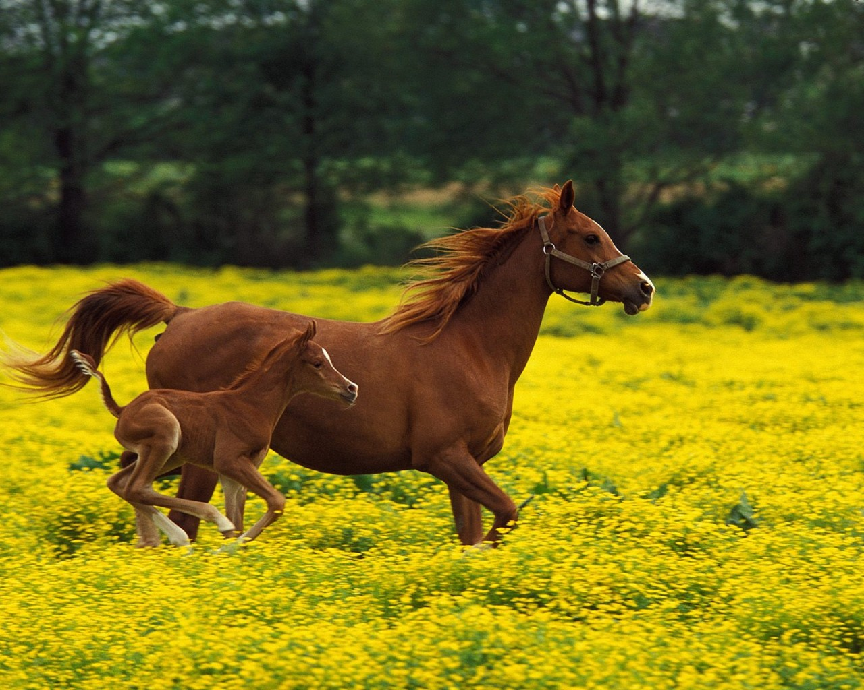
Animals in Britain

Slide 2
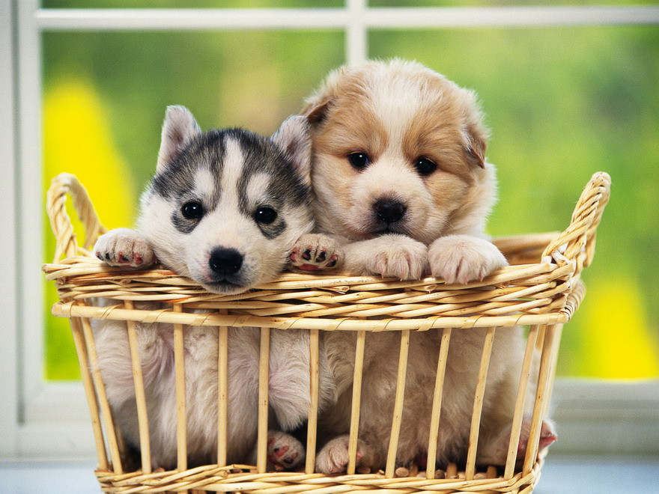
Popular Pets
Most people in Britain like animals. A lot of families have got a pet. Dogs, cats, hamsters, rabbits are all popular pets.

Slide 3
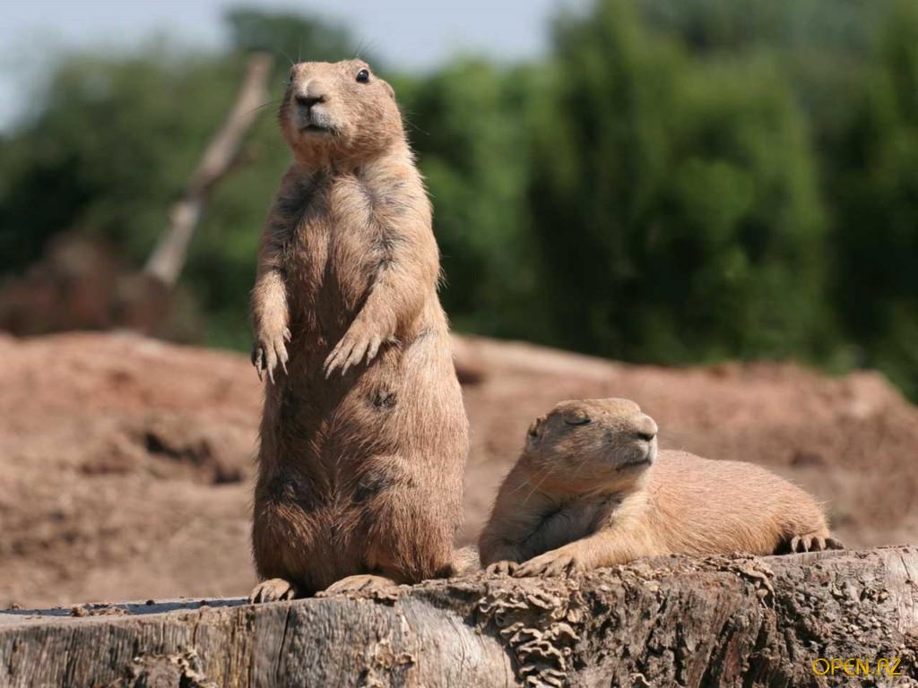
TV Programmes
A lot of TV programmes are about animals. There are programmes about wild animals all over the world.

Slide 4
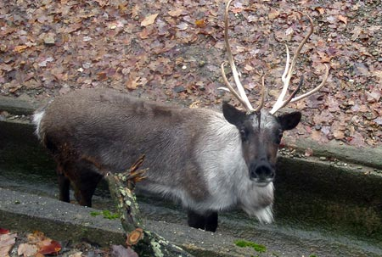
British Zoos
There are lots of zoos in Britain, but nowadays they don’t keep big animals in cages. They are usually in big pens, where they can run and jump

Slide 5
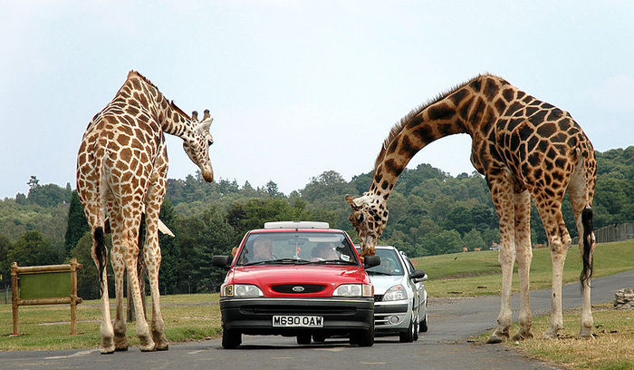
Safari Parks
You can also see animals in Safari parks. They live in fields and woods. People drive round the park in the cars to watch the animals.

Slide 6
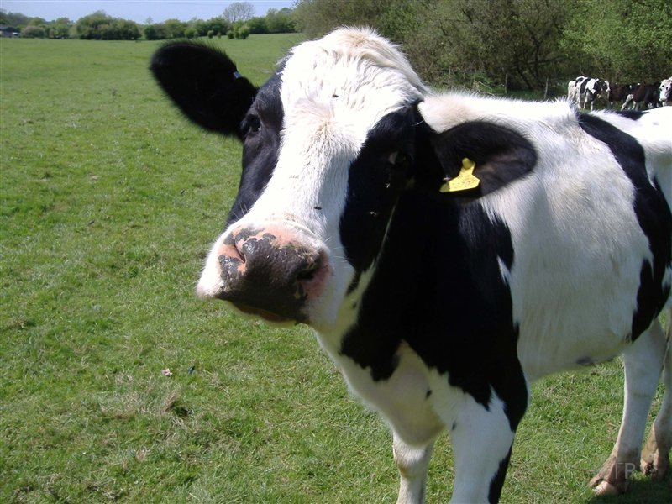
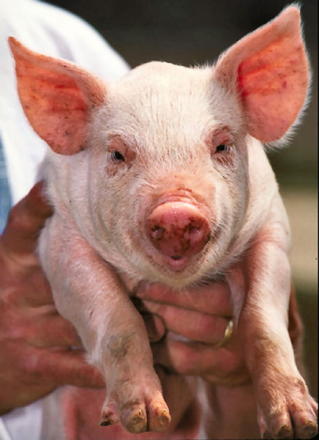
Farms in Britain
Most children in Britain live in towns and cities, so they don’t see animals every day. You can visit some farms and see animals like sheep, pigs and cows.

Slide 7
Answer the questions:
What are some popular pets in Britain?
What programmes can people see on TV?
Where do they keep animals in the zoos? Why?
Where do animals live in Safari parks?
How do people watch the animals in Safari Parks?
What animals live on farms?

