Slide 1
Symbols of London

Slide 2
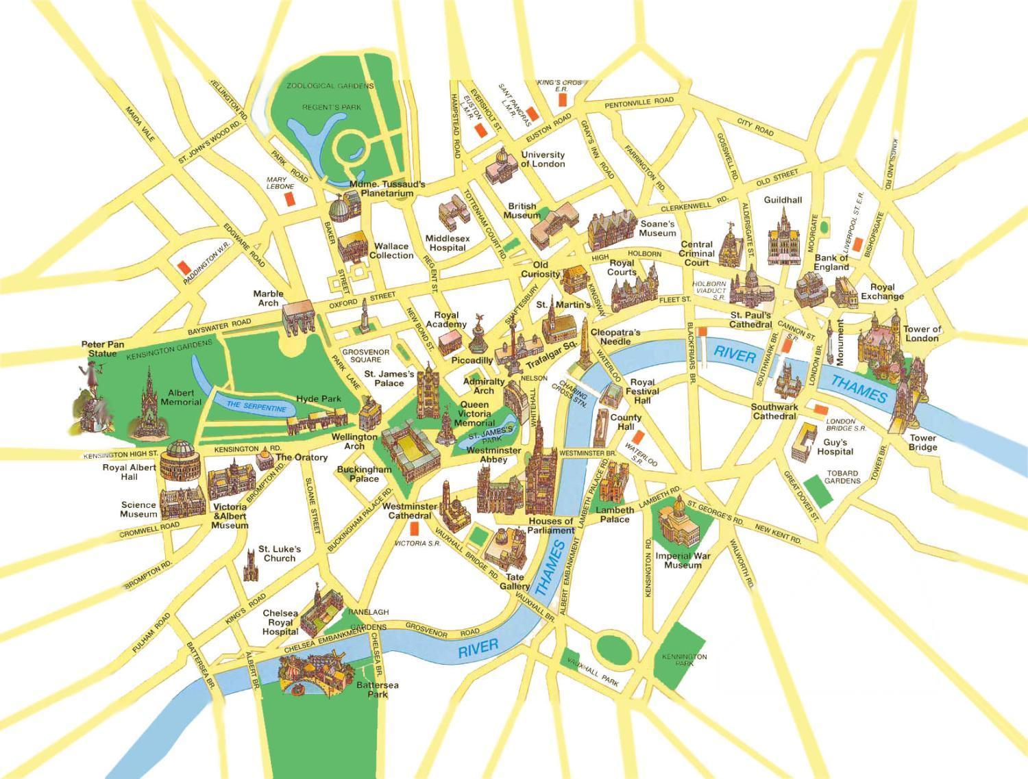
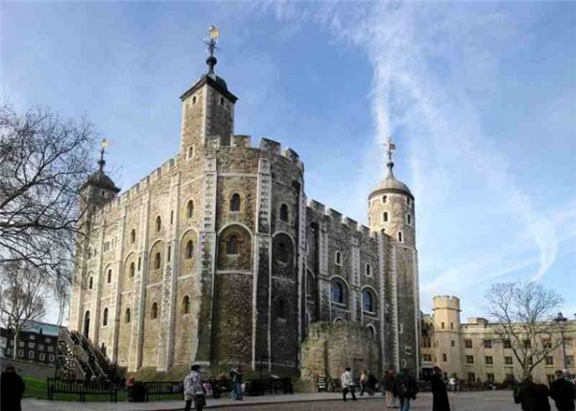
Tower of London

Slide 3
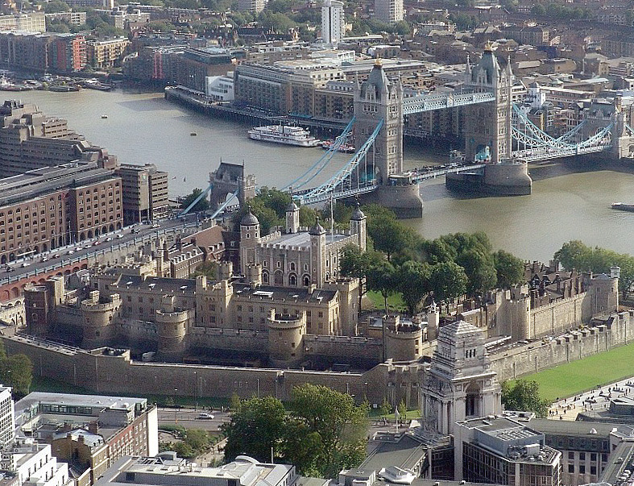
The Tower of London is the oldest place in London.
It is a very big castle. It was a castle, a palace, a zoo, a prison and a museum.

Slide 4
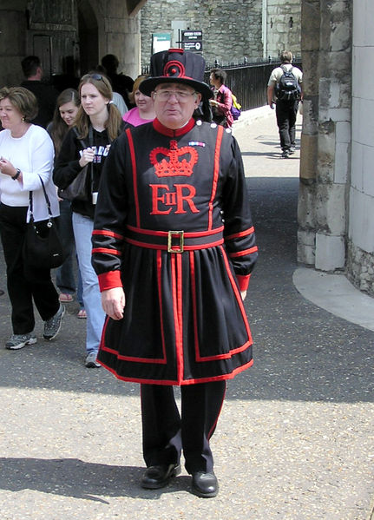
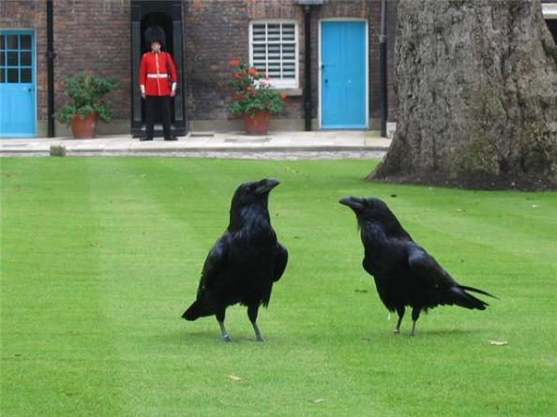
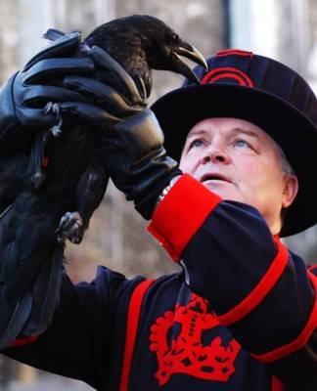
The Yeomen Warders of Her Majesty’s Royal Palace and Fortress the Tower of London (the Beefeaters), are ceremonial guardians of the Tower.
The name Beefeater originates from the Wardens’ payment that included beef.
The Ravenmaster feeds the ravens in the tower.
It is believed that if the ravens leave the Tower, the manarchy will fall.

Slide 5
The video
How many people take part in the ceremony?
What did you understand? Depict the ceremony in Russian.

Slide 6
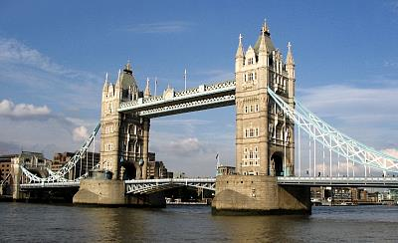
Tower Bridge

Slide 7
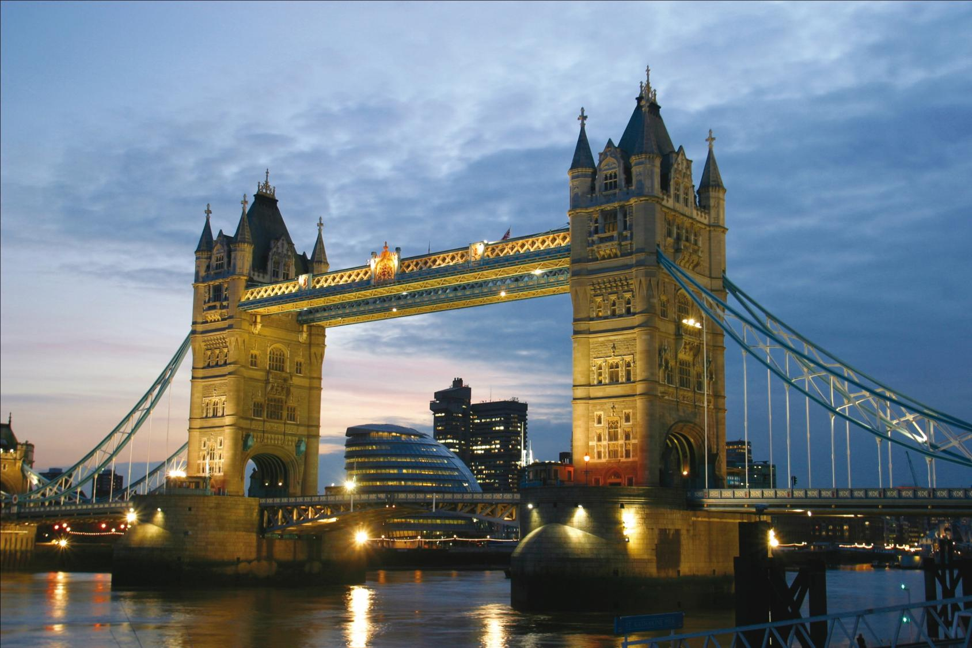
Tower Bridge crosses the Thames River.
It is one of the oldest bridges in London.
It is over a hundred years old.

Slide 8
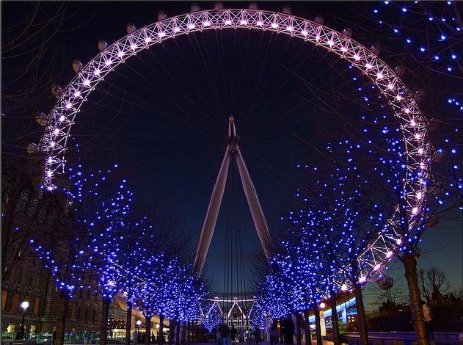
London Eye

Slide 9
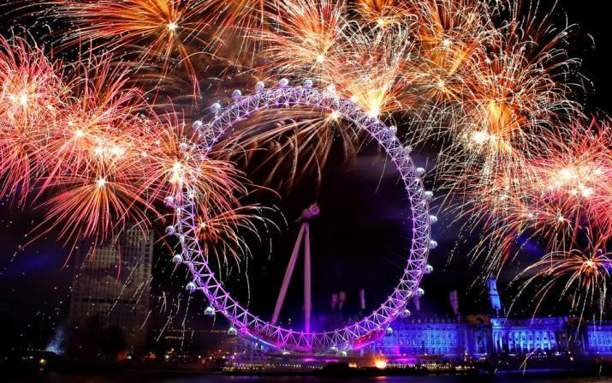
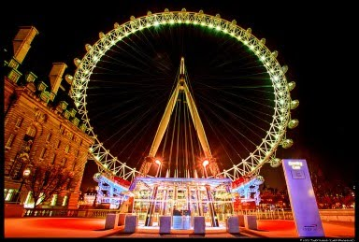
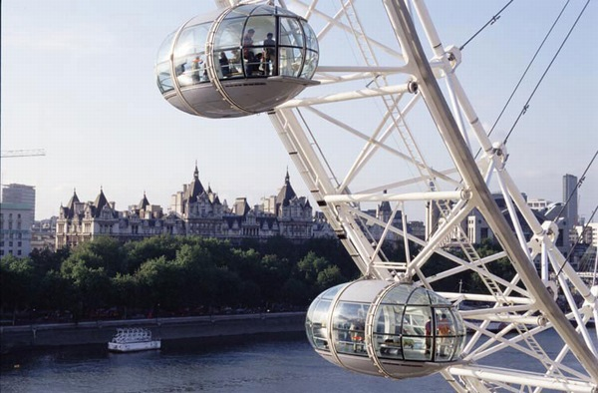
Do you want to ride in such a Ferris wheel?
Why have the passenger cars got such an unusual form?

Slide 10
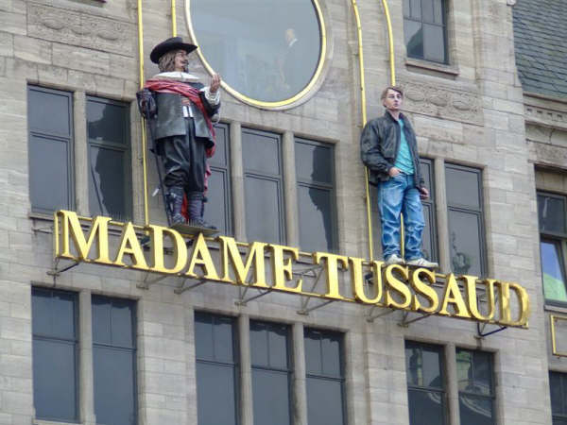
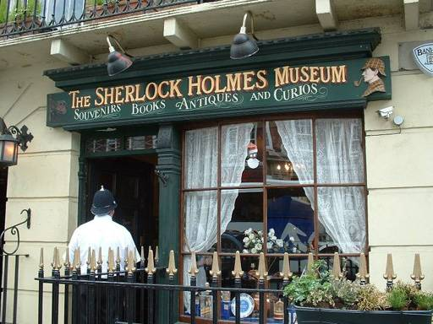

Slide 11
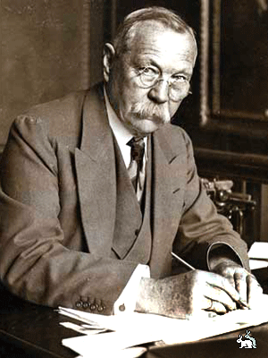
The video
Do you know the author of these books?
Sir Arthur Ignatius Conan Doyle

