Slide 1
Презентация английскому языку

Slide 2
Every country has it a plant and national flower is national. He partly reflects a culture and narrates about history of the state, by submitting his outward things.Concept "national flower" very more ancient: it was engendered before, than in most countries confirmed state flags. Then a national flower played a yet greater role, being character, distinguishing a sign for certain people. But also now flowers not fully lost the roles in the international arena and are often "logotype" the countries. Here a few "national flower".

Slide 3
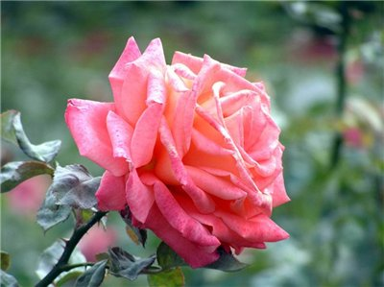
England
In christian symbolism a red rose was character of muchenichestva, and white - by character of innocence. There is an order of knights of Rose and Cross, and war of Yorkov and Lankasterov 1455-1485 was adopted war of the Scarlet and White rose
rose

Slide 4
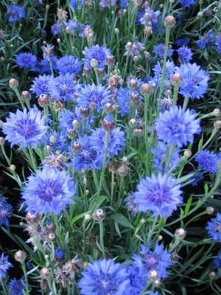
Germany
One hundred years back a corn-flower accompanied the magnificent banquets of Germans necessarily. This flower was the favourite flower of emperor William I and his mother, queen Louisa. There is a lot of histories that a corn-flower was happy omen for the royal Prussian house
corn-flower

Slide 5
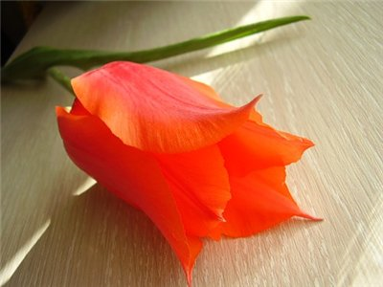
Golandiya
A tulip appeared here only in 1634, and the first time breeding carried him quite commercial character. Noticing an infatuation for this flower of Germans and other people, prudent Dutchmen began to conduct him in as possible greater amount of new varieties, and trading in his bulbs appeared so profitable, that began to be engaged in it soon even and people, having very much little attitude toward gardening, began to be engaged in it hardly not all of population.
The Dutch princess of Julian at one time complimented with Ottawa (Canada) the one hundred thousand bulbs of this flower as a token of gratitude for that in the Second World war-time royal family of Netherlands found refuge in the capital of Canada. And also as a token of confession of merits of this country on business of liberation of its motherland.
tulip

Slide 6
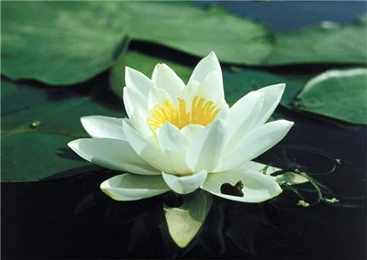
Egypt
Ancient Egyptians, noticing that this flower emerged on water and blossomed out at setting of sun, and closed and submerged in it at rising, supposed that this phenomenon had some mysterious connection with motion of heavenly bodies. This mysterious connection between the flowers of lotus and luminaries impelled Egyptians to devote him god of a sun Ozirisu. Hereupon Oziris was represented with the flower of lotus on a head. Oneself was adorned a lotus head and priests of these gods. Exactly also and tsars are Egyptian as a token of the divine origin put these flowers on a head, and equal an emblem of their power is tsar's sceptre - represented as a flower of lotus with a stem. Finally, he was represented, both in a bud or blossoming out, and on a state coin.
lotus

Slide 7
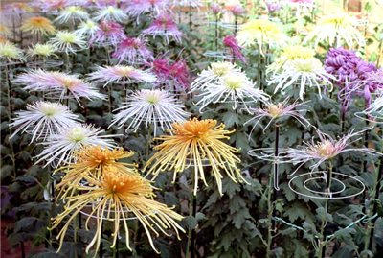
Japan
Image of it sacredly, and the members of emperor's house use only. Other, in the case of breach of this law, are punished a death penalty. Punished a death penalty and every attempt to represent this emblem of the Japanese empire and character of emperor's power, and that is why to the image its Japanese government comes running sometimes even and for preventing of imitation of governmental money signs. Explains reason of such high honouring of this flower Japaneses the best of all self his name: «kiku» (a sun). They have him character of this luminary, giving life to all on earth.
chrysanthemum

Slide 8
Russia
For touching beauty a birch uses the special love in Will you ask any Russian man, is there in Russia a tree which poets would devote so much verses, and people -“ songs? Russia.
birch

Slide 9
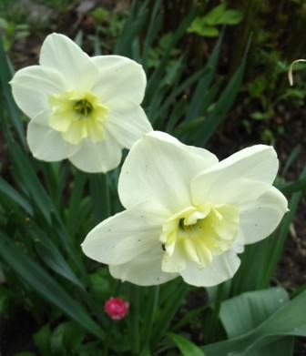
China
An old poor woman lived in China two together with the son. They stood a need and deprivations. Once a mother scraped together the handful of rice, to cook a son dinner. Suddenly a traveler pattered in a house and asked a meal. A kind woman gave him the last rice and began to the cry - now it has nothing it was to feed a son. This traveler was aquatic god. He decided to thank a woman and dashed in a pond, located not far away. And the next morning a tender flower grew at a pond. Since a narcissus in China is character of gratitude.
narcissus

Slide 10
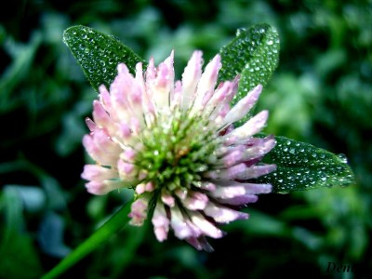
Ireland
From the historical point of view a shamrock is bound to the irish missionary by Sainted Patrick, which, as legend says of, by a shamrock explained to the irishes a christian dogma about Trinity, unity "iooa, son and saint of spirit": "Oae both three sheets can raise from one stem and God can be single in three sheet ". A church hymn reached to our days, about that, how Sainted Patrick, taking advantage of shamrock, cut passing short in of that time irlanskoy the capital - Container heathen ritual.
shamrock

