Slide 1
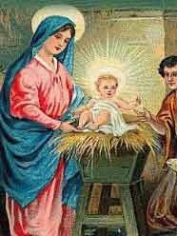
МОУ СОШ № 15
Christmas
Кошевая Н .О.

Slide 3
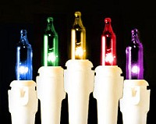
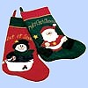
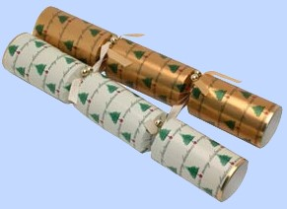
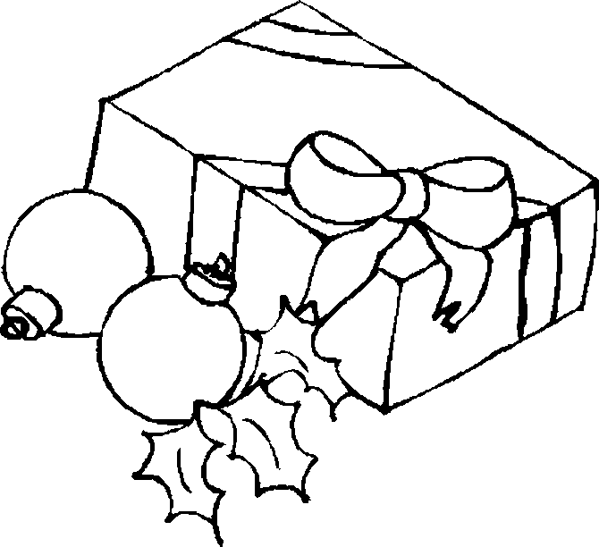
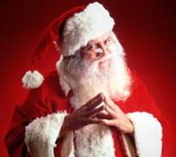
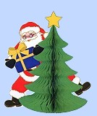
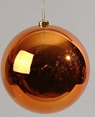
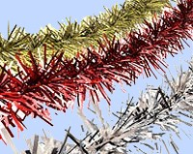
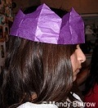
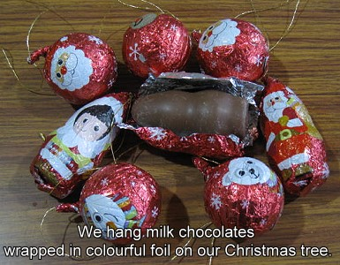

Slide 4
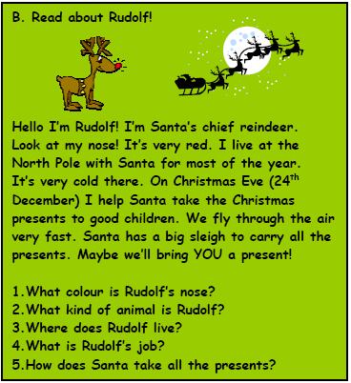

Slide 5
Christmas tree
Christmas tree is a part and parcel of the holiday. It is believed that it brings good luck.
Let’s decorate
Christmas Tree

Slide 6
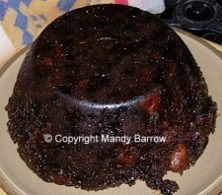
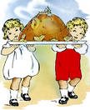

Slide 7
Рождественский Леденец (Candycane)
Родители угощали детей на Рождество леденцовыми палочками форме трости (или пастушьего посоха).
Леденец напоминает букву J, с которой начинается имя Jesus

Slide 8
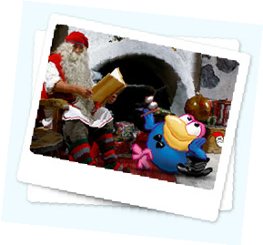
And what about Russia?
In Russia Christmas isn’t too much popular, for example, like in the USA. In our country the main holiday is New Year. We celebrate it on the 31st of December. Children wait for Ded Moroz and Snegurochka, who bring presents
for them.

Slide 9
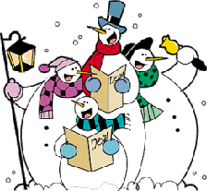
Celebration
For people all over the world Christmas is a season of giving and receiving presents. People go from house to house to sing Christmas carols.

Slide 10
Let’s sing a song!
Dashing through the snow
In a one-horse open sleigh
Over the fields we go
Laughing all the way.
Jingle bells
Jingle bells, jingle bells!
Jingle all the way
Oh! What fun it is to ride
In a one-horse open sleigh!
Bells on bob-tail ring
Making spirits bright,
What fun it is to ride and sing
A sleighing song tonight!

Slide 11
Pronouns
Mine
Yours
His
Hers
Ours
Theirs
The book is mine
My
Your
His
Her
Our
Their
This is my book

Slide 12
Заполни пропуски словами mine,yours,his,hers,ours,theirs
These are our crackers.
This is Mary’s present.
This is my parents’ room.
These are your books.
This is Paul's car.
They are …
It is ...
It is …
They are …
It is …
It is…

Slide 13
Do you like presents?
What presents would you like to have ?
I would like to have...

Slide 14
