Slide 1
Урок английского языка в 5 б классе
Тема: Мои планы на будущее
Учитель: Фролова Т.В.

Slide 2
To be
I am Ann,
You are Dan,
He is Peter,
She is Rita.

Slide 3
I am not Ann,
You are not Dan,
He is not Peter,
She is not Rita.

Slide 4
Am I Ann?
Are you Dan?
Is he Peter?
Is she Rita?

Slide 5
+ | - | ?
I am going to He is going to She is going to We are going to You are going to They are going to | I am not going to He isn’t going to She isn’t going to We aren’t going to You aren’t going to They aren’t going to | Am I going to…? Is he going to…? Is she going to…? Are we going to…? Are you going to…? Are they going to…?

Slide 6
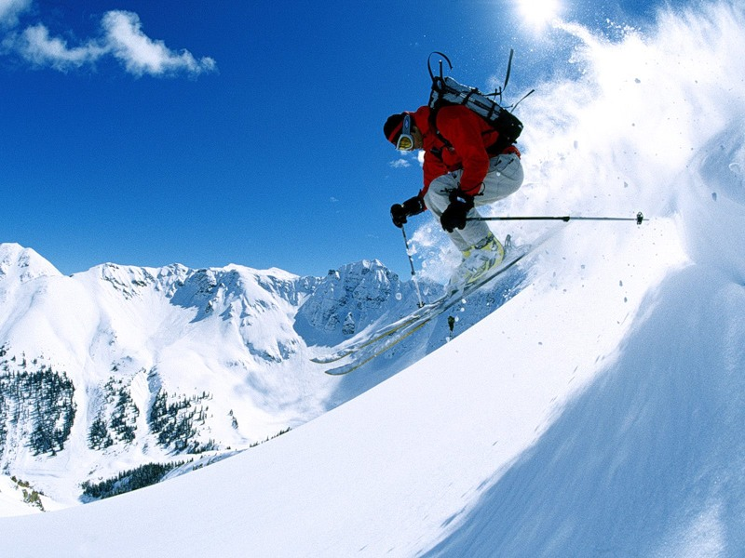

Slide 7
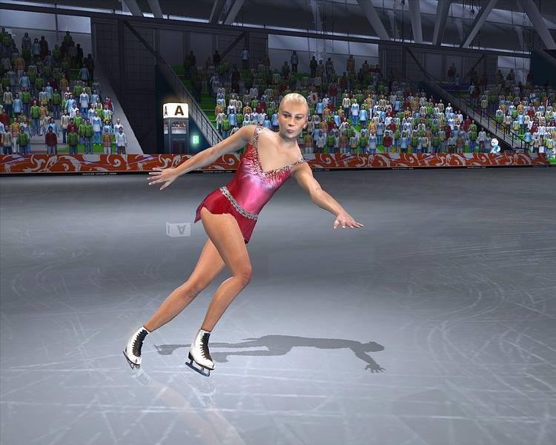

Slide 8
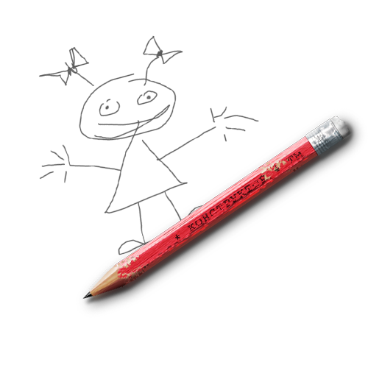

Slide 9
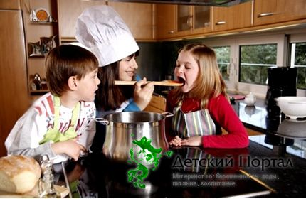

Slide 10
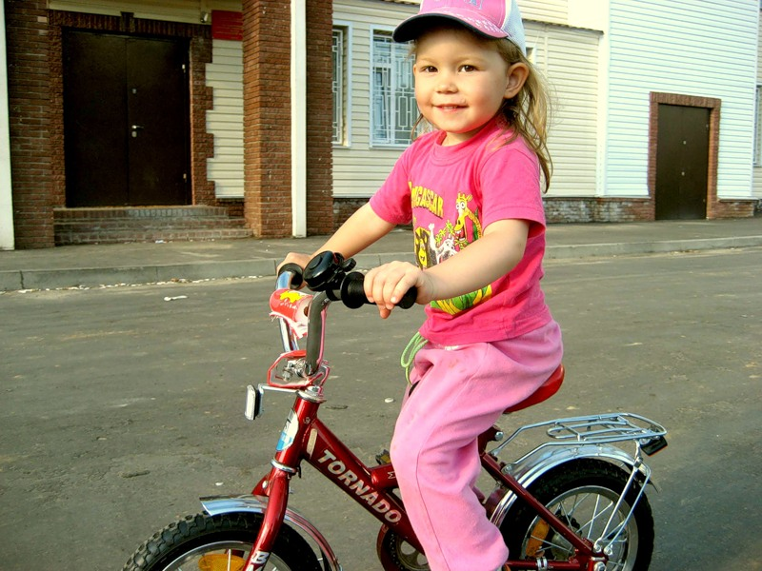

Slide 11
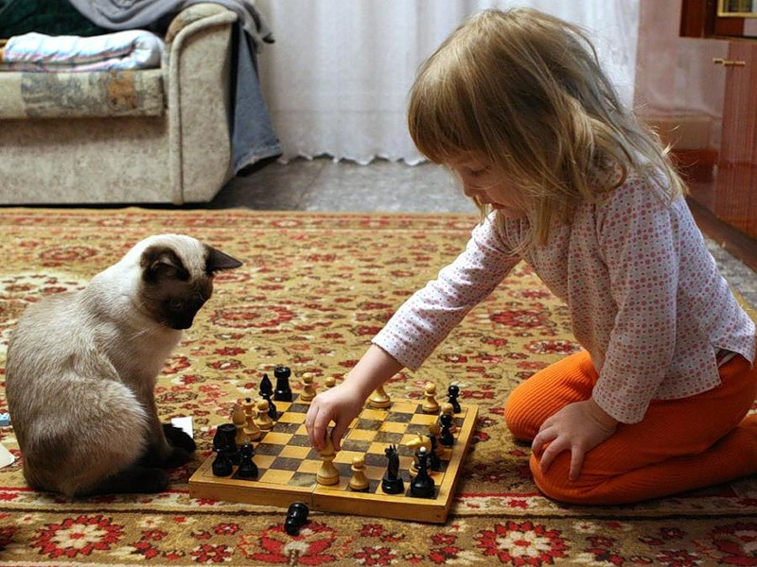

Slide 12
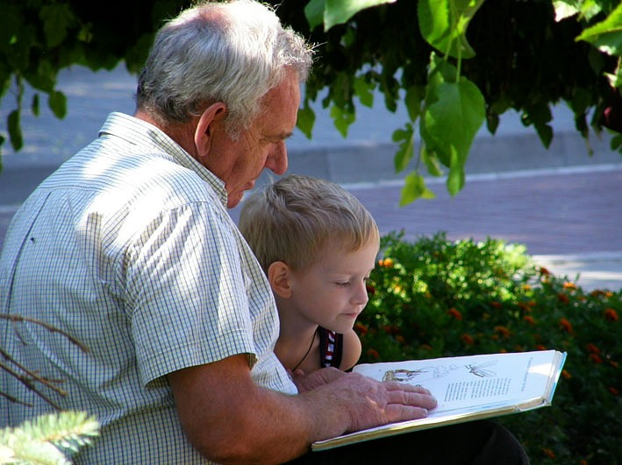

Slide 13
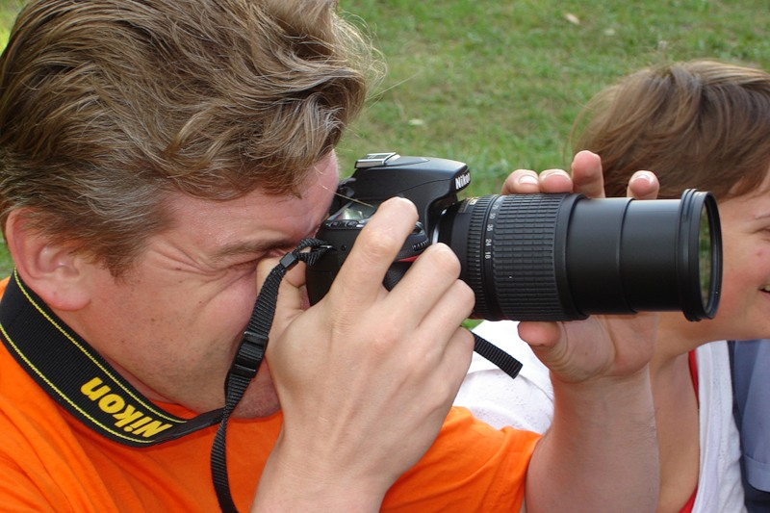

Slide 14
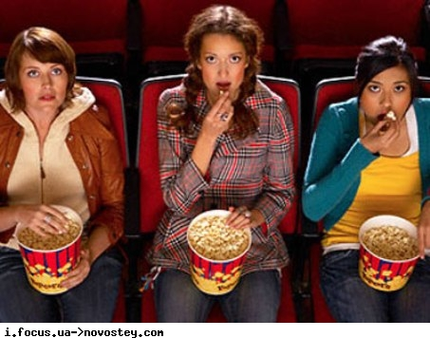

Slide 15
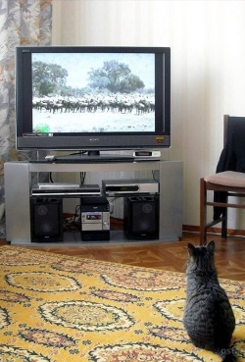

Slide 16
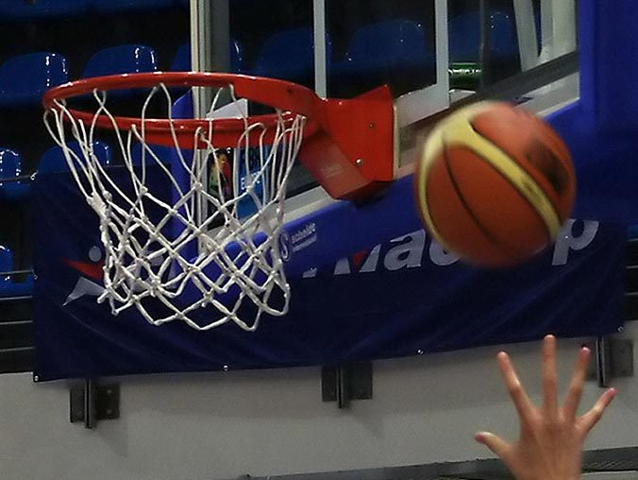

Slide 17
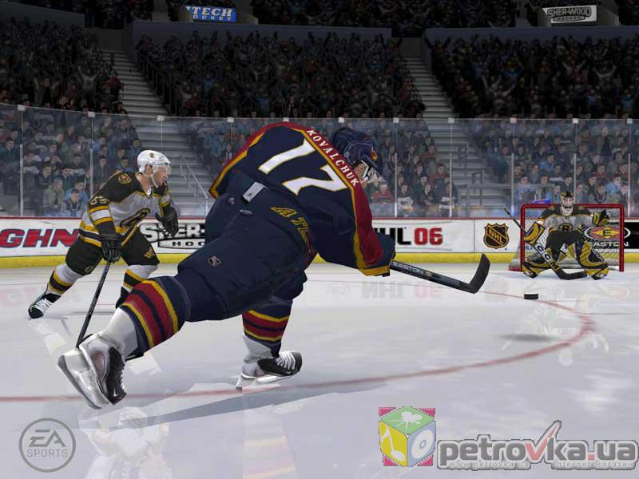

Slide 18
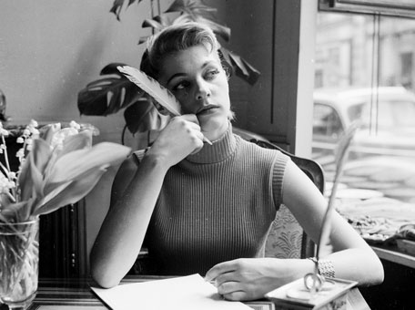

Slide 20
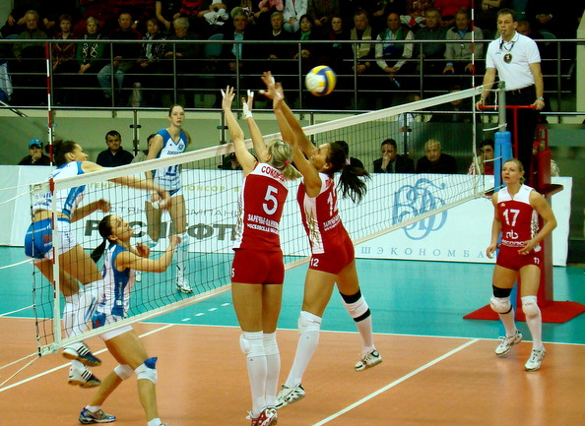

Slide 23
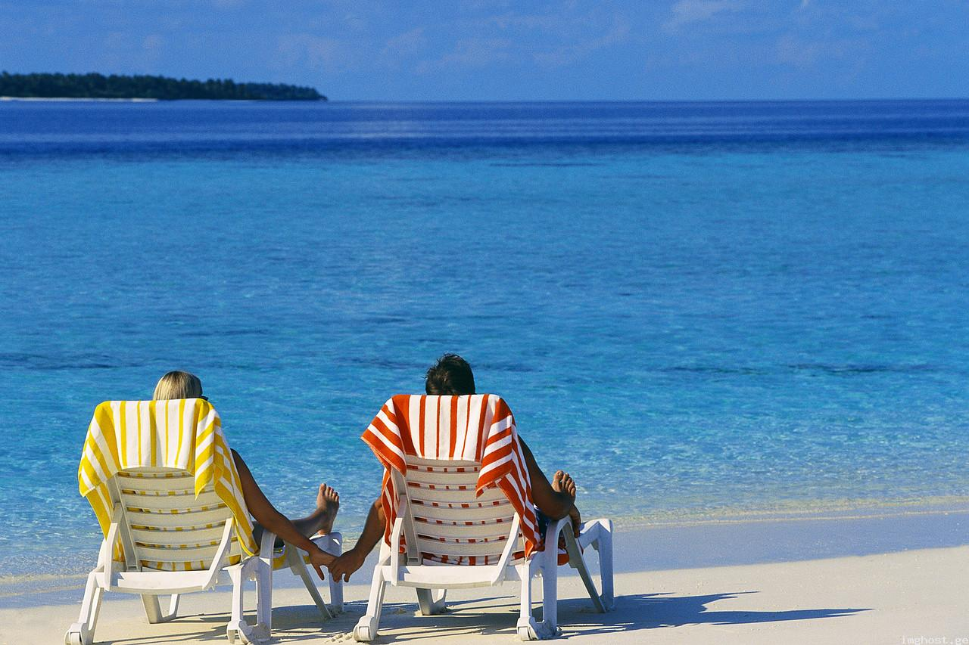

Slide 24
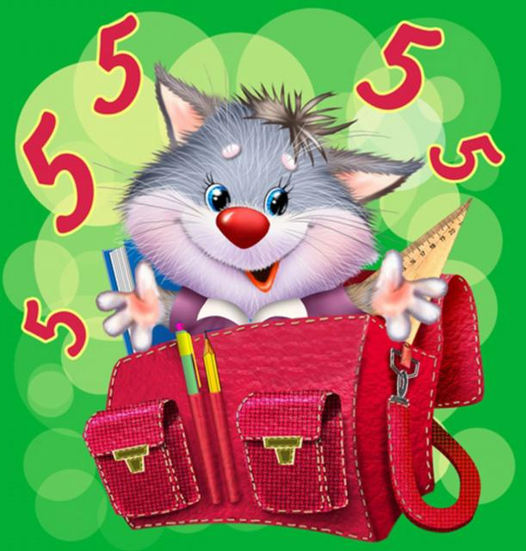

Slide 25
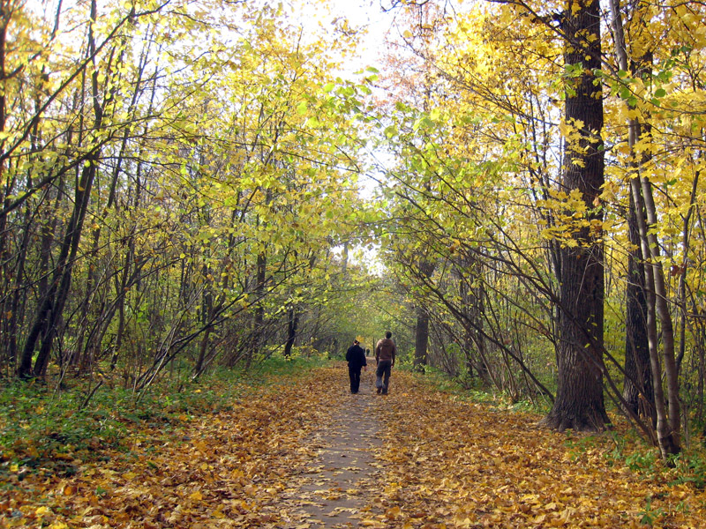

Slide 26
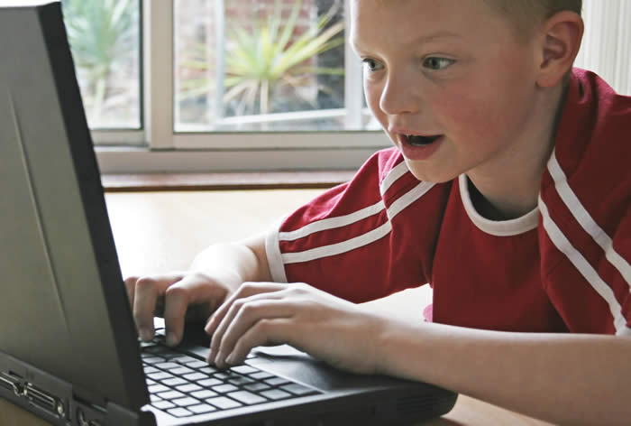

Slide 27
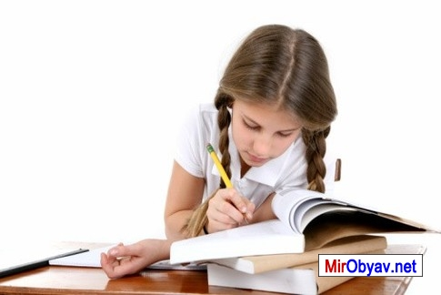

Slide 28
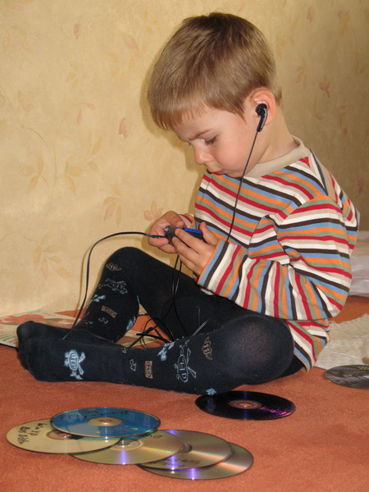

Slide 29
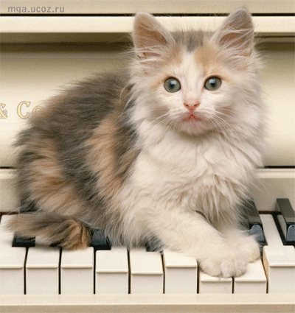

Slide 30
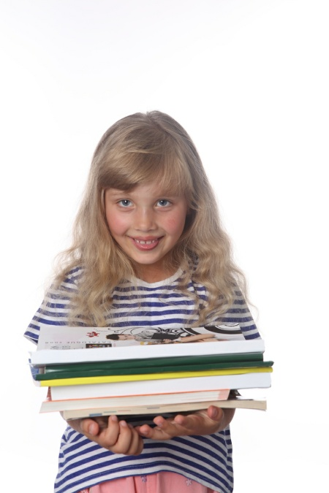
What is Linda going to do?
To arrange her birthday party
To clean her flat
To visit her dentist
To arrange flowers in her room
To visit her sick friend
To have her hair cut

Slide 31
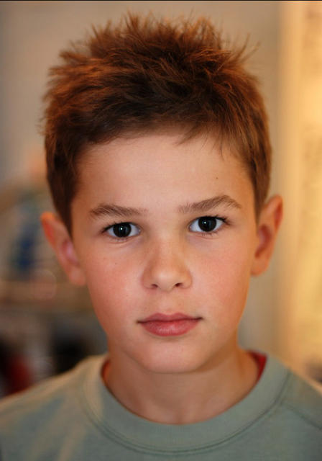
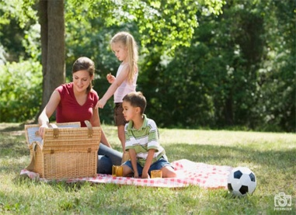
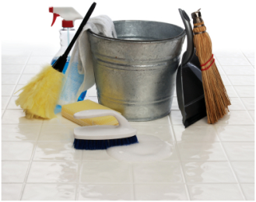
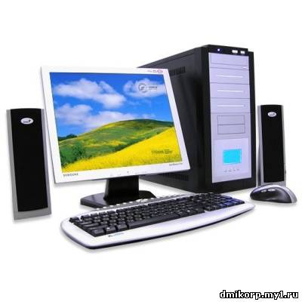
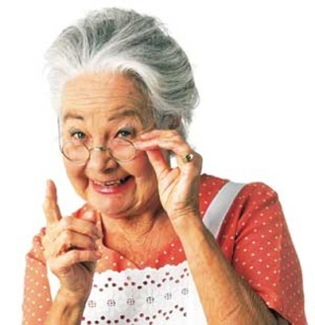
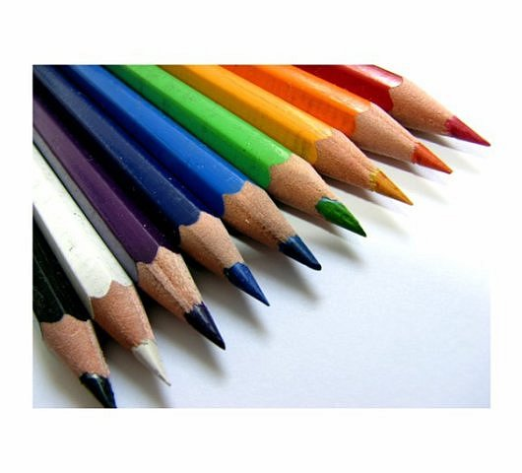
What is Tom going to do?

Slide 32
What are going to do on…? I’m going to…
Monday Study English | Friday Visit grandmother
Tuesday ? | Saturday ?
Wednesday Read books | Sunday Play computer games
Thursday ?

Slide 33
What are going to do on…? I’m going to…
Monday Study English | Friday ?
Tuesday Do homework | Saturday Arrange a party
Wednesday ? | Sunday ?
Thursday Clean the room | 1 2 3 4 4 5 6 7 8 9 10 11 12 13 14 15 16 17 18 19 20 21 22 23 24 25 26 27 28

Slide 34
What are you going to do?
What are you going to do?
What are you going to do?
I’m going to read a book.
That’s what I am going to do.
What is she going to do?
What is she going to do?
She is going to write a letter.
That’s what she is going to do.

Slide 35
Dear friends,
My name is Paul. I am 11 years old. I live in London.
Today it’s Thursday and I need to plan my weekend.
Every weekend we go to the country to visit my grandmother, but this week we are not going to. So Mum and dad want to know what I am planning for the coming weekend. Here is what I am going to do.
On Friday after school I’m going to play football with my friends. In the evening I’m going to help Mom clean the flat.
On Saturday I’m going to my friend’s birthday party. I won’t stay there long. After that I’m going to see a good film on TV or play computer games in the evening.
On Sunday I’m going to do my homework in the morning. I have to learn a poem by heart. After lunch I’m going to the cinema with my friends.
And what about you? What are your plans for the weekend?
What are you going to do?
Please, write me letter!
Best wishes,
Paul.

