Slide 1
Автор: учитель английского языка
Фень Надежда Георгиевна
МОУ «Лицей №1 пос . Львовский»
Подольский муниципальный район
2012 год

Slide 2
Информация о проекте
Английский язык
Под редакцией Кауфман К.,
Кауфман M. «Нарру English.ru»
Тема урока «Косвенная речь»

Slide 3
Цели и задачи
Цель:
познакомить с правилами преобразования прямой речи в косвенную
Задачи:
закрепить новый материал упражнениями на заданную тему

Slide 4
Косвенная речь и согласование времен

Slide 5
Общие вопросы в косвенной речи
"Do you know the boy?" I asked him. – «Ты знаешь мальчика? » – спросил я его.
I asked him if he knew the boy. – Я спросил его, знает ли он мальчика.
He asked, "Have you met my wife?" – Он спросил: «Ты знаком с моей женой? »
He asked if (whether) I had met his wife. – Он спросил, знаком ли я с его женой.
He asked me, "Will you be here tomorrow?" - Он спросил меня: «Вы будете здесь завтра?»
He asked me whether (if) I should (или would) be there the next day. - Он спросил меня, буду ли я там на следующий день.

Slide 6
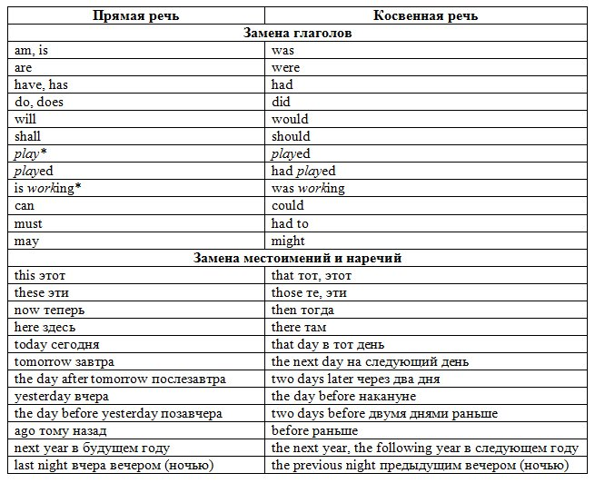
Преобразования в косвенной речи

Slide 7
Специальные вопросы в косвенной речи
“Who has read this book?”asked the teacher.
The teacher asked who had read the book.
‘’Whom was it written by?’’ he said.
He asked whom it had been written by.
‘’What novel shall we read next year?’’ said the pupil.
The pupil asked what novel they would read the following year.

Slide 8
Практическая работа
Найдите одно предложение с косвенной речью, в котором нет ошибок. Исправьте ошибки в остальных предложениях.
1. Mike told the policeman that he lost his identity card.
2. Jane said to Dick that Julia doesn’t live next to her.
3. She told the detective that she sees the thief in the house.
4. He said that he ate nothing since morning.
5. My girlfriend told me that she felt very bad, and she had a headache.
6. Tom’s boss said to him that he hasn’t done the work properly.
7. Anna said that she doesn’t want to wear her old dress.
8. Her brother told her that they will have plenty of time to do their work.

Slide 9
Утверждения в косвенной речи
“I have no time for lunch today”,said the boy.
The boy said that he had no time for lunch that day.
“You speak English very well”,said the teacher to me.
The teacher told me that I spoke English very well.
The pupil said to the teacher ,”I can do my homework tomorrow’’
The pupil told the teacher that he could do his homework
the next day.
Boris said,’’I go to the south every year’’
Boris said that he went to the south every year.

Slide 10
Практическая работа
Turn from Direct into Reported speech.
1. “I’ve ordered a pizza for dinner”, she said.
2. “We must write a letter to our lawyer”, she said.
3. “I will come tomorrow and fix the tap”, the plumber said to them.
4. “This is the best holiday I’ve ever had”, she said to her friend.
5. “Why did you say that to me?” she asked him.
6. “Don’t speak to your father like that”, she said to them.
7. “Could you show me where the manager’s office is?” she asked the secretary.
8. “Take your books with you”, she said to her son.

Slide 11
Thank you!

