Slide 1
Tastes Differ
History and Tendencies of Youth Fashion in Brief
Куртасова Т.П. МОУ «СОШ р.п.Духовницкое»

Slide 2
The history of business costume
The origin of school uniform
The best inventions of American clothing
School uniform in the USA
Trainers are the choice of teens
Hoodies as a part of youth image
Clothes of different subcultures

Slide 3
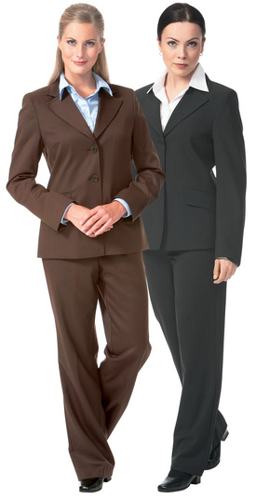
The History of Business Costume
In 1870th the clothes of men’s fashion from Great Britain came to women’s wardrobes. It was a practical and firm costume. It became a favorite kind of clothes among business women. We’ve followed this style since that time. In general , it’s a combination of a jacket and trousers, a jacket and a skirt or a waistcoat and trousers or a skirt.

Slide 4
These clothes are comfortable. They show discipline, strictness and freedom at the same time.
Business clothes mustn’t be boring. Colours are of great importance. Light and delicate colours are all right. You may use striped, smooth and relief fabric for your costume. A white blouse or a shirt will always fit your business costume for a special event or a visit.

Slide 5
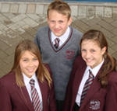
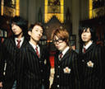
The Origin of School Uniform
School uniforms originated in England and were essentially common only to that country. They were at first used to identify boys as members of a privileged elite.
The advantages of school uniforms, both how they are worn and when they should be used have been a topic of hot discussion for many years.

Slide 6
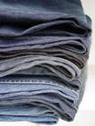
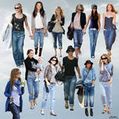
The Best Inventions of America’s Clothing
America has created its own type of clothing, which is now popular all over the world. Blue jeans were a product of the Gold Rush. Levi Strauss who emigrated from Germany to San Francisco in 1850 decided to sell clothes to the miners of California. He began making trousers of strong cotton later called “denim”. Strauss dyed denim blue. The company he started is known all over the world.
Hollywood westerns made jeans popular.

Slide 7
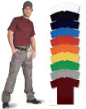
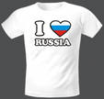
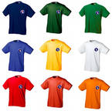
The next invention is a T-shirt. During the First World War European soldiers wore them as underwear to keep warm. Americans copied the idea and called them “T-shirts” because of their T- shape.
In the mid 50s actor James Dean and rock star Elvis Presley shocked the world by wearing T- shirts on TV. Everyone wanted to look like James and Elvis…
Today T-shirts are worn by babies, kids, teenagers and adults.

Slide 8
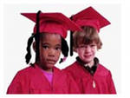
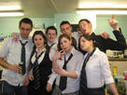
School Uniform in the USA
Uniforms have not traditionally been worn in the United States.
However, many Americans are beginning to see the school uniform as one way of addressing certain problems in their educational system, especially the lack of discipline and the increase of violence.
School uniforms are often worn in private schools of the USA and Canada

Slide 9
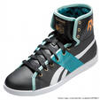
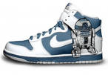
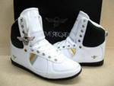
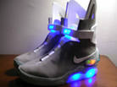
Trainers are the Choice of Teens
Teenagers prefer sport style to feel comfortable in any place. Trainers are not like other shoes. Good trainers stay with the natural shape of your feet. Teenagers want to wear trainers everywhere. Now, with new technologies trainers have become lighter and more comfortable.

Slide 10
Hoodies as a part of youth image
The hoodie attracted negative publicity through its association with youth crime and anti –social behavior.
Teenagers say they look smart and are welcomed by parents as well as students. The only thing is students are not allowed to keep their hoods up in class.

Slide 11
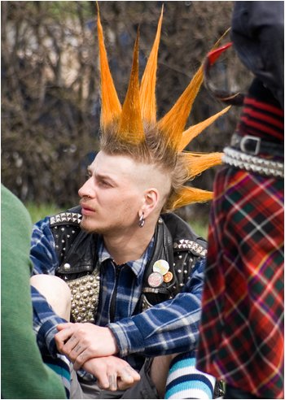
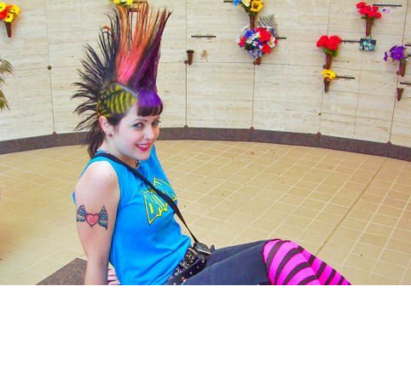
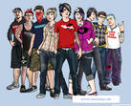
Clothes of Different Subcultures
Young people who dress in a shocking way want to express their individuality. They wear bright clothes and a lot of chains. Plenty of make up and an unusual haircut characterize their punk style.
There are a lot of other subcultures which members wear different kinds of clothes distinct from mainstream fashion. They reject everything including fashionable tendencies.

Slide 12
Answer the questions
What country did the business costume and the school uniform originate in?
For what reasons was a uniform introduced in the UK?
Why is the school uniform becoming popular in the USA?
What are the best inventions of America’s clothing? Are they still cool?
What can teenagers do to look different from others?

Slide 13
Источники информации
М.З.Биболетова, Е.Е.Бабушис, Н.Д.Снежко Английский с удовольствием .Учебник для 10 класса общеобразовательных учреждений. Изд. Титул 2010
В.П.Кузовлев, Н.М.Лапа. Английский язык. Учебник для 10-11 классов общеобразовательных учреждений Изд.Просвещение 2007
http://www.englishteachers.ru
http://www.hello-online.ru

