Slide 1
ЗИНОВЬЕВ А. М.
ПРЕПОДАВАТЕЛЬ ИНОСТРАННОГО ЯЗЫКА
МБОУ «СЮКЕЕВСКАЯ СОШ»

Slide 2
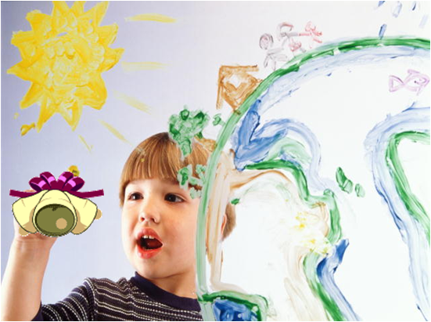
OUR MOTTO
Whenever the weather is cold.
Whenever the weather is hot.
We'll weather the weather,
whatever the weather,
whether we like it or not.

Slide 3
DAYS OF THE WEEK
Monday is the first day of the week.
Tuesday is the second day of the week.
Wednesday is the third day of the week.
Thursday is the fourth day of the week.
Friday is the fifth day of the week.
Saturday is the sixth day of the week.
Sunday is the seventh day of the week.

Slide 5
GOALS:
Learning new words (subjects names);
Reading (schools in England and Wales);
Writing (do some exercises);
Speaking in English

Slide 6
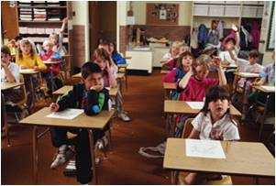
OUR TIMETABLE
School starts at _____ _________.
We go to school ____ days a week.
We have 5-6 _________ a day.
We have main __________ : Russian, Literature, Mathematics, History, Biology and English.
We also _____ Music, Art, Information Technology, Physical Education and Technology.
We don’t have lessons on ________ .
8:30 o’clock
six
lessons
subjects
have
Sunday

Slide 7
SCHOOL TIMETABLE
MONDAY | TUESDAY | WEDNESDAY | THURSDAY | FRIDAY | SATURDAY
English | Literature | Russian | French | English | Music
Mathematics | Information Technology | Mathematics | Mathematics | English | Biology
Religious education | Mathematics | Social Science | History | French | Literature
Social Science | Physical Education | Technology | English | Physical Education | Mathematics
History | Mathematics | Technology | Literature | Biology | Art
Art

Slide 8
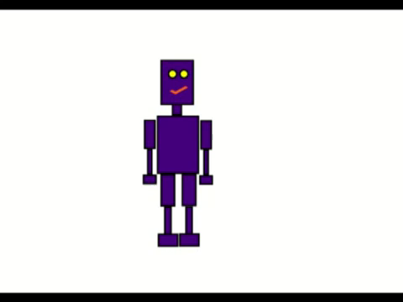
Let’s relax
Head on the left Head on the right
Head on the left Head on the right
Hands on the hips
Hand on the left
Hand on the right Hand on the left
Hand on the right
Hands up and down
Hands up and down
Hands on the hips
Slope on the left Slope on the right
And sit down.

Slide 9
Your TIMETABLE
MONDAY | TUESDAY | WEDNESDAY | THURSDAY | FRIDAY | SATURDAY

Slide 10
Answer the questions
1
What is the name of the second day of the week?
2
Friday it is the name of the _____ day of the week?
3
_____ you read a lot of books.
4
Translate in Russian : Physical Education, Information Technology.
5
Translate in English : искусство, физика, русский язык.

