Slide 1
Rules of reading
2

Slide 2
Ee
[i:]
[e]

Slide 3

green

Slide 4

bell

Slide 5
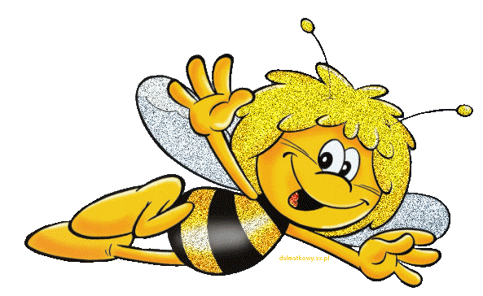
bee

Slide 6
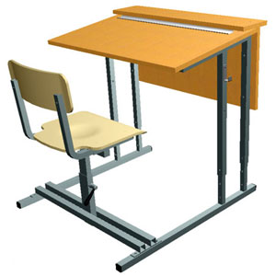
desk

Slide 7

tea

Slide 8
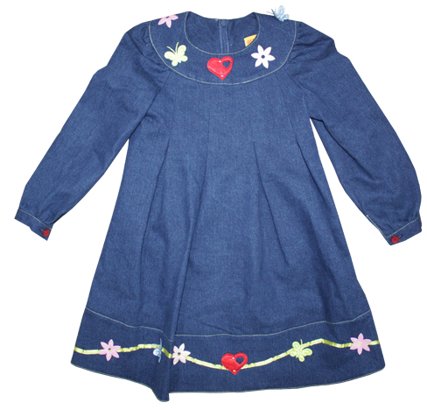
dress

Slide 9

sea
море

Slide 10
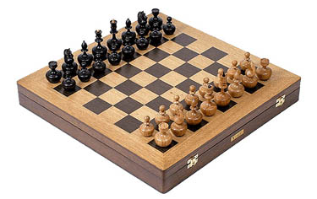
chess

Slide 11
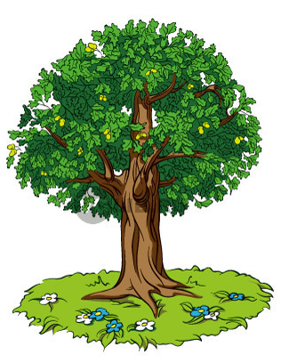
tree

Slide 12
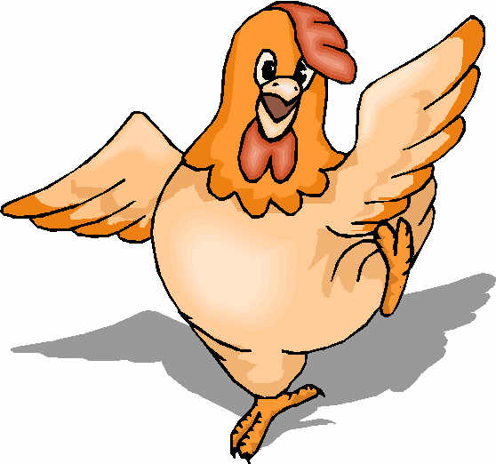
hen

Slide 13
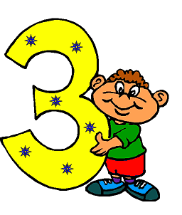
three

Slide 14
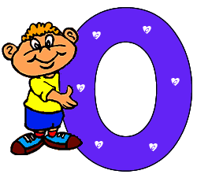

ten

Slide 15
green bell
bee desk
tea dress
sea ten
tree chess
three hen

Slide 16
green bell bee desk tea dress sea tree chess three ten hen

Slide 17
МОУ ДОД
Дворец детского(юношеского) творчества г. Белоярский объединение «КОНТАКТ»
2010г.

