Slide 1
William Shakespeare

Slide 2
Shakespeare
WILLIAM
W. Shakespeare is the greatest poet, a writer, a famous dramatist

Slide 3
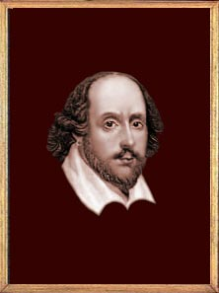
William Shakespeare
He was a great poet, but not the only one, a great dramatist, but not the only one, he was a learnt man but not the only one. And still he is the greatest of the great, because he was «for all time» , because he was very much of his own age.

Slide 4
The birth of Shakespeare
On April 23,1564 a son, William, was born to John and Mary Shakespeare in Stratford-upon-Avon , a small country town. Shakespeare was the eldest son of Mary Arden, the daughter of a local landowner , and her husband, John Shakespeare, a glover and wood dealer.
Place of Shakespeare’s birth

Slide 5
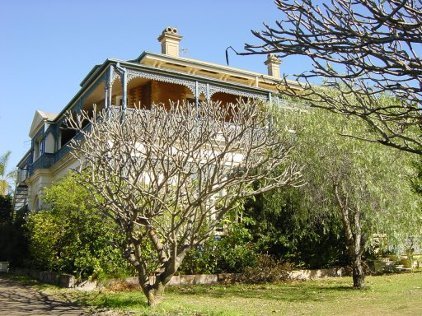
William Shakespeare
Early days on Henley Street
Since we know Stratford's famous Bard lived with his father, John Shakespeare, we can presume that he grew up in Henley Street, some one hundred miles northwest of London.

Slide 6
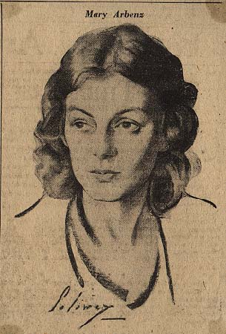
William’s mother: Mary Arden
William's mother was Mary Arden who married John Shakespeare in 1557.
The youngest daughter in her family, she inherited much of her father’s landowning and farming estate when he died

Slide 7
In his childhood he went to Grammar School, where he studied Latin besides reading and writing, Greek. The School began early in the morning and ended late in the evening. So he knew a lot! After finishing grammar school he worked a teacher there.

Slide 9
Anna Hathaway`s house ,a mile from Stratford, where she was born in 1556
At the age of 18 Shakespeare married a local girl , Anna Hathaway, who was eight years older. He had three children, Susanna, Hamlet and Judith.

Slide 10
When he was 21 he left for London, made friends with many actors there. Sometimes he worked as an actor. William began writing plays. Soon they built their own theatre and called it «Globe» the famous Globe theatre. There was a sign on its door. «All the world is a stage»

Slide 11
Globe Theatre

Slide 12
Shakespeare`s literary work may be divided into 4 periods. The most famous of the first period is « Richard III». During the second period Shakespeare wrote historical plays and comedies such as « Henry V» , « Julious Caesar».
All his comedies are written in easy flowing verse. The text is full of jokes and puns. All the comedies tell of love and harmony. One of the most popular comedy is « Merry Wives of Windsor».
During the third period Shakespeare wrote the great tragedies that were the peak of his achievement and made him truly immortal.
He brought something new to the tragedy. All his tragic characters are shown in their development. Hamlet, Othelloo, King Lear at the end of the tragedy are not the people they were at the beginning. The most popular tragedy is « Romeo and Juliet». It is a true masterpiece.
We can not speak about Shakespeare without speaking about his sonnets .
They are his only lyrical pieces, the only things he has written about himself.
By reading between the lines of the sonnets we may see a tragedy in Shakespeare`s life, a tragedy which he might not have fully understand himself.
He wrote 154 sonnets. They are very beautiful and very lyrical even in Russia.

Slide 13
My love is strengthen'd, though more weak in seeming;
I love not less, though less the show appear:
That love is merchandized whose rich esteeming
The owner's tongue doth publish every where.
Our love was new and then but in the spring
When I was wont to greet it with my lays,
As Philomel in summer's front doth sing
And stops her pipe in growth of riper days:
Not that the summer is less pleasant now
Than when her mournful hymns did hush the night,
But that wild music burthens every bough
And sweets grown common lose their dear delight.
Therefore like her I sometime hold my tongue,
Because I would not dull you with my song.
Шекспир. Сонет 102
Сильнее всех люблю,
Но не дарю любовь свою.
Я не желаю чувствами играть,
Мне ведь любовь не продавать!
Весной все было в первый раз,
Была любовь нова для нас;
Тебя всегда я песнею встречал,
И с тонкой грустью провожал,
Сейчас мне легче вспоминать
О том, что ту любовь заставило молчать.
Увы… достигли мы конца,
Не бьются в унисон сердца;
И песни приутихли все,
Любви нам не вернуть уже…
( Широбокова Анастасия 9 «Д» класс
2009-2010 учебный год )

Slide 17
Сонет 7
Розовеет рассвет долгожданный,
Поднимая голову с ложа,
Мир встречает его благодатный,
Благодарен за все тебе, Боже!
Смотря на мир с горы крутой,
Ты помнишь возраст золотой,
Когда красив и полон сил,
паломником ты в мир входил!
Ну а на склоне многих лет,
Твои глаза устали, не горят
И с мудростью, пришедшей вслед
В другую сторону они глядят.
Иди же на покой на склоне лет,
Твой сын исполнит твой обет!
( Лизунова Арина 9 «Г»
2009-2010 учебный год )
Lo! in the orient when the gracious light
Lifts up his burning head, each under eye
Doth homage to his new-appearing sight,
Serving with looks his sacred majesty;
And having climb'd the steep-up heavenly hill,
Resembling strong youth in his middle age,
Yet mortal looks adore his beauty still,
Attending on his golden pilgrimage;
But when from highmost pitch, with weary car,
Like feeble age, he reeleth from the day,
The eyes, 'fore duteous, now converted are
From his low tract and look another way:
So thou, thyself out-going in thy noon
Unlook'd on diest, unless thou get a son.

Slide 18
So is it not with me as with that Muse
Stirr'd by a painted beauty to his verse,
Who heaven itself for ornament doth use
And every fair with his fair doth rehearse
Making a couplement of proud compare,
With sun and moon, with earth and sea's rich gems,
With April's first-born flowers, and all things rare
That heaven's air in this huge rondure hems.
O' let me, true in love, but truly write,
And then believe me, my love is as fair
As any mother's child, though not so bright
As those gold candles fix'd in heaven's air:
Let them say more than like of hearsay well;
I will not praise that purpose not to sell.
Сонет Шекспира № 21
Я вовсе не из тех поэтов
Чью музу вдохновляет красота,
Они приукрашают все предметы
Возлюбленным даруя небеса.
Пытаясь сравнивать для гордых сочетаний
Моря и земли, солнце и луну,
Апрельские цветы, знакомых всем созданий
И все, что видят на яву.
Но я не собираюсь лгать!
Любовь моя на веки останется чиста,
Не стану я как все писать,
Ведь истина всегда проста!
Зачем мне прибегать к торжественным словам,
Ведь я не продавец и чувства не продам!
( Перевод Анастасии Захаровой
2009-2010 учебный год )

Slide 19
Сонет № 116
Никто не может помешать слиянию
Двух близких душ.
Любовь уж не любовь,
Коль поддается вражьему влиянию.
И если от разлуки остывает кровь,
Всей жизни цель, любовь, она повсюду с нами.
Ее не сломят бури никогда,
Она во тьме, над жалкими судами
Горит, как путеводная звезда.
Летят года, а с ними исчезает
И свежесть сил, и красота лица…
Одна любовь крушенья избегает,
Не изменяя людям никогда.
И если мой пример того не подтверждает,
То на земле никто любви не знает!
( Баранов Елисей 9 «Б» класс
2009-2010 учебный год )
Let me not to the marriage of true minds
Admit impediments. Love is not love
Which alters when it alteration finds,
Or bends with the remover to remove:
O no! it is an ever-fixed mark
That looks on tempests and is
never shaken;
It is the star to every wandering bark,
Whose worth's unknown, although his height be taken.
Love's not Time's fool, though rosy lips and cheeks
Within his bending sickle's compass come:
Love alters not with his brief hours and weeks,
But bears it out even to the edge of doom.
If this be error and upon me proved,
I never writ, nor no man ever loved.

Slide 20
Шекспир. Сонет 71
Ты погрусти, когда умрет поэт,
Покуда звон ближайшей из церквей
Не возвестит, что этот низкий свет
Я променял на низший мир червей.
И, если перечтешь ты мой сонет,
Ты о руке остывшей не жалей.
Я не хочу туманить нежный цвет
Очей любимых памятью своей.
Я не хочу, чтоб эхо этих строк
Меня напоминало вновь и вновь.
Пускай замрут в один и тот же срок
Мое дыханье и твоя любовь!..
Я не хочу, чтобы своей тоской
Ты предала себя молве людской.
Перевод С.Маршака
No longer mourn for me when I am dead
Then you shall hear the surly sullen bell
Give warning to the world that I am fled
From this vile world, with vilest worms to dwell:
Nay, if you read this line, remember not
The hand that writ it; for I love you so
That I in your sweet thoughts would be forgot
If thinking on me then should make you woe.
O, if, I say, you look upon this verse
When I perhaps compounded am with clay,
Do not so much as my poor name rehearse.
But let your love even with my life decay,
Lest the wise world should look into your moan
And mock you with me after I am gone.

Slide 21
William Shakespeare
This is the Holy Trinity Church where Shakespeare was buried.
Visitors coming to Stradford admire the beauty of the church and honour his memory.

Slide 22
It is interesting that he died on his birthday, 23 April, 1616.

Slide 23
Shakespeare`s grave

Slide 24
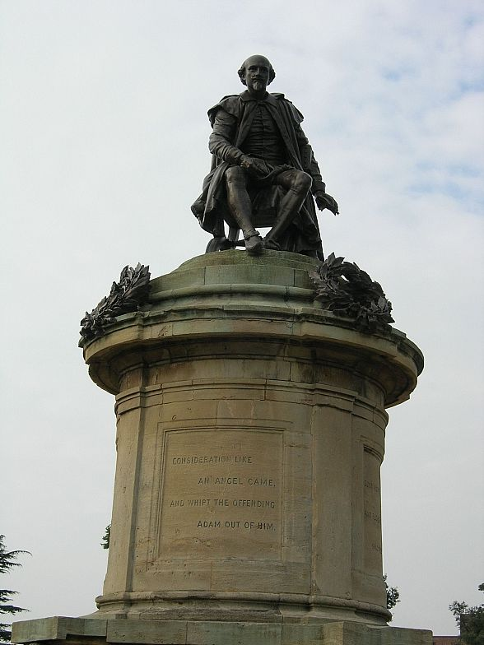
The bronze statue of Shakespeare, presented to Stratford by Lord Ronald Sutterland Gower in 1888. Shakespeare` figure is high above the ground and on the ground there are small figures of Shakespeare`s famous characters.

