Slide 1
APPROACHES

Slide 2
Discussion
Tell your partners about your speaking activity.

Slide 3

Accuracy
Facilitator
Aspect
Schemata (Activate)
Interaction pattern
Function
Eliciting
Shwa
Concept Checking Questions
Focus on form, mistakes and structure more than on meaning
A guiding, assisting, learner-centered role of a teacher
Continuous, Perfect
Background knowledge of SS. (What do we do with it?)
S-S, T-SS, SS-SS etc The ways in which students work together in class.
The reason or purpose for communication.
When a teacher asks careful questions to get students to give an answer, dragging it out of them.
T
Questions asked by the teacher to make sure that a student has understood the meaning of new language
REVISION

Slide 4
Systems lesson
Jigsaw reading
Skimming
Information gap
Feedback
Warm-up
Lead-in
Fluency
Lessons focusing on form: Grammar, Vocabulary and Phonetics
A text divided into two or more parts. SS have to listen/read their part, then share their information with other students in order to complete the task.
Looking through the text to get the gist.
An activity in which SS work in pairs or groups. they are given different info and to complete the task, they have to find out the missing parts from each other.
To tell students how well they are doing.
An activity that used at the beginning of a lesson to give the class more energy.
The activity to prepare students to work on a main task. An introduction to the topic.
The use of connected speech at a natural speed without hesitation, repetition or self-correction. More attention is given to the communication of meaning.

Slide 5
Terms
Group | Terms
TEACHING APPROACHES | TBL (Task-based Learning) TPR (Total Physical Response) TTT (Test Teach Test) Guided Discovery PPP (Presentation Practice Production)
SKILLS DEVELOPMENT | Oral Fluency Process Writing Listening for gist Intensive reading Skimming and Scanning
TASKS AND ACTIVITIES | Information gap Role play Brainstorming Jigsaw reading Find someone who
LESSON PLAN COMPONENTS | Aims Time Anticipated problems Interaction patterns Procedure
LESSON PLAN STAGES | Warmer Lead-in Controlled practice Free practice Feedback

Slide 6
Which word is missing?
Eliciting
What is it?
Technique
Approach
Method
Method
Procedure
Procedure
Approach
Technique

Slide 7
Approaches
Learning outcomes
By the end of this session you will be able to:
Differentiate between the most popular approaches and methods;
Build up lessons basing on the structure and principles of each approach.

Slide 8
Fill in the following table:
Approach/Method | Main principles | Procedure | Example task | Advan-tages + | Disadvan-tages –
1.
2.
3.
4.
5. TPR | Movement, action, no L1 | SS do what T says | Movement songs, poems, Simon says | Kinaesthetic, no L1 agent, motivating | Only certain set of words, mostly primary

Slide 9
Finish up the sentences:
If you won a lot of money…
If it never rained…
If you had 2 months’ holiday…
If I were invisible…
If I knew how to fly…
If I had a million dollars…
If I did my homework all right…
If I were a teacher for a day…
If I played in the NBA…

Slide 10
What is the approach?
TTT (Test Teach Test)
Stages:
I. Test (to see what learners know and create a need for the target language)
II. Teach (present the language and analyze it)
III. Test (practice using the target language):
a) the same structure
b) extra examples (possibly more creative)

Slide 11
What is the approach?
Utopian Society 1:37
TBL (Task-based Learning)
1. Pre-task
2. Task cycle
3. Post task

Slide 12
What is the approach?
Guided Discovery
1. Give a task.
2. Make SS discover the rules.
3. Give another exercise.

Slide 13
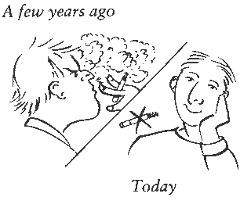
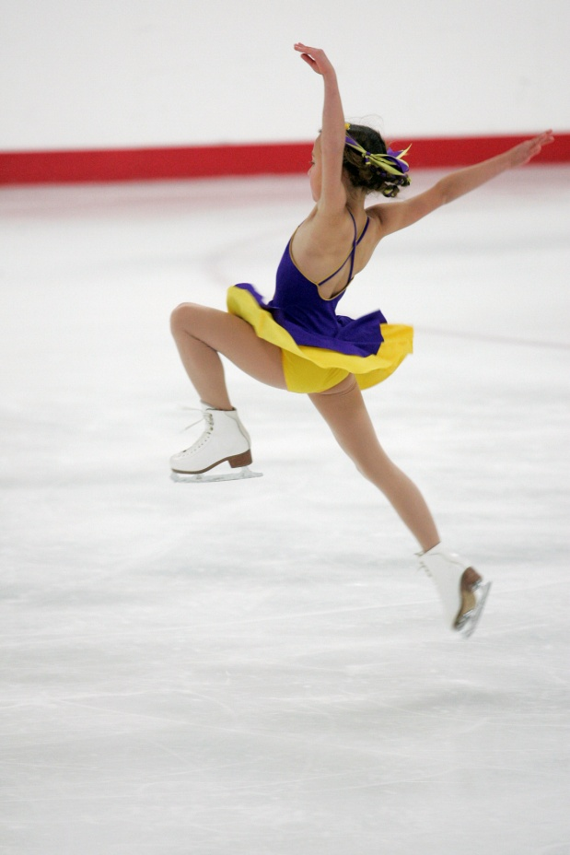
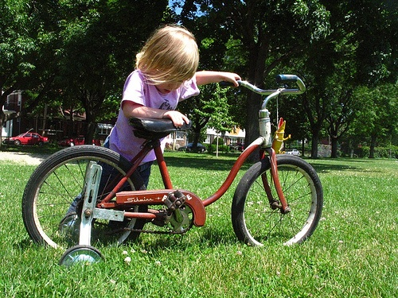

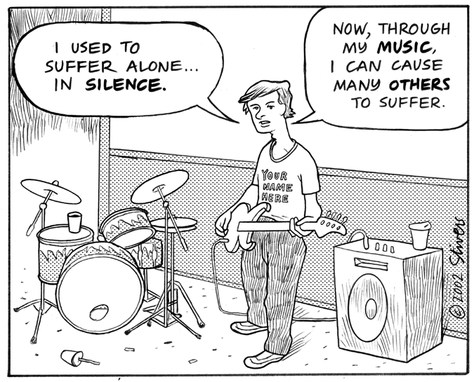


Slide 14
What is the approach?
PPP (Presentation Practice Production)
Aim: to present and practice the target language ‘used to’
Stages:
I. Context setting. (Lead-in)
II. Presentation.
  elicitation of the example
  modelling
  pronunciation drill
  concept checking questions
  writing the model down on the board
  grammar analysis
III. Controlled Practice.
IV. Production.
V. Feedback.

Slide 15
Take a Reflection break…
THANK YOU FOR YOUR PARTICIPATION!!!

