Slide 1
Animals
zoo

Slide 2
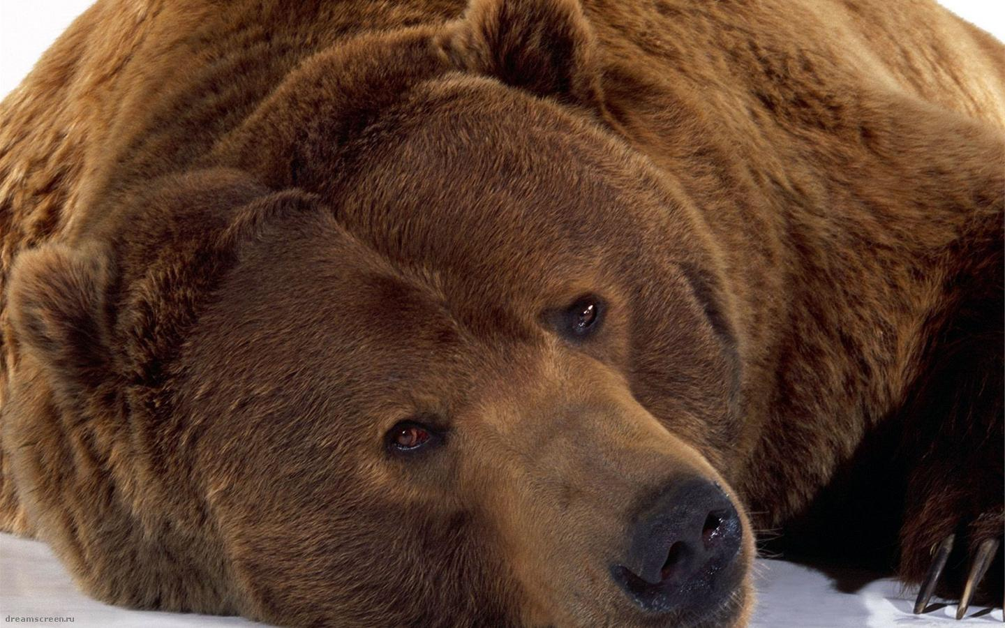
Bear
It is a bear

Slide 3
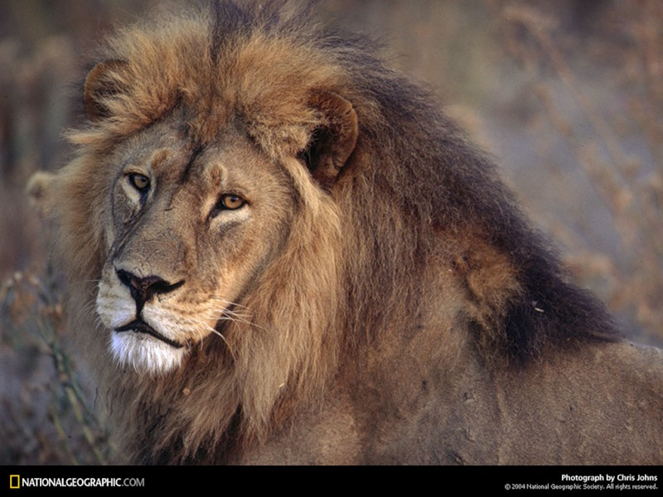
Lion
It is a lion

Slide 4
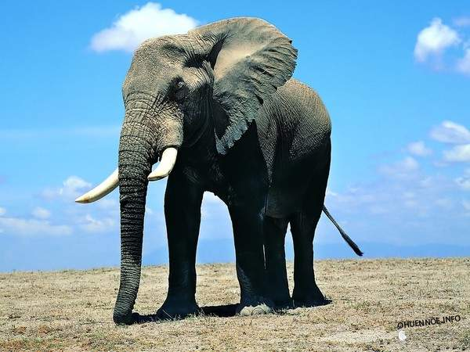
Elephant
It is an elephant.

Slide 5
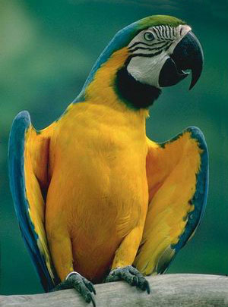
Parrot
It is a parrot

Slide 6
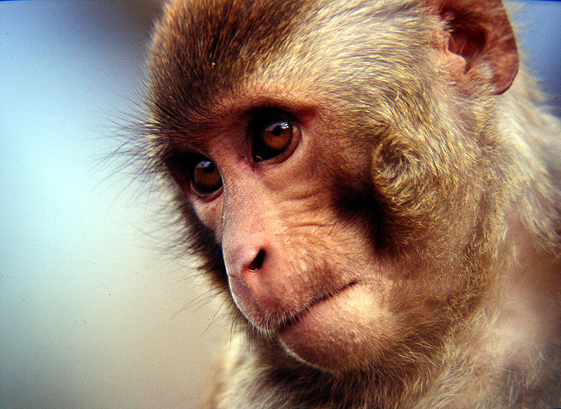
Monkey
It is a monkey

Slide 7
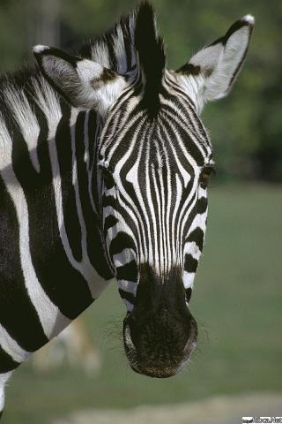
Zebra
It is a zebra.

