Slide 1
Wild Animals Numbers

Slide 2
1
one
dinosaur

Slide 3
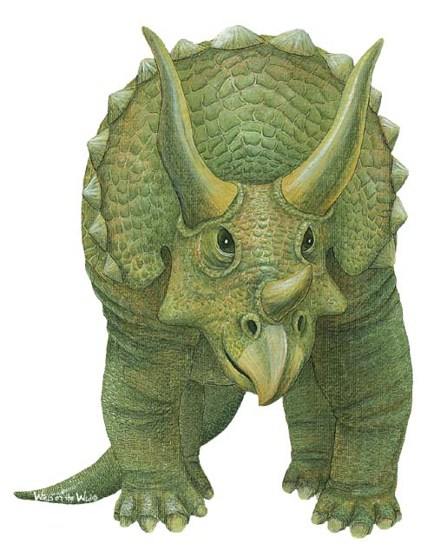
2
two
dinosaurs

Slide 4
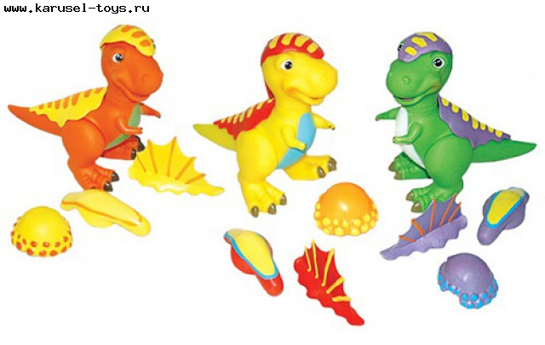
3
three
dinosaurs

Slide 5
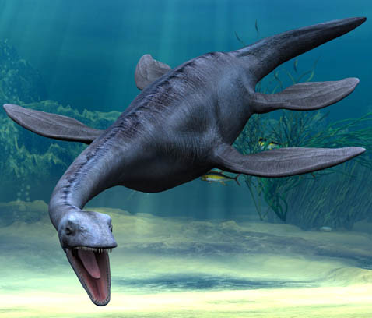
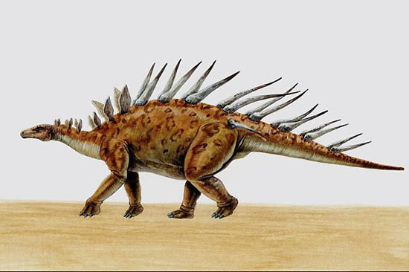
4
four
dinosaurs

Slide 6
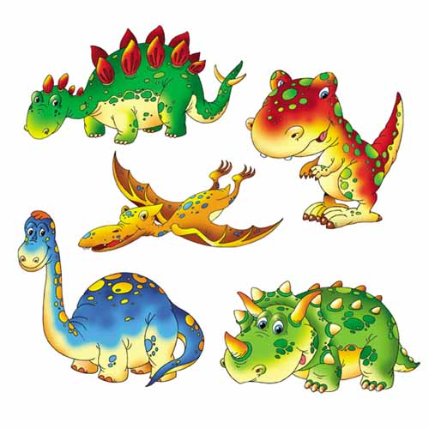
5
five
dinosaurs

Slide 7
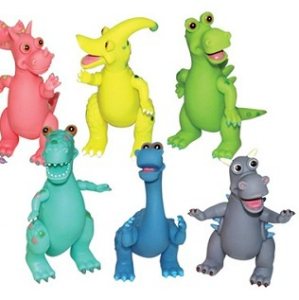
6
six
dinosaurs

Slide 8
How many?
Сколько

