Slide 1
Classwork
Man – the Child of Nature
Destruction of Animals’ Natural Habitat
February, 19. Saturday.

Slide 2
Richard Adams
British novelist
Two daughters
Animals
Human features
Heroism and Friendship
True-to-life
The most famous book
British novelist
Two daughters
Animals
Human features
Heroism and friendship
True-to-life

Slide 3
What are the main characters of this novel?
What are their names?
How can you describe them?
What is their usual life in warren?

Slide 4
the cartoon
“Watership Down”
The task:
pay attention to the details
and describe
the atmosphere of the story

Slide 6
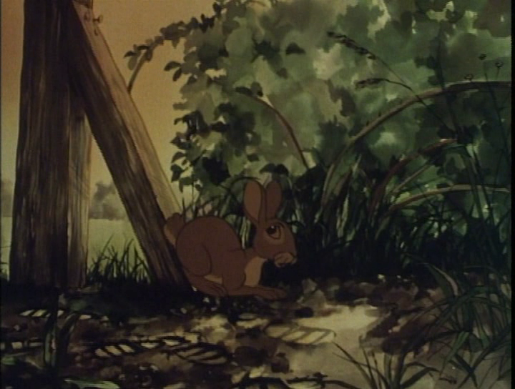

Slide 7
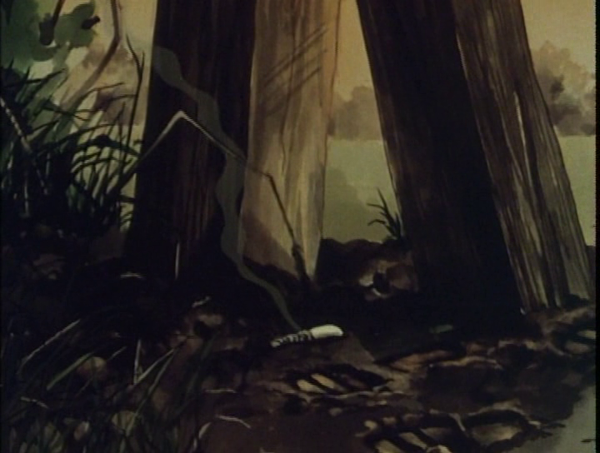

Slide 8
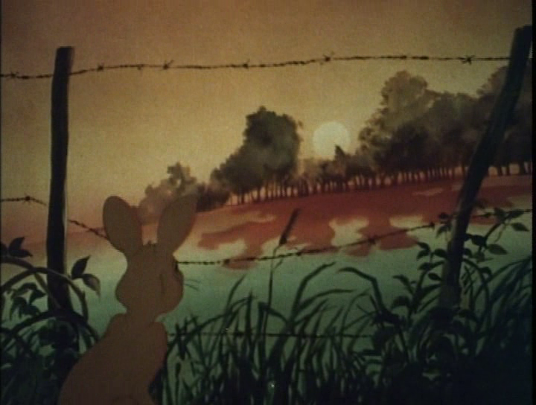

Slide 9
Discussion
People
Animals
want to prove that nothing dangerous can happen if they build there new houses, because…
want to prove that people will destroy their habitat, because…

Slide 10
Linking Words
Words to make a contrast
Words to show your opinion
but, however,
nevertheless,
alternatively,
despite, in spite of,
on the contrary,
although, even though,
from one hand… on the other hand,
in theory…in practice…
while, unlike
I (don’t) agree that…
I’m for/against (this idea)…
I think you're right/ wrong…
Instead, I think that…
It is (not) a good idea, …

Slide 11
Let’s imagine
that we are writers!
What will be the end of the story “Watership Down”?
Let’s make it up in groups!

Slide 12
Hometask:
to watch the cartoon “Watership Down”
in English
till the end

