Slide 1
Англоязычные страны

Slide 2
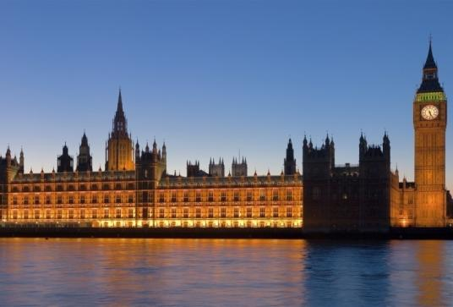
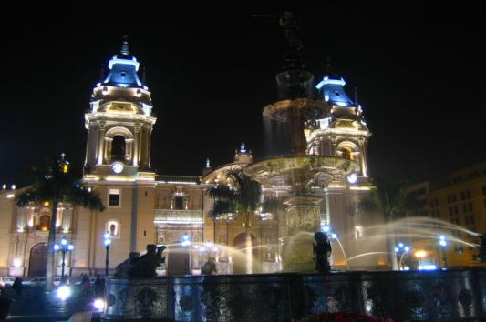
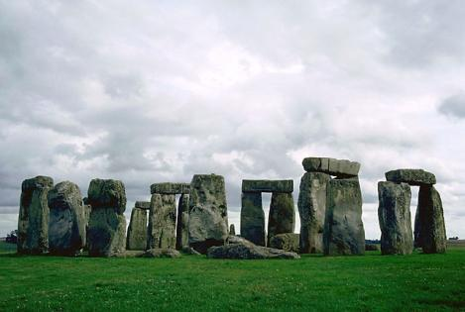
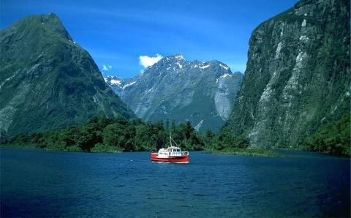
What a wonderful world !
Dear travelers !
Promise you will spend the time entertaining and fun.
Invite you to visit countries such as: Great Britain, Canada, New Zealand,
Australia. All these countries are
Beautiful and interesting for visiting.

Slide 3
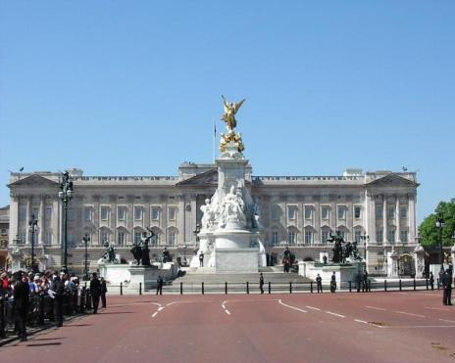
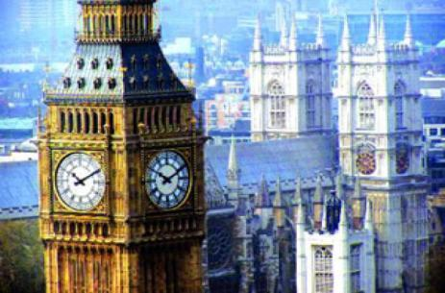
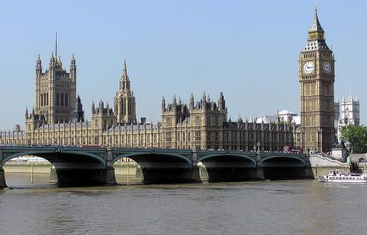
Great Britain
The total area: 244,000 sq. kms.
The population: 57 min people
The capital: London
The places of interest of country:
Trafalgar Square, Westminster Abbey,
Tower of London, Buckingham Palace,
Big Ben, Liverpool, Manchester, etc.

Slide 4
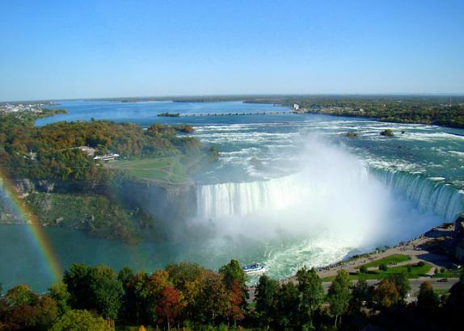
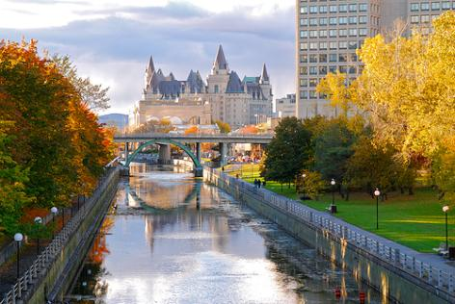
Canada
The population: 26 min people
The total area: 9976 sq.kms
The capital: Ottawa
The places of interest of country:
The Great Lakes, the Niagara Falls,
Toronto, Vancouver, the Rockies,
Baffin land, etc.

Slide 5
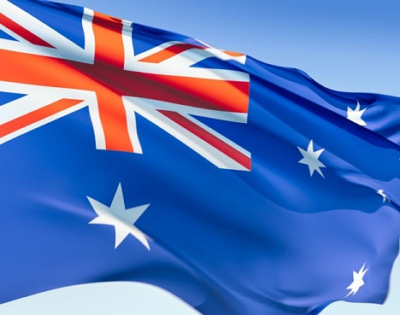
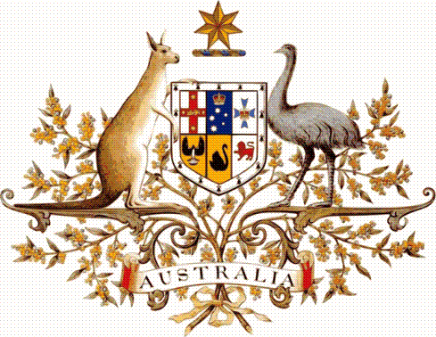
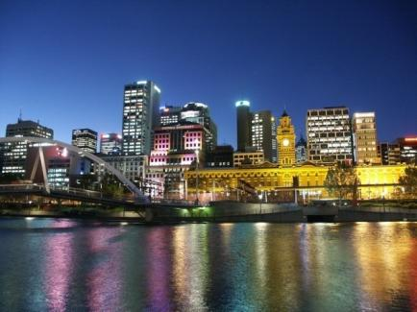
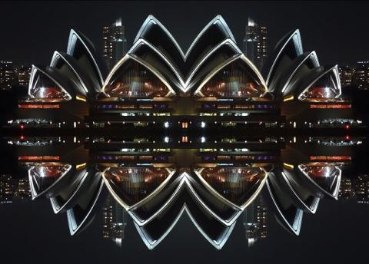
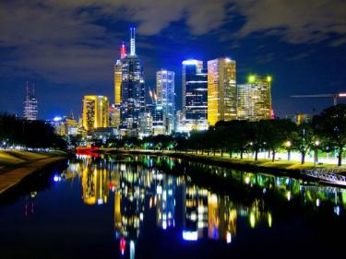
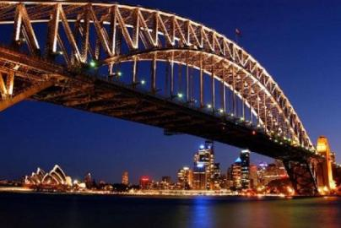
Australia
The total area: 7687 sq. kms.
The population: 16 min people
The capital: Canberra
The places of interest of country:
The kangaroo, the dingo, the emu,
The koala, the echidna, Tasmania Island,
The Central Lowlands, etc.

Slide 6
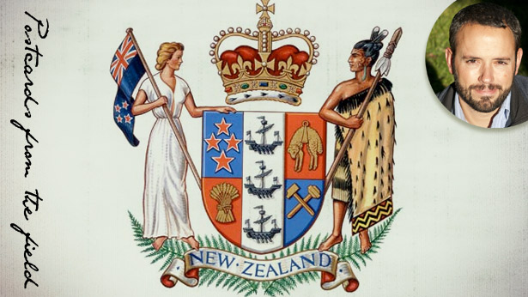
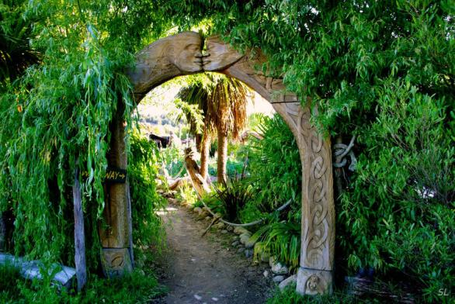
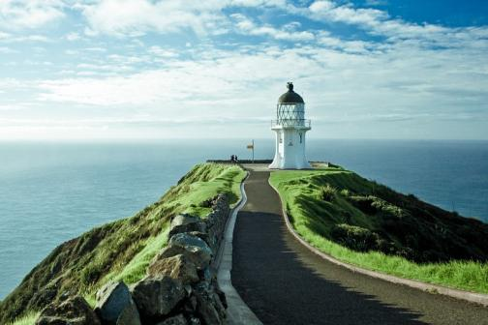
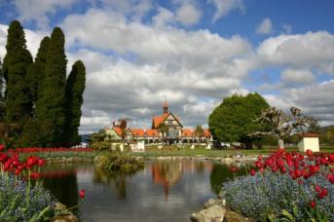
New Zealand
The total area: 269 sq. kms.
The population: 3,3 min people
The capital: Wellington
The places of interest of country:
The kiwi, the aborigines Maori, North
Island ,South Island, Stewart Island, etc.

Slide 7
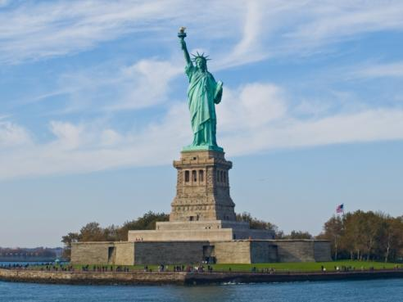
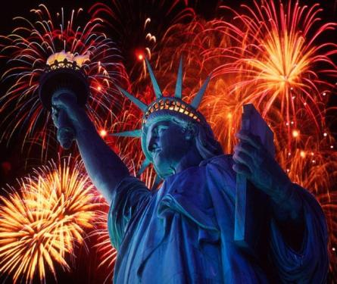
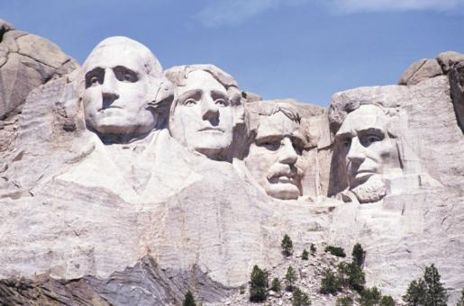
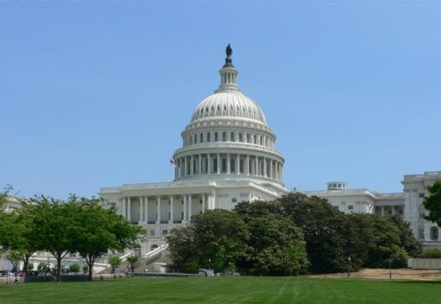
The USA
The total area: 9,39 sq. kms.
The population: 309 min people
The capital: Washington
The places of interest of country:
Times Square, Las Vegas Strip, National
Mall, Disney World`s Magic Kingdom,
Disneyland Park, Memorial Parks, etc.

Slide 8
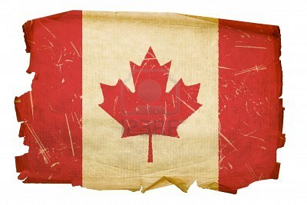
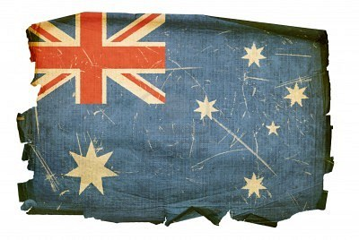
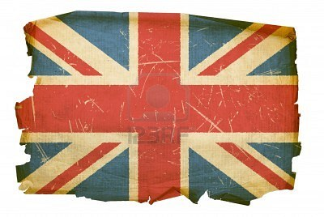
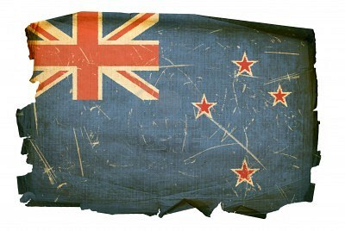
Thank you, hope you had a great time. It was a pleasure to meet you. Until next time!

Slide 9
The End

Slide 10
The total area: 18 sq. kms.
The population: 849000 people
The capital: Suva
The places of interest of country:
The Sand Dunes Sigatoka, the park
Koroyanity , the Village Viseisei, etc.

