Slide 1
Шекспир на все времена shakespeare for all time

Slide 2
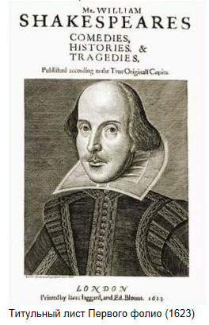
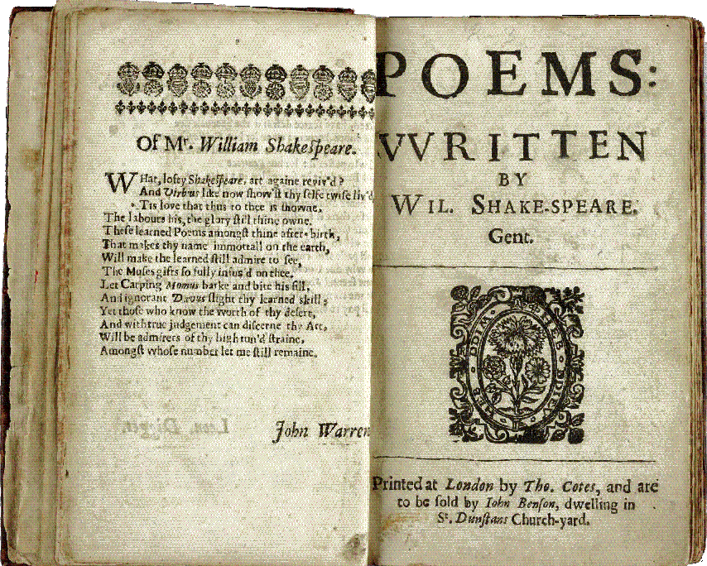

Slide 4
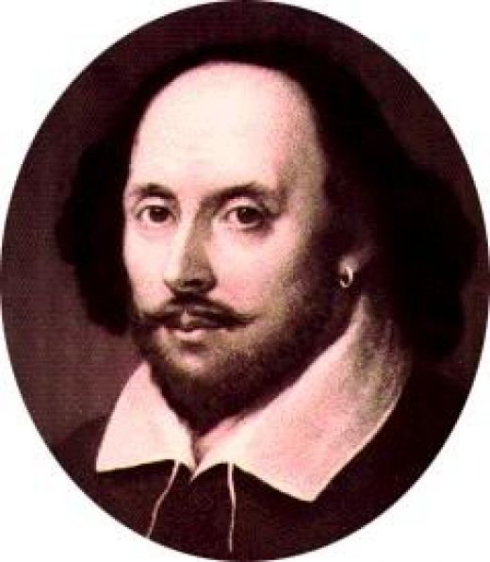

Slide 5
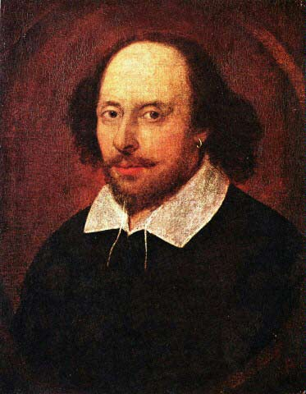
The brilliant
poet
WILLIAM
SHAKESPEARE
The greatest
of the great
The marvelous
dramatist

Slide 6
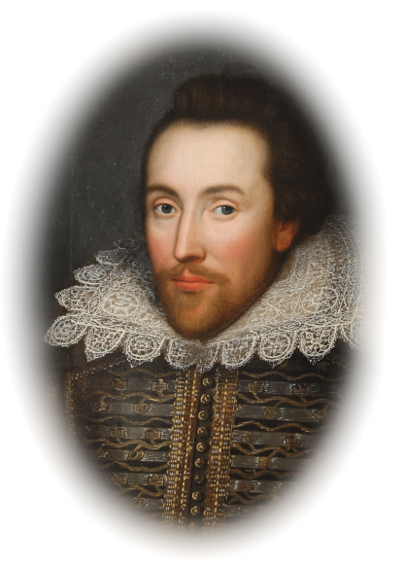
23 APRIL
1564
STRATFORD - ON - AVON

Slide 7
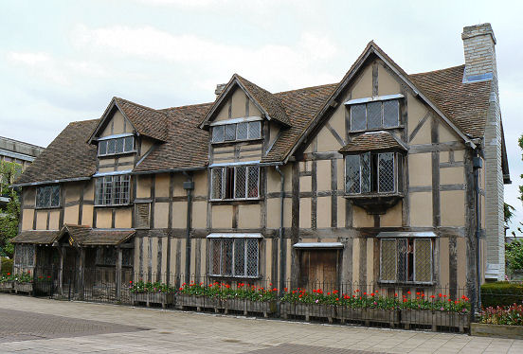
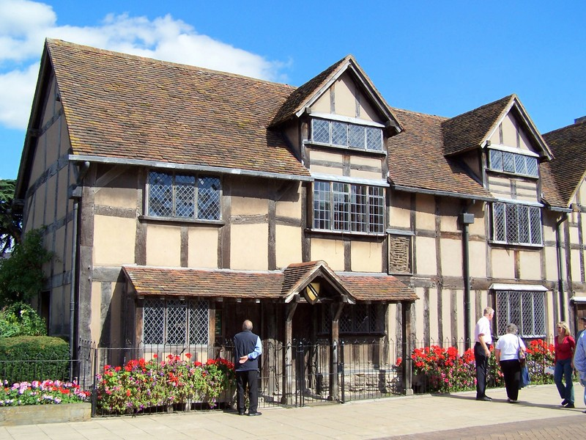
SHAKESPEARE, S BIRTHPLACE

Slide 8
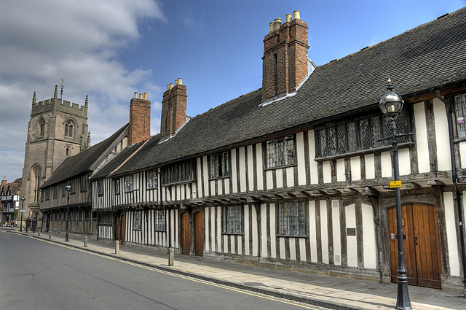
The Grammar School that William attended

Slide 9
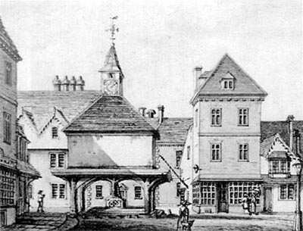

Slide 11
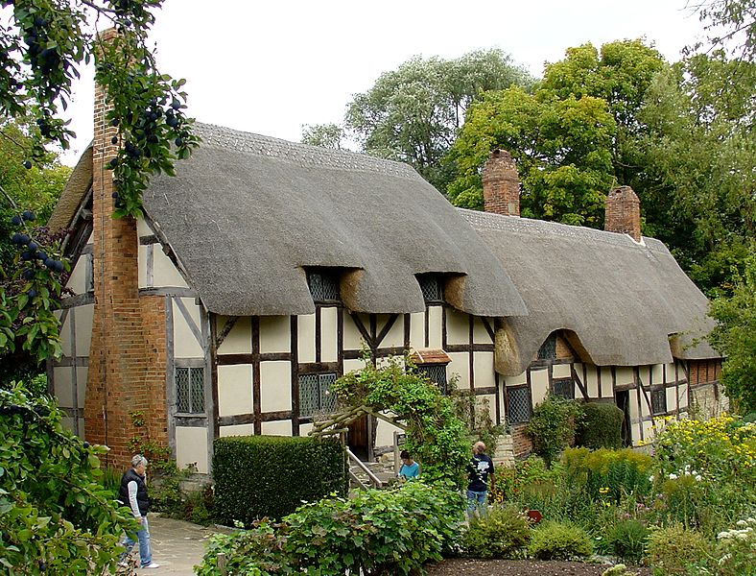
The Cottage of Ann Hathaway

Slide 12
1586 – left Stratford on Avon
1592 – great success in London
1594 – joined a group of artists

Slide 13
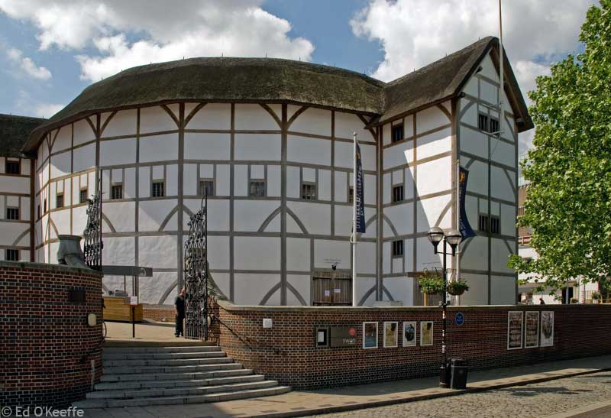
In 1599 Shakespeare built THE GLOBE

Slide 14
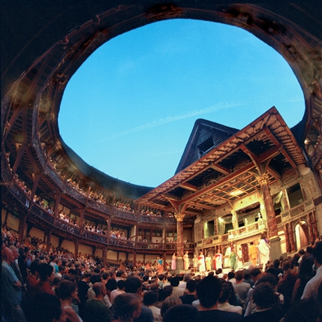
“ALL
THE WORLD
IS A STAGE”
«ВЕСЬ МИР
- ТЕАТР»

Slide 15
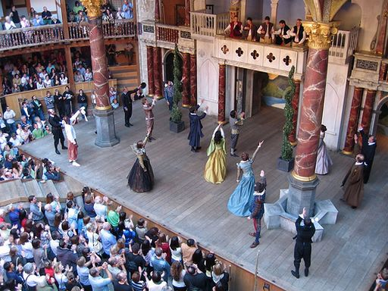

Slide 16
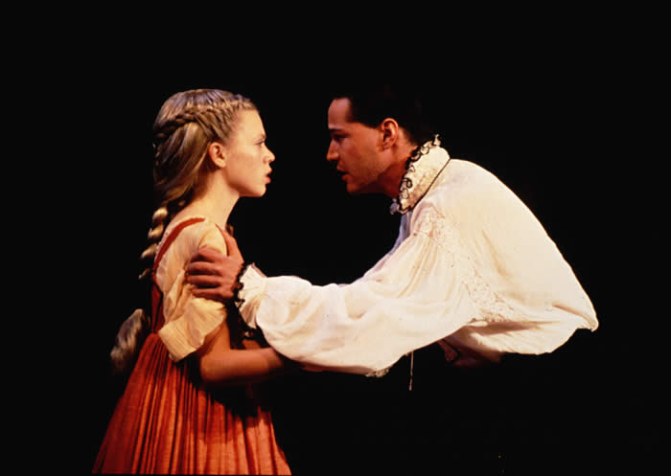

Slide 17
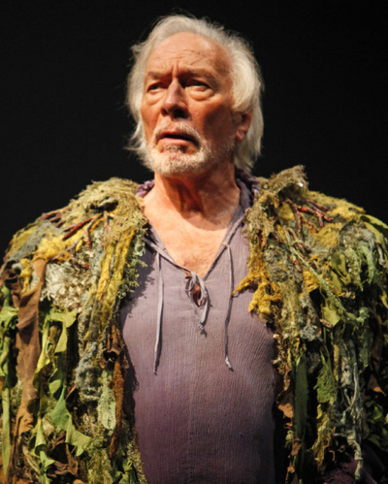

Slide 18
157 sonnets
The last 27 sonnets
are devoted
to a mysterious lady

Slide 19
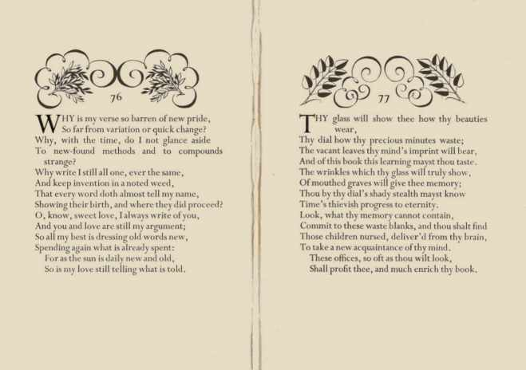

Slide 20
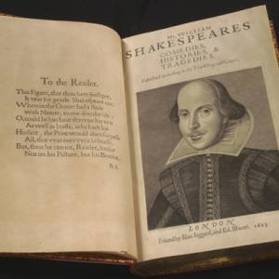

Slide 21
SHAKESPEARE WROTE 37 PLAYS
HAMLET
KING LEAR
OTHELLO
ANTHONY AND CLEOPATRA
ROMEO AND JULIET
TWELFTH NIGHT

Slide 22
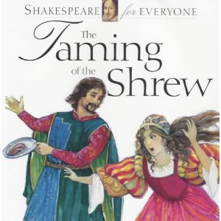
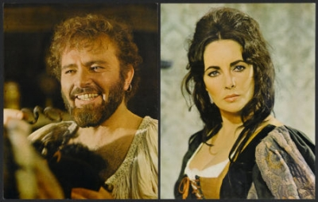

Slide 23
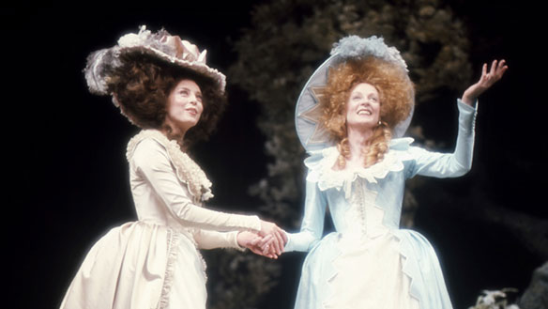

Slide 24
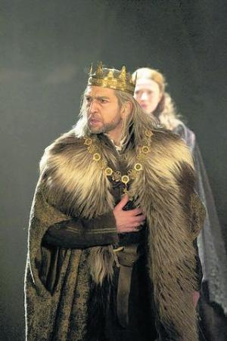

Slide 25
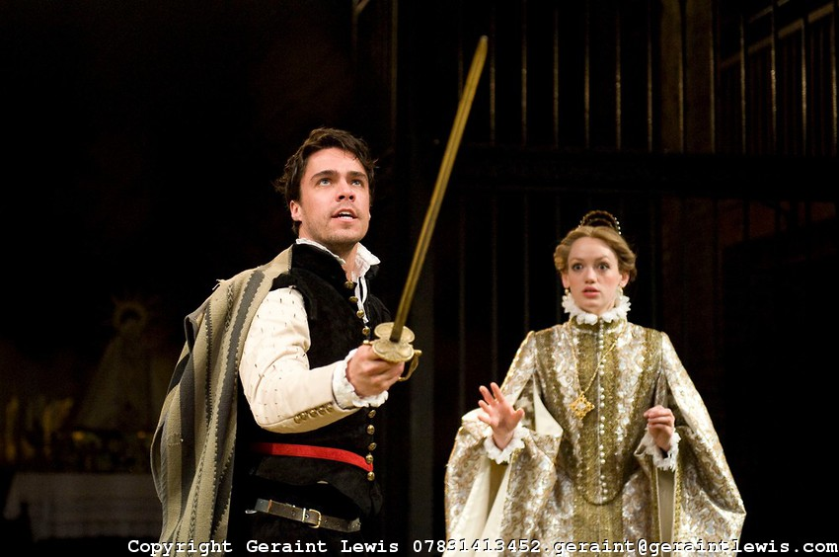

Slide 26
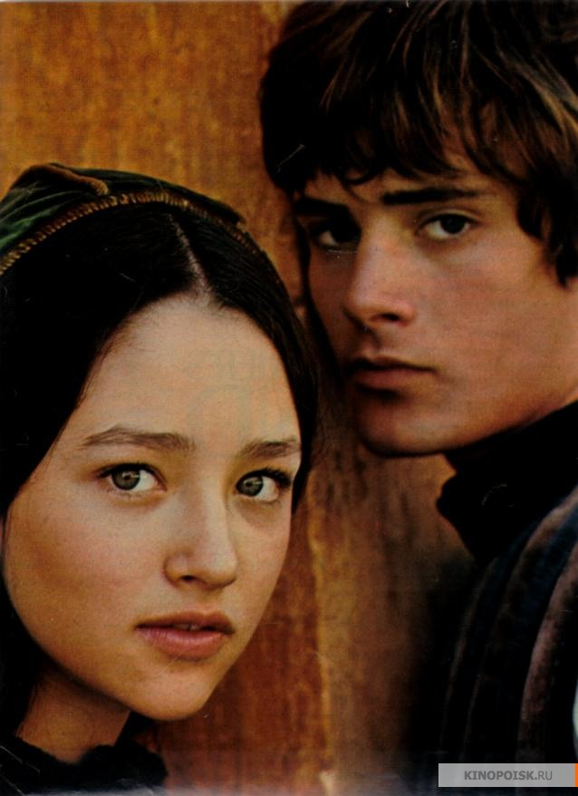
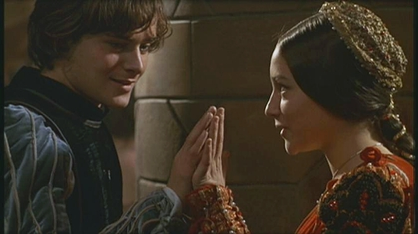

Slide 27
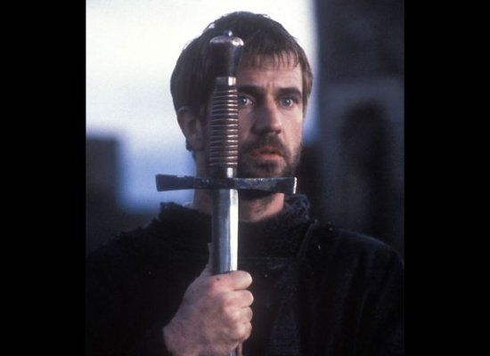
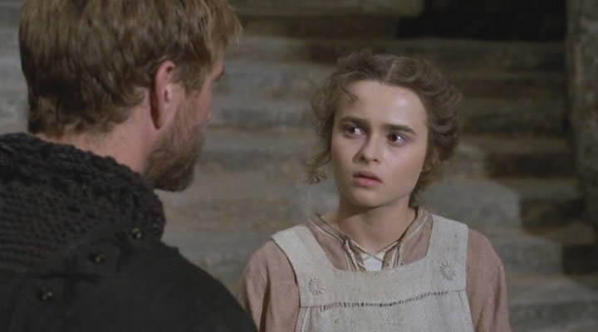
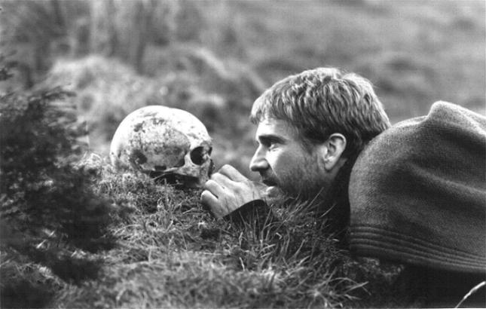
HAMLET

Slide 28
1614 – THE GLOBE WAS BURNT
1615 – THE GLOBE WAS REBUILT
AND SHAKESPEARE
LEFT LONDON FOREVER

Slide 29
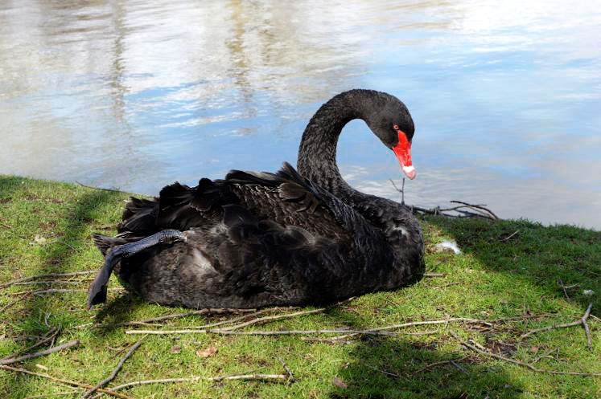
23 APRIL 1616 –
SHAKESPEARE DIED

Slide 30
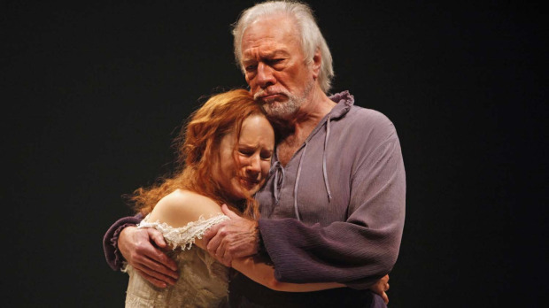

Slide 31
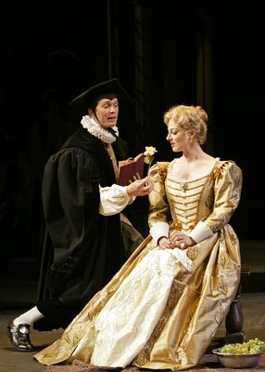
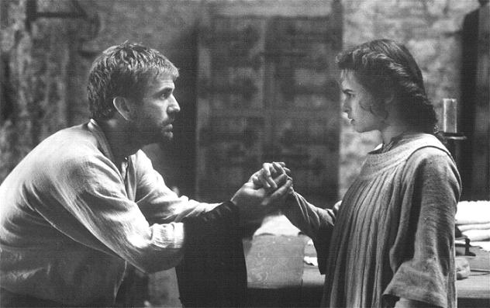

Slide 32
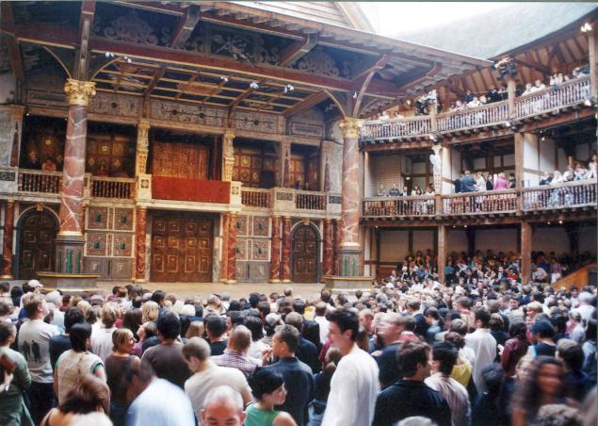

Slide 34
www.wikimedia.org
http://www.things-to-do-in- london.com/wpontent/uploads/2011/07/Shakespeare-Globe.jpg
http://www.koozzz.com/Nature/stratfordecocenter/DSC0085b/872165955_dFGSA-M-3.jpg
http://www.britainunlimited.com/photos/Shakespeare%20Birthplace.JPG
http://www.featurepics.com/FI/Thumb300/20070824/Anne-Hathaways-House-427149.jpg
http://www.vidpochivay.com/wp-content/uploads/2011/02/shekspir.jpg
http://media.thestar.topscms.com/images/d5/d6/920b25514f0aa3587d77020e1e2f.jpeg
http://www.cbc.ca/gfx/images/arts/photos/2010/12/16/domini-blythe1.jpg
http://img1.liveinternet.ru/images/attach/c/0/35/834/35834903_royal1.jpg
http://www.ontariopics.com/p2/m/Stratford/Black-Swan-11437.jpg
http://www.english-online.at/literature/william-shakespeare/shakespeares-birthplace-stratford-upon-avon.gifhttp://
www.flickr.com/photos/chalto/4536257788/
http://www.operosa.org/bg/pics/Shakespeare.jpg
http://nimg.sulekha.com/entertainment/original700/theater-stratford-festival-plays-2009-7-10-11-15-24.jpg

Slide 35
http://4umi.com/shakespeare/sonnet
http://myweb.tiscali.co.uk/barbarajupe/pictures/Picture7.jpg
http://www.the-romans.co.uk/p7hg_img_13/fullsize/46.shakespeare_larger.jpg
http://upload.wikimedia.org/wikipedia/commons/thumb/f/f6/Sonnets1609titlepage.jpg/200px-Sonnets1609titlepage.jpg
http://dic.academic.ru/dic.nsf/ruwiki/1167947
http://www.londonforyou.ru/pic/IMGF083RS.jpg
http://beta.images.theglobeandmail.com/archive/01297/WEB-tempest_JPG_1297985cl-8.jpg
http://www.thehindu.com/multimedia/dynamic/00775/TH08_OPED_SHAKESPEA_775468f.jpg

