Slide 1
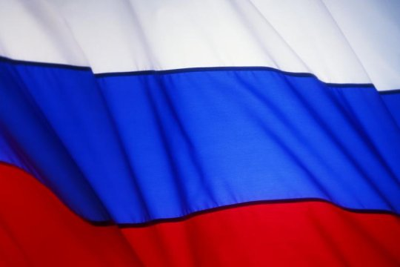
Education system in Russia
Project was prepared by
Devyatkina Ekaterina
Gerasimenko Veronika
Belousova Jane

Slide 2
An educated person is one who knows a lot about many things. I think it is very important that everyone should be educated. Each pupils ought to do his best to become a useful member of our society. Education is very important in our life. Going on educational excursions gives us opportunities to acquire some scientific knowledge.
In the Russian Federation the school education is compulsory. Pupils begin to go to school at the age of six. When they complete high grades they can either continue to study at school for more 2 years, or go to a professional school where they study not only main subjects , but are able to learn some profession. When school pupils leave school they can try to continue their education in institutes or universities.
There are many school types of schools in Russia: specialized, polytechnic, musical art and others. Nowadays appeared some new types of schools: gymnasiums and colleges.

Slide 3
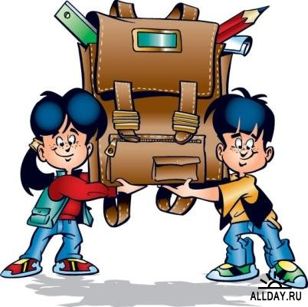
Education system in Russia
Education system in Russia is similar to European and American education systems:
2 cycle education system:
undergraduate level of education System in Russia: Bachelor degree,
postgraduate level of education System in Russia: Master degree and Ph.D.
Credit transfer system.
Academic exchange programs on basis of ECTS (European Credit Transfer System).
European diploma supplement.
There is one difference between Russian and European education systems: 5-year engineer / Specialist programs.
Those who would like to take courses in Russian must be fluent in Russian and present the Russian Language State Certificate as evidence. The most effective way in reaching this goal is to take the one year Preparatory Course.

Slide 4
The day of knowledge

Slide 5
…what about …?
Secondary Education. Russia has 11-grade system of secondary education. It is compulsory up to 9th form inclusive. Children begin school at age 6 or 7 and study for 4 years to receive primary general education. Then, they study for another 5 years to receive basic secondary education. The Certificate of Incomplete Secondary Education (ATTESTAT) is awarded. After finishing the 9th form graduates of this level may continue their education for another two years at senior high school to receive secondary complete general education. Secondary education leads to the award of the ATTESTAT (a Certificate of Completed General Secondary education.
Initial and Intermidiate Education (Professional). Institutions of initial and intermidiate professional education (PTU -proftekhuchilischa, professional leceums, tekhnikums and colleges train qualified workers, middle-level specialists such as techncians and skilled nurses. They confer Diplomas after 2 years' study on the basis of Secondary (complete) general education and after four to four-and-a-half years on the basis of Basic general education.
Higher Education. Higher education is provided by public and non-State accredited higher education institutions. The majority of state institutes of higher education are regulated by the Ministry of Education of the Russian Federation. Some of them are regulated by other state Ministries, such as the Ministry of Health Care, the Ministry of Railway Transportation, the Ministry of Culture, the Ministry of International Affairs and others. There are three levels of higher education: 1) incomplete higher education (2 years at least); 2) basic higher education (4 years) leading to the Bakalavr's degree, the first university level degree; 3) postgraduate higher education (total number of years of post-secondary education: 5-6 years or more.

Slide 6
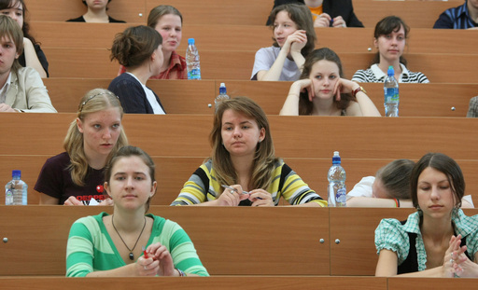
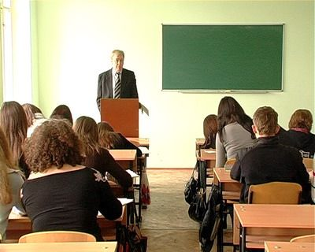

Slide 7
Russia’s institutions of higher education
The University is inexhaustible source of educated and mobile young people, who master quickly modern high technologies and become leaders of prospective directions. Nowadays TUSUR is oriented to graduation not only of high-skilled engineers and scientists, but also future entrepreneurs of science intensive business.
TUSUR has been occupied with training of future entrepreneurs of science intensive business for a long time and quite successfully. Many of Tomsk IT enterprises are organized by TUSUR undergraduates and make up 80 per cents of goods and services market size.
In May of 2006 TUSUR became one of 17 university-winners of the contest of university of higher education, introducing innovation education programs. Aim of TUSUR education programs is activation of graduate innovation activity, training either independent entrepreneurs of science intensive business, or specialists, able to initiate and realize innovation projects at any acting enterprise.
Some years ago at the University was organized innovation division - Education-science-innovation complex, which consists of science research institutes, design bureaus, student design bureaus, Engineering centers, first in the country science-technological park, student business incubator, scientific laboratories and science intensive companies.
In 2004 on the basis of TUSUR was organized first in Russia interuniversity student business incubator, which becomes one of the components of new model of innovation staff training system. SBI is intended for 220 work places and oriented on support of science intensive projects on Information technologies and Radioelectronics first of all. Projects, which aspire to placing in business incubator, are selected among each other. Main requirement to science intensive projects-competitors is possibility of their commercialization and delivery to the market.
In January of 2007 SBI produced first independent science intensive company - Center of independent supply source “Free energy”. All SBI system helped company to recover its feet: it was permitted to use data bank, given by TUSUR, Internet, office equipment, legal counseling of specialists. Besides having worked in business incubator, young company kept the means, which could be spent on lease of expensive office.
Progress of SBI not only shows its prospects, but also allows saying about project expansion. Vast network of TUSUR branches and offices gives opportunity to develop science intensive business in other cities, organizing business teams on the basis of regional students’ projects, who receive basic education in any branch of TUSUR. Then organized team with its project continues study in university business incubator in project study mode and in some time it will organize new enterprise of science intensive business.
Serious step TUSUR innovation activity became the project realization of international “ bridges of technology and knowledge transfer”. These “bridges” (California-Tomsk, Toronto-Tomsk and Nuremberg-Tomsk) opens new opportunities for exit to foreign market with products of Tomsk enterprises, commercialization of TUSUR scientists’ developments with foreign investments involvement, elite specialists training on “ export” programs for work in Tomsk organization divisions of international companies.
Notes:
It’s about Tomsk State University

Slide 8
Evening classes
Evening classes
The part-time (evening) studies
The lessons of the exemplary evening studies are conducted in the evening. Usually there are 6 - 8 lessons per week. The evening studies are convenient for those who work. The lessons usually start after 18.00 p.m. Usually there are 2 - 3 pairs or paired lessons (1 pair lasts 80 minutes).
The contact lessons do not take so much time in comparison with the lessons of full-time studies.
The percentage of lessons with a teacher and independent studies is 50 to 50 %. Contact lessons are usually conducted in the form of lectures, seminars, colloquiums, etc.
Recently a modified type of the exemplary evening studies has been extended. The difference of this training type from the exemplary evening studies is that the lessons are conducted in weekend days, mostly on Saturdays or Sundays (sometimes there can be two days running), and the number of pairs is increased to 4 - 5 per day consequently.

Slide 10
Moscow State Forest University
"MOSCOW STATE FOREST UNIVERSITY"
Moscow State Forest University (MSFU) is a leading multi-discipline higher forest educational institution in Russia. It was founded in 1919. Apart from forest-related specialties, the University trains Bachelors, Masters and Specialists in various fields requiring computer and information systems as well as economy. MSFU has long and close cooperation with many corresponding educational and scientific institutions in Great Britain, USA, Vietnam, China, Bulgaria, Germany, France, Finland, Serbia and Montenegro, Iran, Mongolia and others. It has been educating international students for several decades through various educational and research programmes.
World famous scientific schools in fundamental and applied research work in the University. Hundreds of highly qualified specialists, academicians, doctors and candidates of sciences deliver lectures and carry out research work.
The University has 80 departments, 5 research institutes, Experimental Forest Management Unit in Schelkovo (with area over 34 thousand hectares), 40 department branches at industrial enterprises, 3 Certification Centres, a library, a sports complex.
The University Campus consists of ten academic buildings, five hostel towers, sanatorium for preventive medical treatment, student medical centre, cafe, a sports complex and a summer camp at the Black Sea. Our students go in for sports and take part in the creative work. Among them are Olympic champions, champions of world, Europe, etc.
Students live in comfortable rooms for 2 or 3 persons with all commodities in a separate hostel tower.

Slide 11
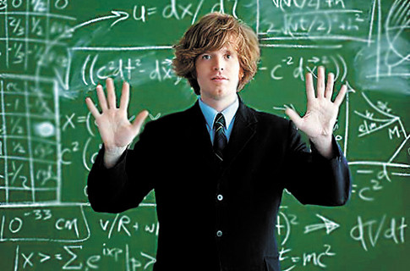
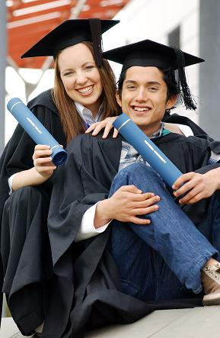
Hard-working
students

Slide 12
Moscow State Forest University
"MOSCOW STATE FOREST UNIVERSITY"
Faculties• Forest Faculty
• Faculty of Mechanical and Chemical Wood Technology
• Faculty of Landscape Architecture • Faculty of Computer Sciences
• Faculty of Economics and Foreign Relations
• International School of Management and Business
• Humanities Faculty
Foreign Citizens Educational Centre
Specialties• Forest Engineering
• Forestry
• Machines and Equipment for Forestry
• Operation and Maintenance of Transport and Technological Machines and Equipment (forest complex)
• Technology of Wood
• Chemical Technology of Wood
• Automation of Technological Processes and Production Lines (wood-processing industry)
• Garden and Park and Landscape Design • Computer Complexes, Systems and Networks
• Applied Mathematics
• Standartisation and Certification
• Accounting, Analysis and Audit
• World Economics
• Industrial Enterprise Economics and Management (in different branches)
• Management• Translation and Translatology
• Professional Training (economics and management)
• Professional Training (design)

Slide 13
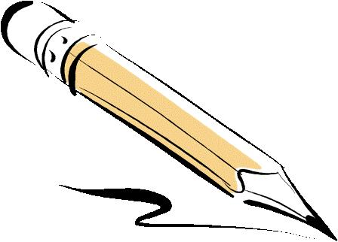
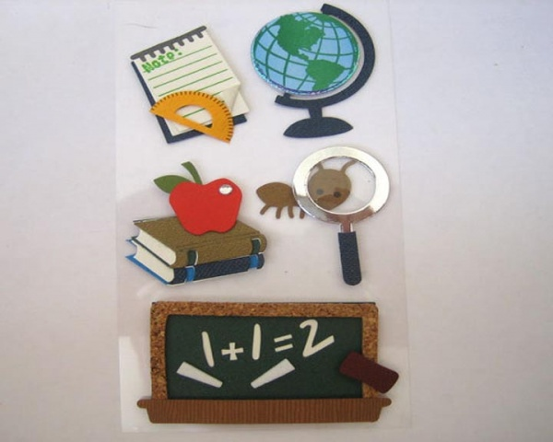
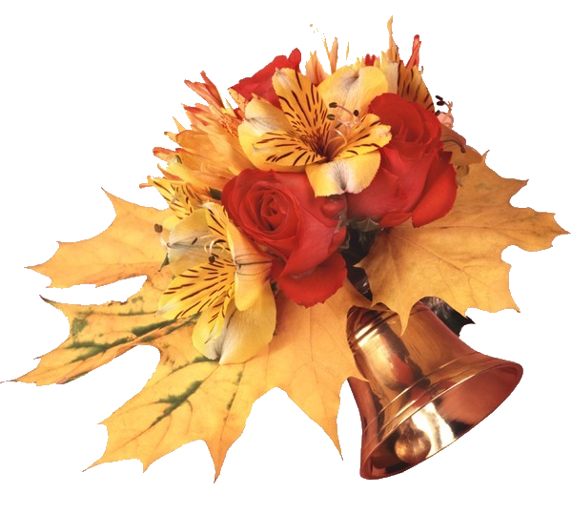

Slide 14
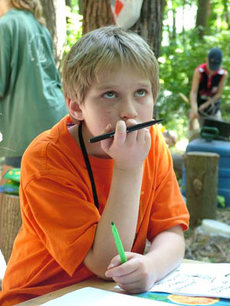
Notes:
The end…

