Slide 1
A STAR
Push!

Slide 2
A STAR
IT SHINES BRIGHTLY

Slide 3
A BALL
Push!

Slide 4
A BALL
IT JUMPS HIGH

Slide 5
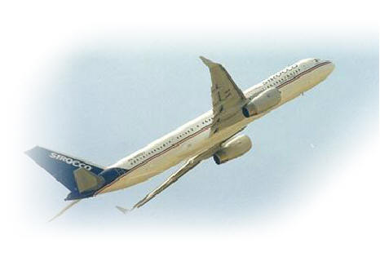
A PLANE
Push!

Slide 6
A PLANE
IT FLIES IN THE SKY

Slide 7
A HORSE
Push!

Slide 8
A HORSE
IT GALLOPS fine

Slide 9
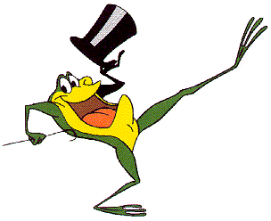
A FROG
Push!

Slide 10
A FROG
It dances very funny

