Slide 1
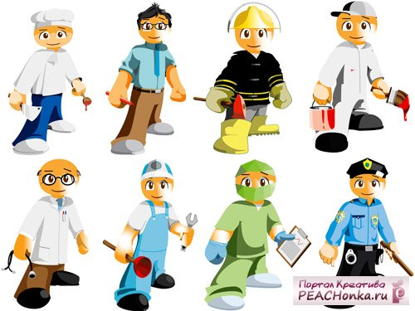
Professions

Slide 2
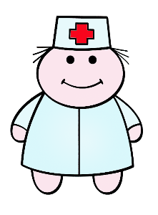
Professions
Hello, boys and girls!
My name is Mr. White.
I work in a hospital and treat sick people.
Can you guess what am I?
You are right! I am a doctor!

Slide 3
Professions
Hello, boys and girls!
My name is Mr. Truth.
I work in a traffic police and regulate the traffic .
Can you guess what am I?
You are right! I am a traffic-policeman!

Slide 4
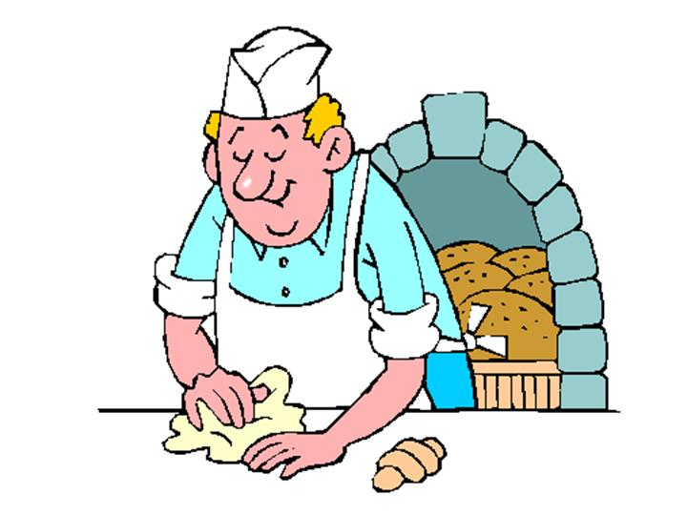
Professions
Hello, boys and girls!
My name is Mr. Baker.
I work in a bakery and bake cakes, biscuits and bread.
Can you guess what am I?
You are right! I am a baker!

