Slide 1
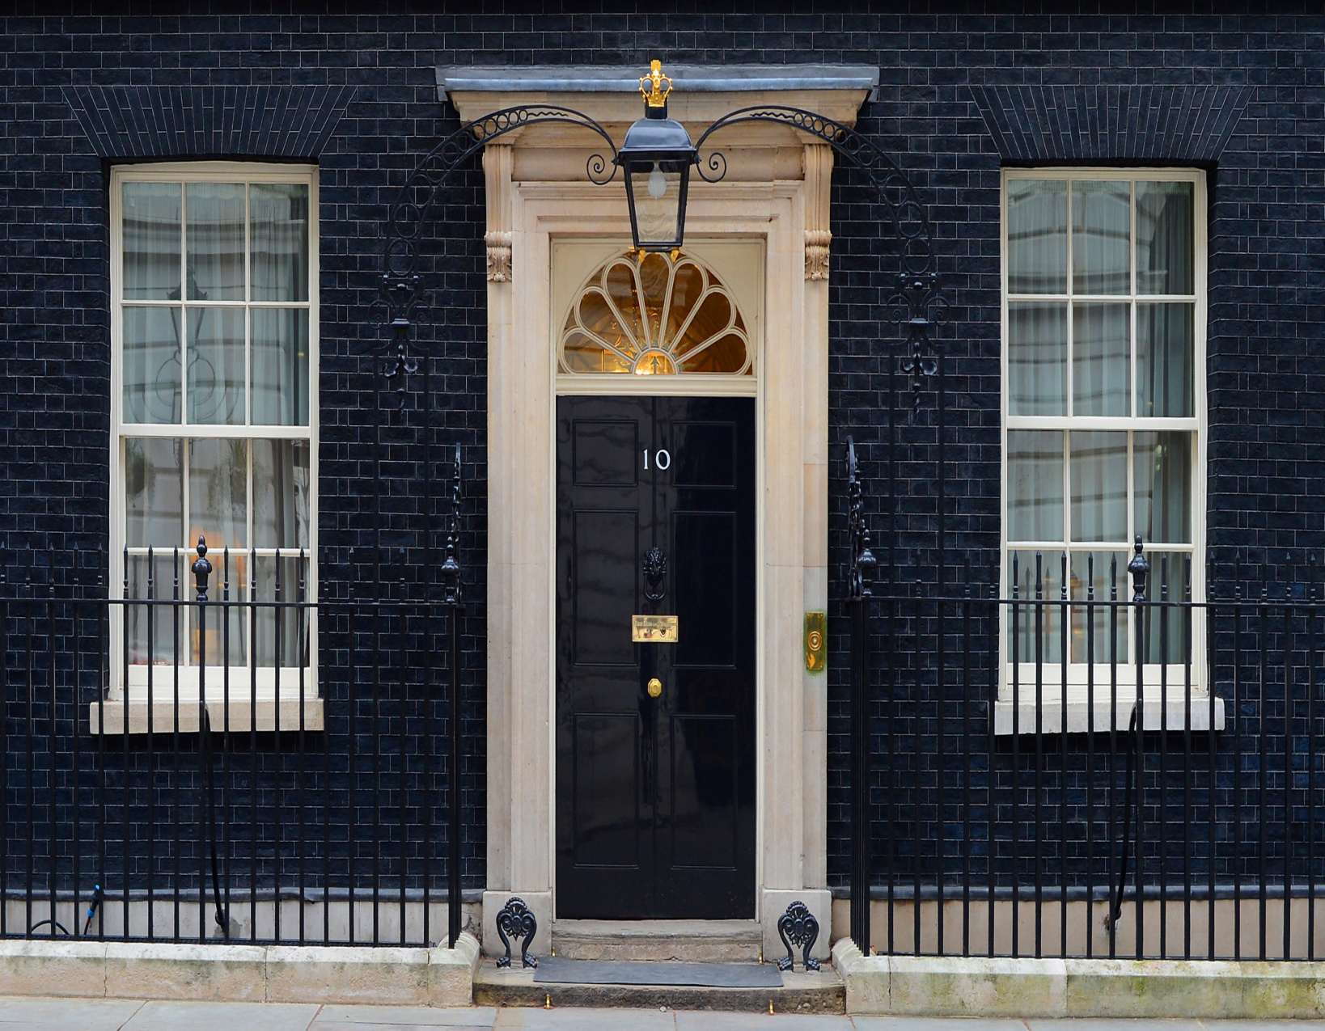
Do you know this famous address?

Slide 2
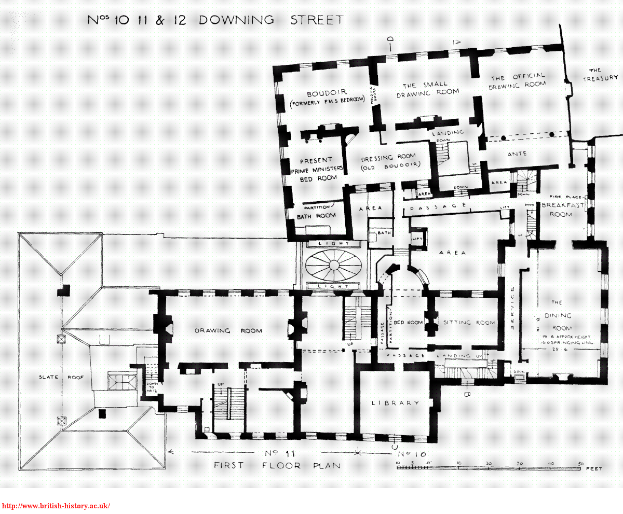

Slide 3
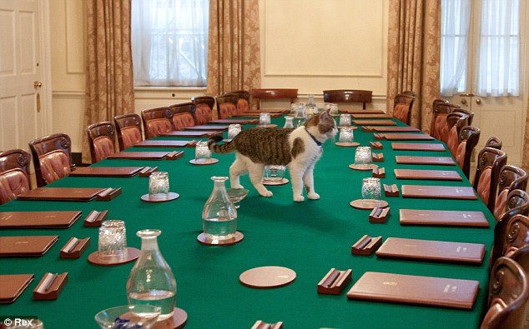
The Study and the Downing St.cat Larry

Slide 4
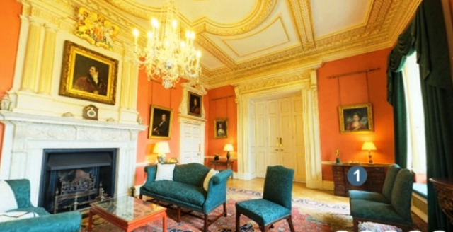
The Terracotta Room

Slide 5
The first ladies in the kitchen

Slide 6
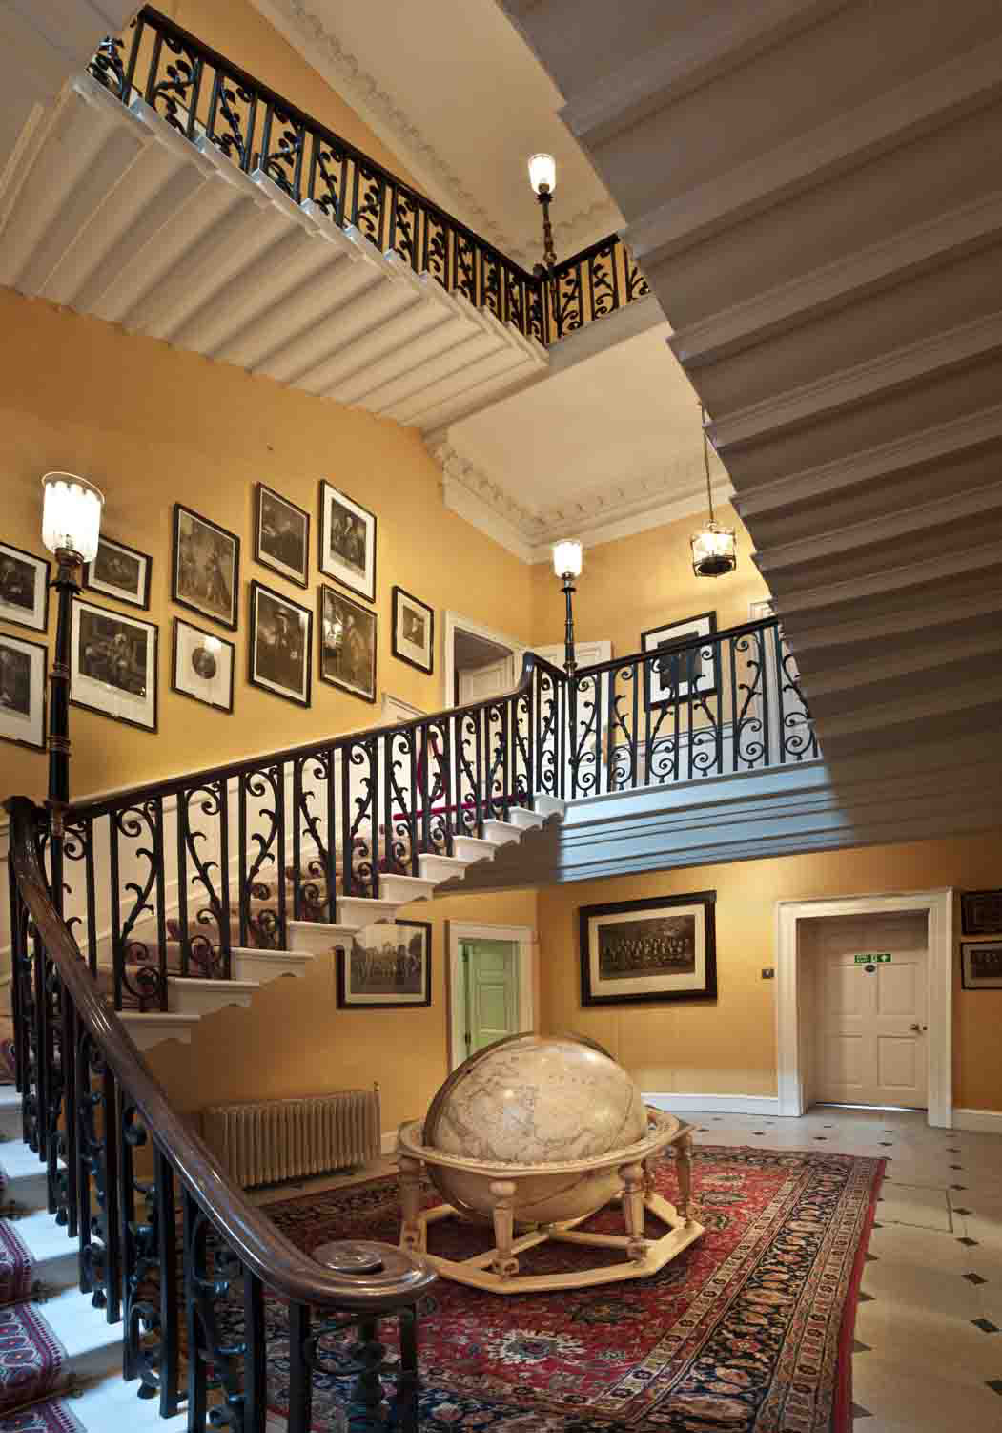
The Grand Staircase

Slide 7
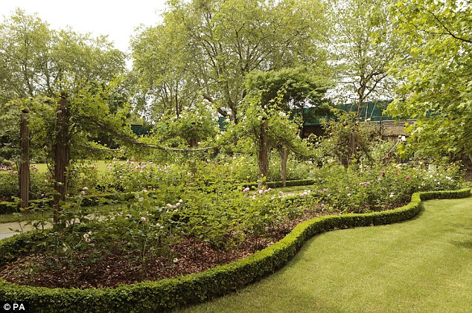
The Garden

Slide 8
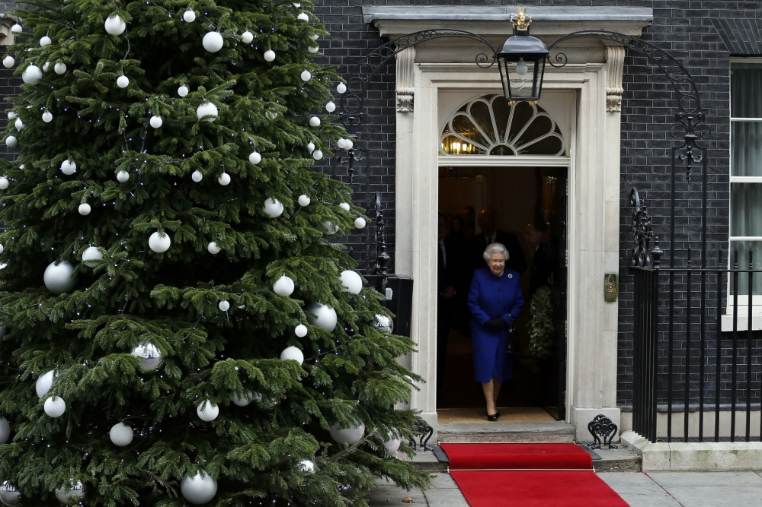
The Queen leaving the residence

