Slide 1
Past Simple

Slide 2
What, were, we, when, to want, why, was, where, questions
What, when, where, was, were why are the words we often say
when we want to ask questions.

Slide 3
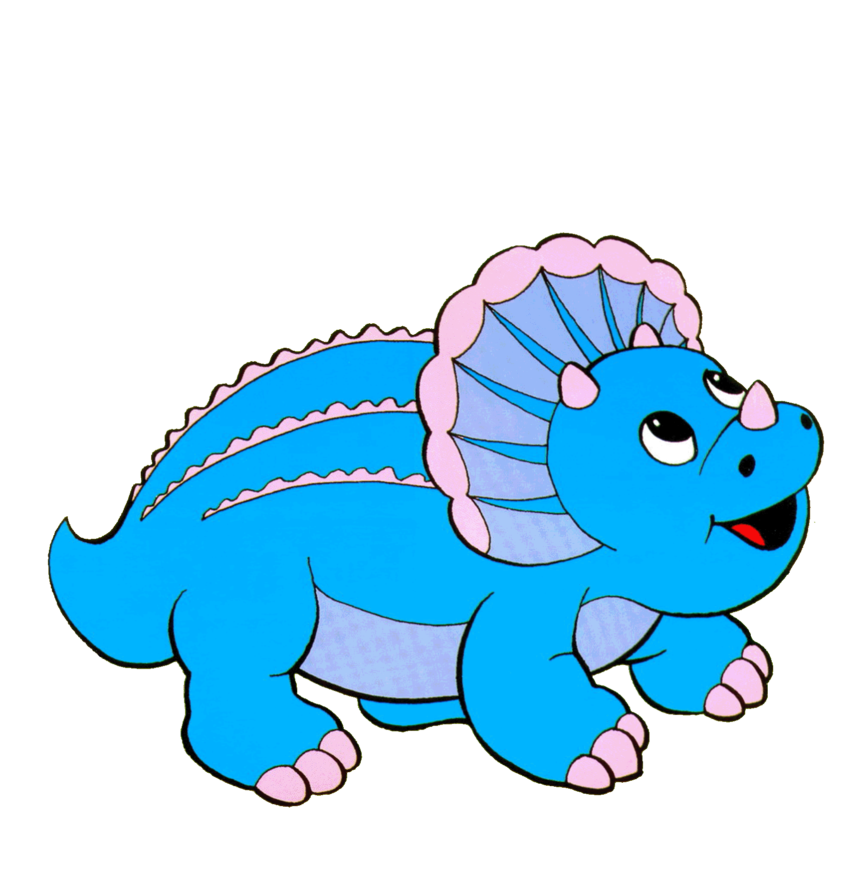
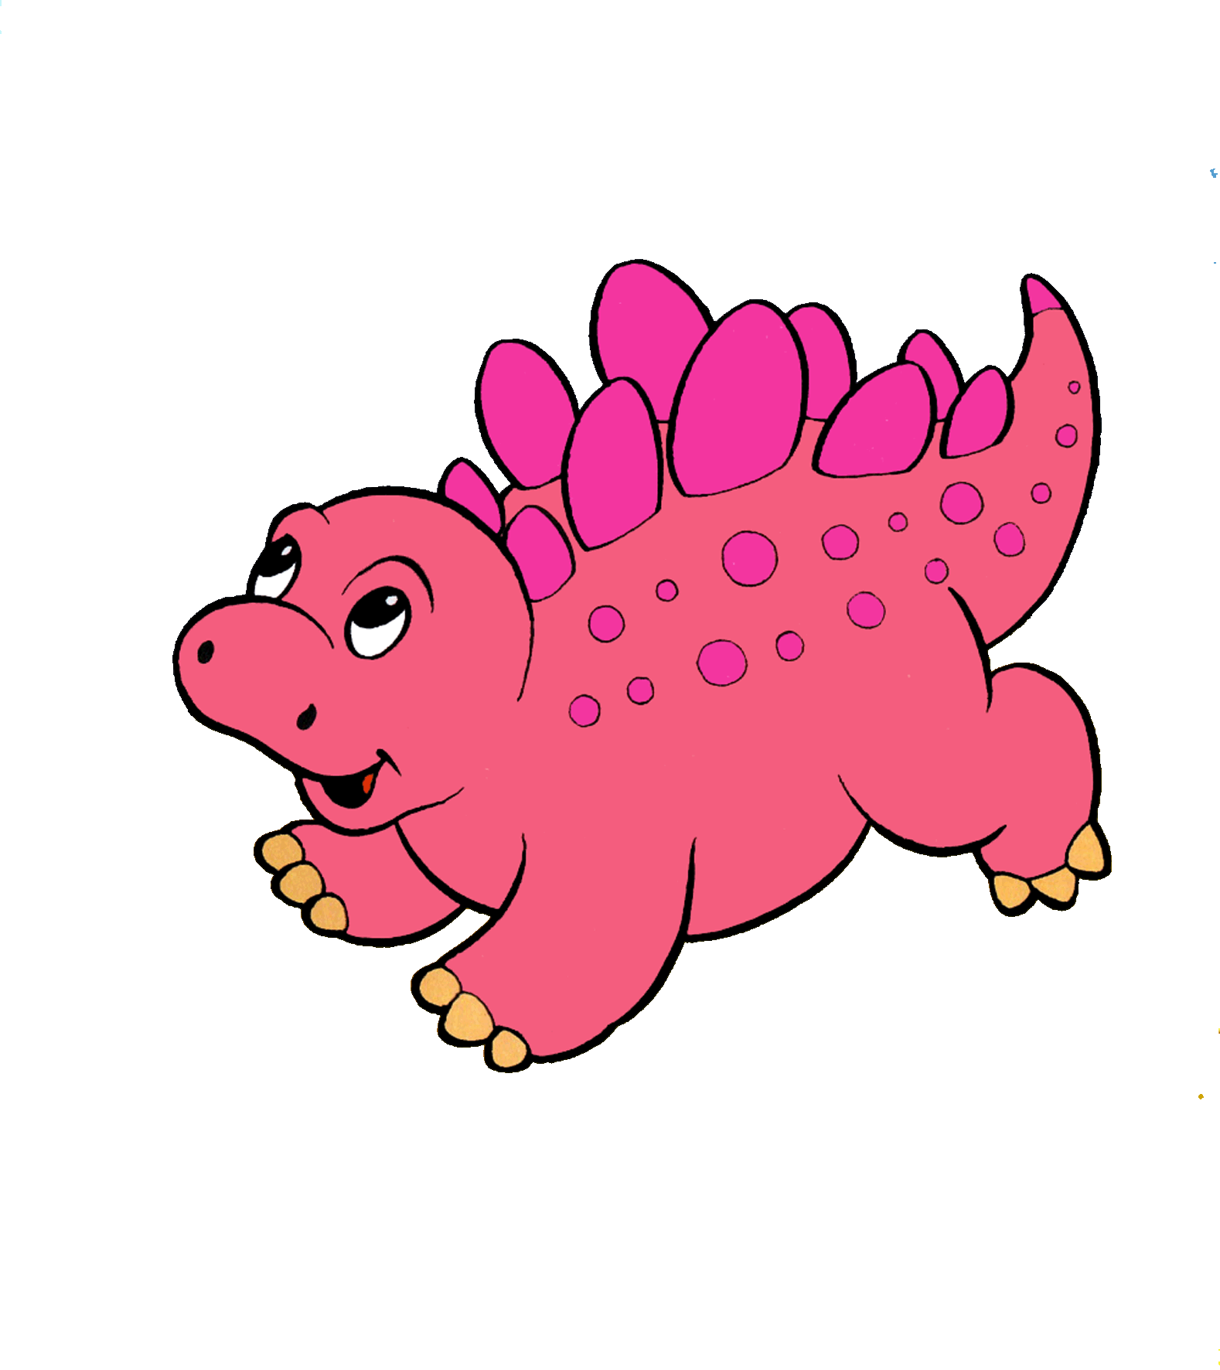
To be
Present Simple
Past Simple
I__________
I__________
it__________
it__________
He_________
He_________
She________
She________
You________
You________
We________
We________
You________
You________
They_______
They_______

Slide 4
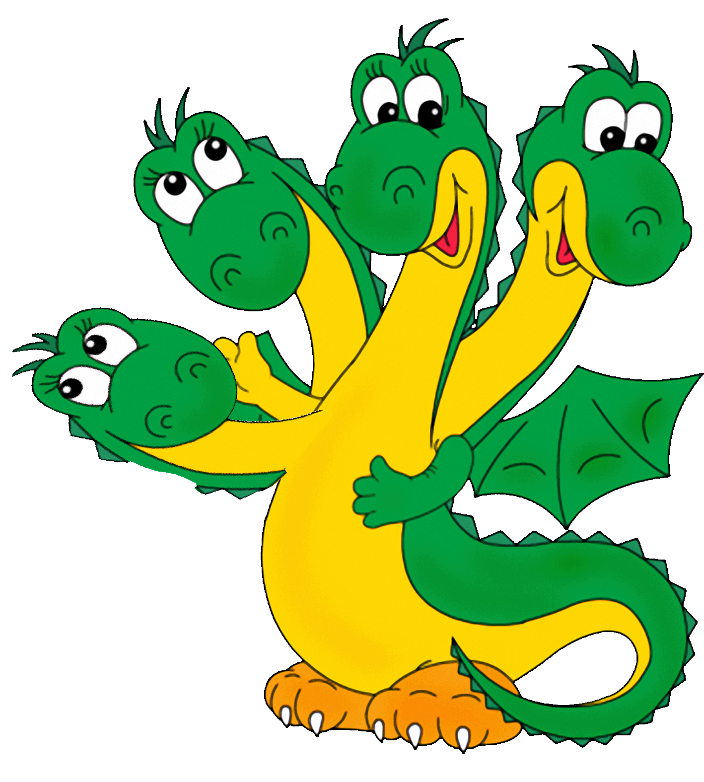
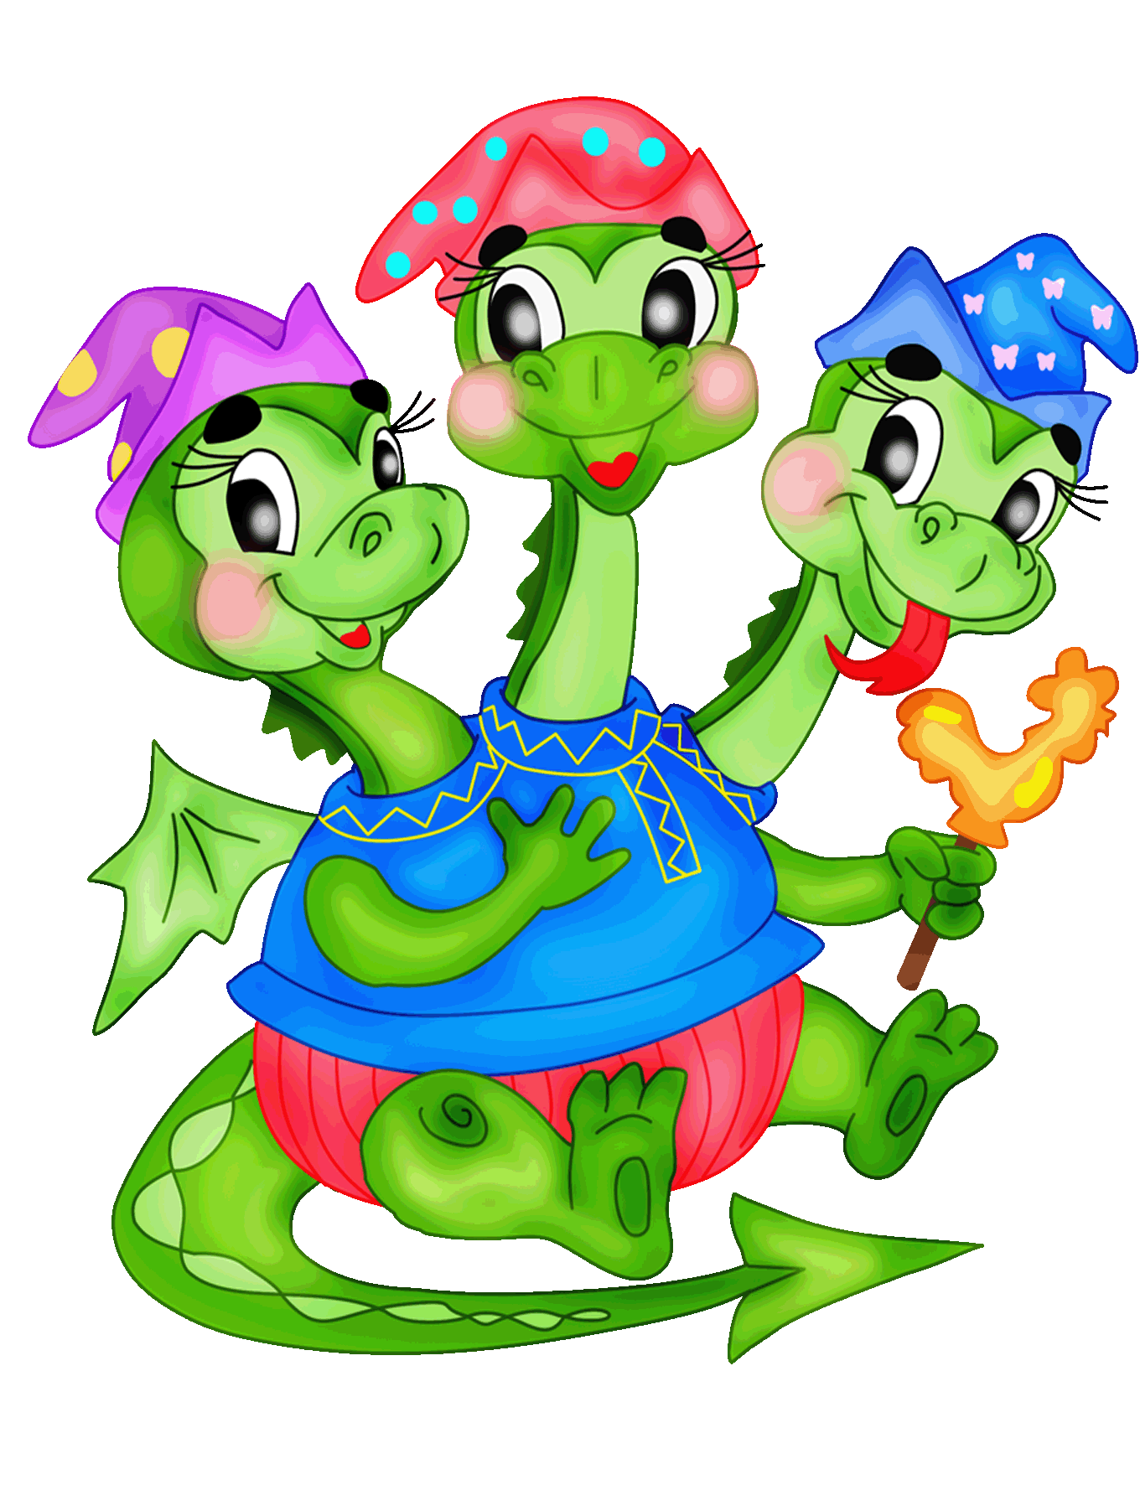
It
They
I
We
She
You
He
Was
Were

Slide 5
Yesterday
Last week
Last month
Last year
… days ago
… months ago
…years ago

Slide 6
10 дней назад,
вчера,
на прошлой неделе,
месяц назад,
в прошлом году,
пять лет назад.
в прошлом месяце,
ten days ago
last week
Yesterday
a month ago
last year
last month
five years ago

Slide 7
She busy yesterday.
was
You busy yesterday.
were
I _______in the park yesterday.
It _______ cold last month.
We _______ busy yesterday.
You _______ late for school yesterday.
They _______ happy yesterday.
She _______ home last summer.
was
was
were
were
were
was

Slide 8
She busy yesterday.
was
You busy yesterday.
were
Sister, I, at ,with, was, my, yesterday, home.
In, was, office, Monday, my, on, the, mother .
Were, best, weeks, they, friends, two, ago.

Slide 9
She was at school yesterday.
She at school yesterday.
was not/ wasn't
They were at school yesterday.
They at school yesterday.
were not/ weren't
1. It was warm yesterday.
2. You were busy yesterday.
3. We were happy yesterday.
4. I was late yesterday.
5. They were hungry yesterday.
It wasn't warm yesterday.
You weren’t busy yesterday.
We weren’t happy yesterday.
I wasn’t late yesterday.
They weren’t hungry yesterday.

Slide 10
Where
she
was
at home.
?
The party was great.
Was the party great?
They were in London.
Were they in London?
His parents were in the office.
Were his parents in the office?

Slide 11
She busy.
was
?
He was at home with my sister yesterday.
2) My mother was in the office on Monday.
3) They were best friends two weeks ago.

Slide 12
They were at home.
Where
they
were
at home.
?
Who
was
at home ?

Slide 13
Fill in the gaps. Use was or were.
They … here ten minutes ago.
He … at the cinema yesterday.
We … in Moscow last spring.
They … in the country last week.
It … many years ago.
I … at the theatre last weekends.

Slide 14
- Hi , where were you yesterday?
- I was in the shop.
- Oh! I was at home yesterday. I wasn’t well.
- My daughter wasn’t at school yesterday, because she wasn’t well either.

Slide 15
The End!

