Slide 1
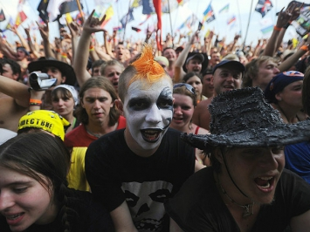
Being in a big crowd at a musical festival can be dangerous

Slide 2
The sound produced by powerful amplifiers does great damage to the nervous system

Slide 3
The rock and pop music deals with the young people’s world: their dreams, hopes, disappointments and joys. It attracts great masses of young people.

Slide 4
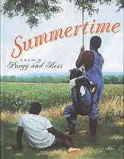
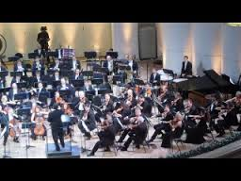
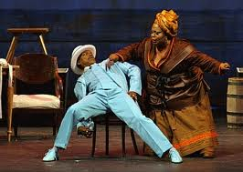

Slide 5
Из наслаждений жизни одной любви музыка уступает. Но и любовь – мелодия… А.С. Пушкин

