Slide 1
Read the names of the cities
Sydney
Paris
Los Angeles
Bangkok
Wellington
Bombay
Moscow
Prague

Slide 2
Read the names of the countries
Australia
France
India
Thailand
New Zealand
Czech Republic
Russia
The USA

Slide 3
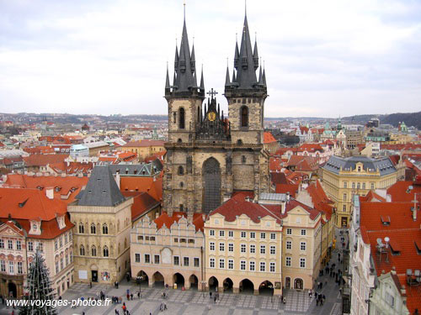
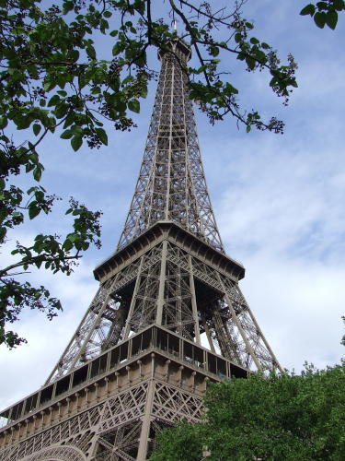
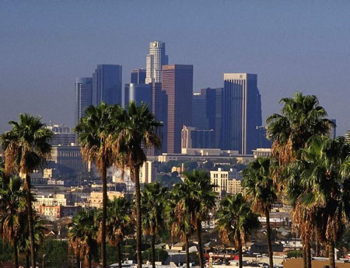
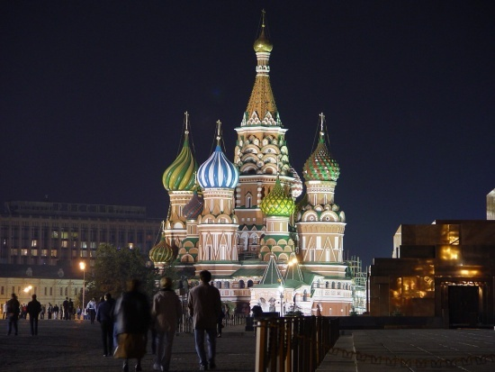
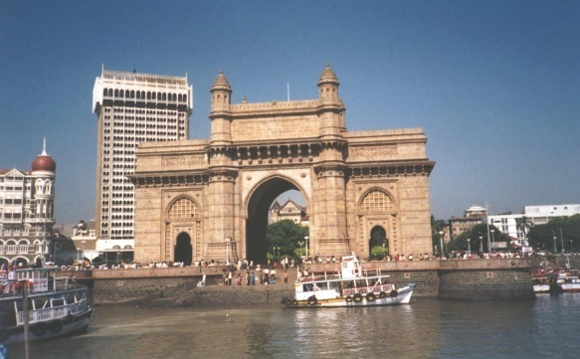
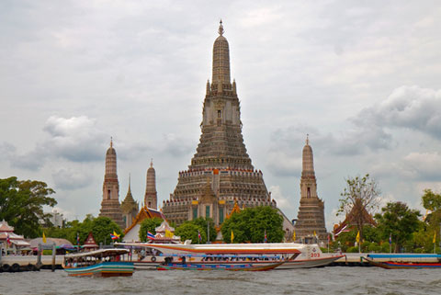
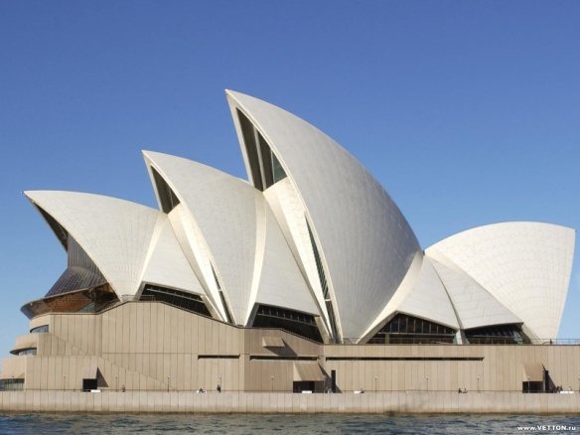
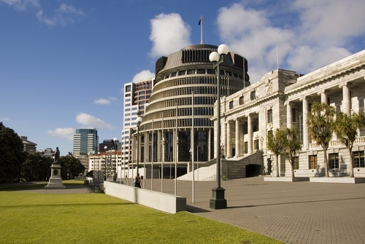
What city is it?
1.
6.
2.
4.
2. 7.
5.
3. 8.

Slide 4
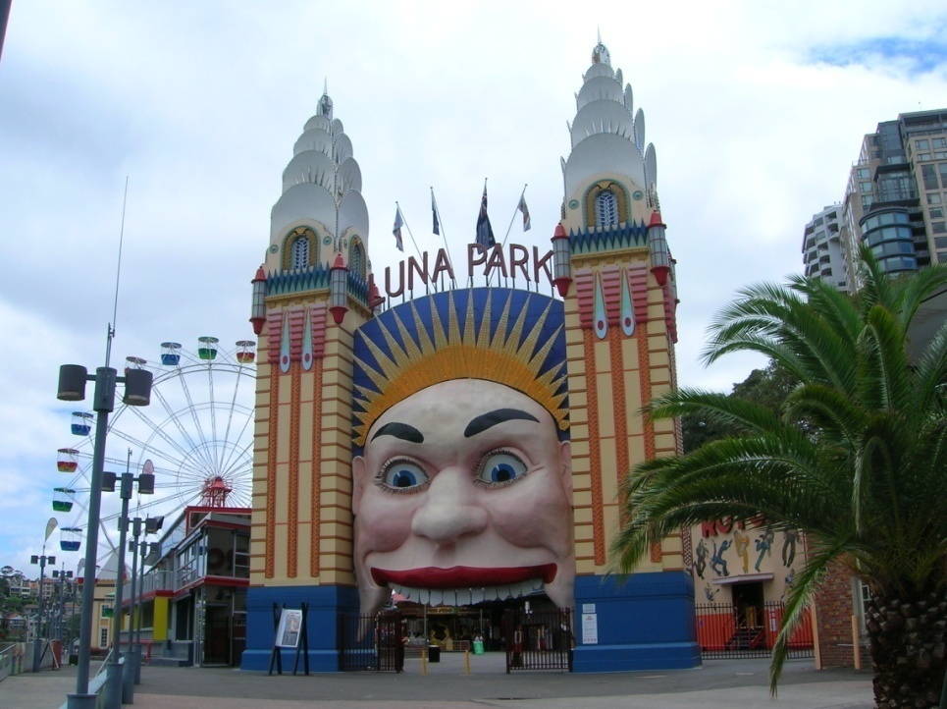
Sydney is the largest city in Australia

Slide 5
Los Angeles is the second largest city in the USA.

Slide 6
Bangkok is the capital of Thailand

Slide 7
Prague is the capital of Czech republic

Slide 8
Paris is the capital of France

Slide 9
Bombay is the largest city in India

Slide 10
Wellington is the capital of New Zealand. It’s the country’s second largest city and a main port

Slide 11
Moscow is the largest city in Russia

Slide 12
Check yourself
1. Moscow
2. Los Angeles
3. Bombay
4. Wellington
5. Paris
6. Prague
7. Sydney
8. Bangkok
1. -is the biggest city in India
2. -is the capital of Czeck Republic
3. -is the largest city in Australia
4. -is the capital of France
-is the second largest city in the USA
5. -is the largest city in Russia
6. -is the second largest city if New Zealand and a main port
7. -is the capital of Thailand

