Slide 1
HELLO! ¡Hola!

Slide 2
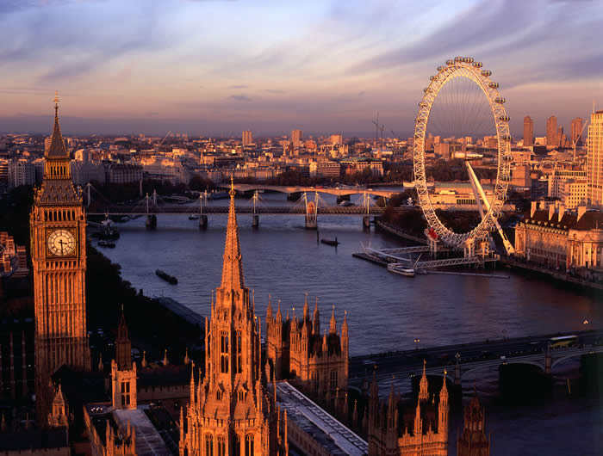
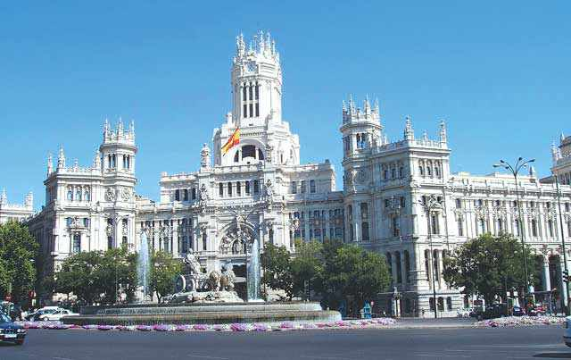

Slide 3
World is a book and those who don’t travel, read only one page st. Augustine.

Slide 4
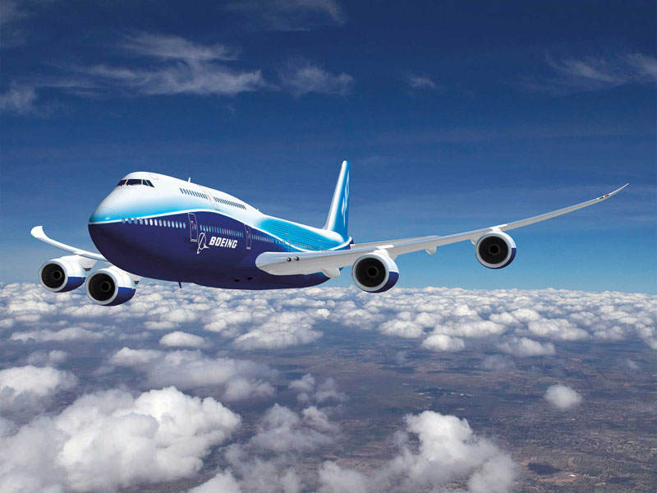

Slide 5
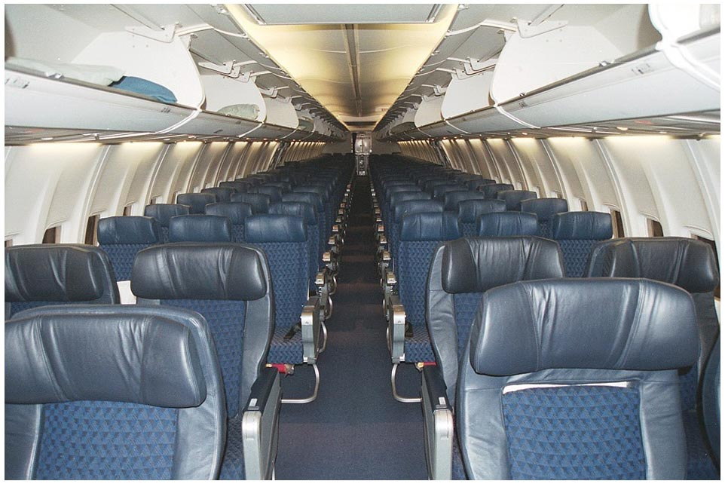
Fasten seatbealt ¡Abróchense los cinturones de seguridad!

Slide 6
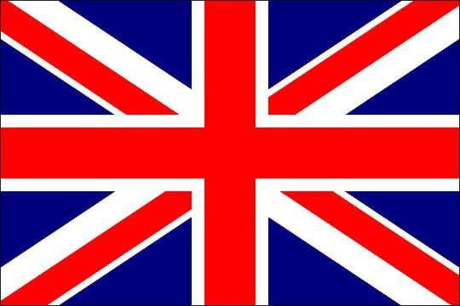
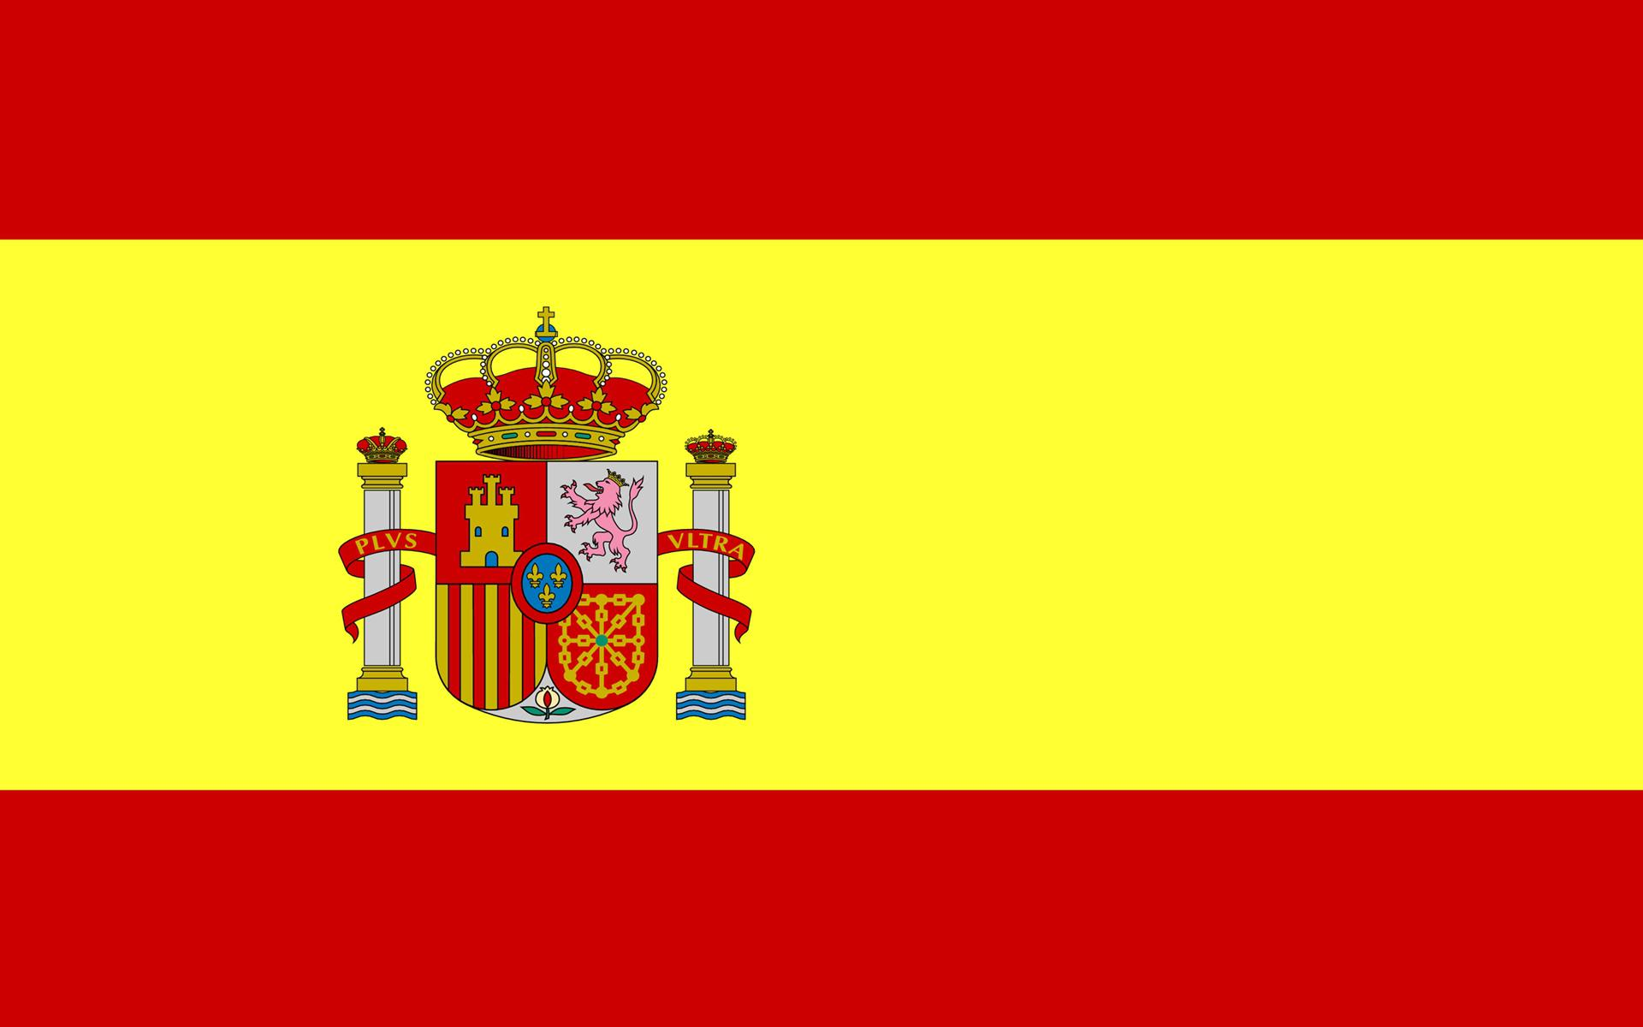

Slide 7
N | T | I | C | K | E | T | O | N | C
P | O | W | I | N | T | E | Y | W | I
L | L | C | O | U | N | T | R | Y | T
A | U | Y | E | A | T | H | A | R | Y
N | G | G | A | G | E | V | I | M | P
E | X | H | Z | V | B | J | L | O | R
D | R | T | C | N | O | W | W | K | I
Y | S | E | A | T | B | E | A | L | T
L | A | P | R | I | L | H | Y | M | Q
E | A | T | B | S | U | M | N | P | O

Slide 8
VIAJEDACAVIONOSFERROCARILENEQUIPAJECUEBILLETEQUPASAJEROZPILOTOSHEATRACCIONESECI

Slide 9
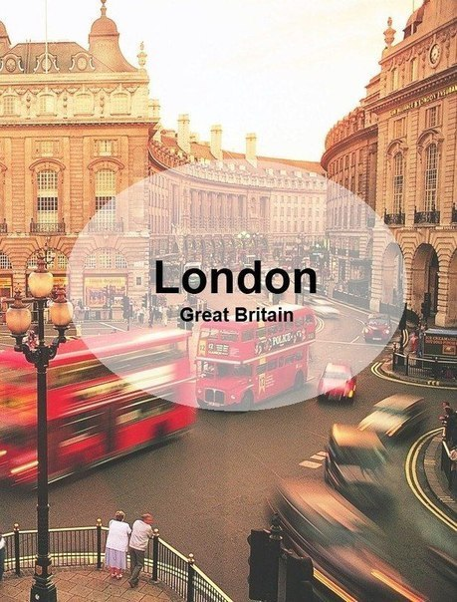
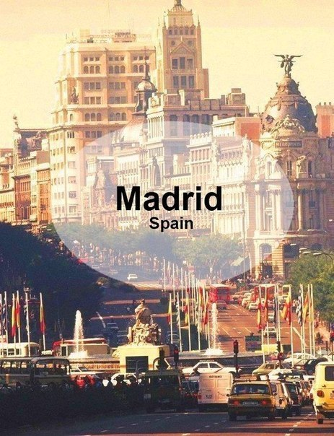
Music

Slide 10
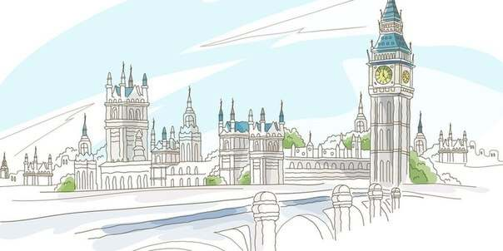
St. Paul’s Cathedral | a) is a bridge which rises in about one and a half thousand, gives the nice view of London
2. Buckingham Palace | b) is the geographical centre in London
3. Trafalgar square | c) is the official residence of the Queen
4. Tower Bridge | d) is the castle, which served as a citadel, a palace, a prison, an observatory in the history of London
5. The Tower of London | e) is the church where many great people were buried
6. Westminster Abbey | f) is the greatest church in Britain

Slide 11
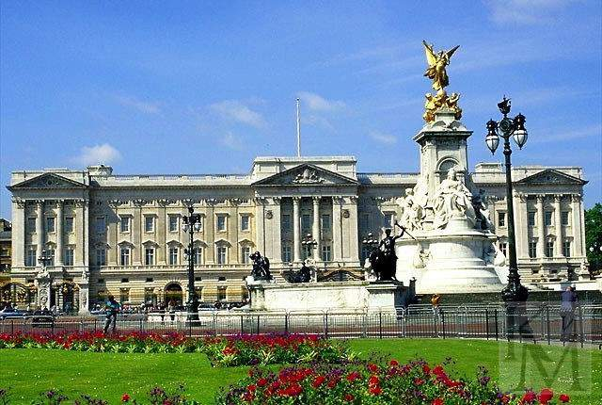

Slide 12
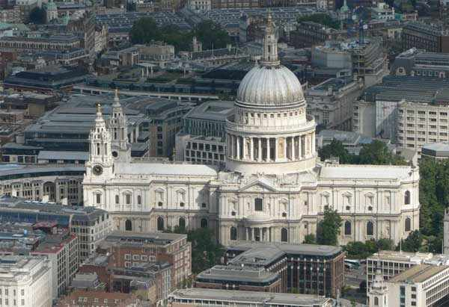

Slide 13
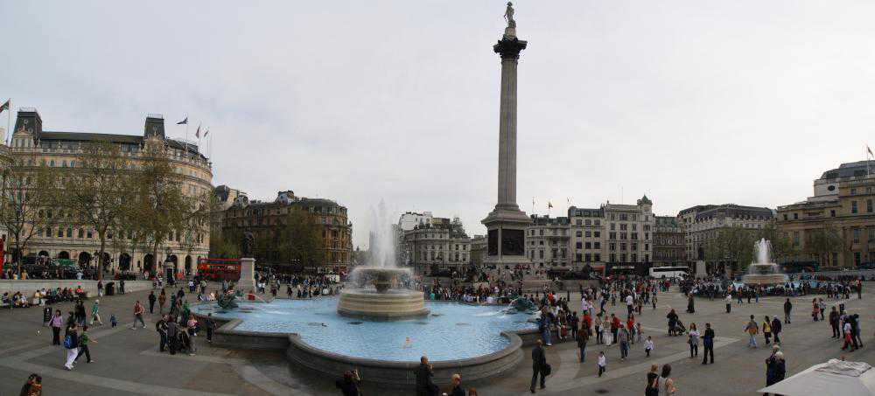

Slide 14
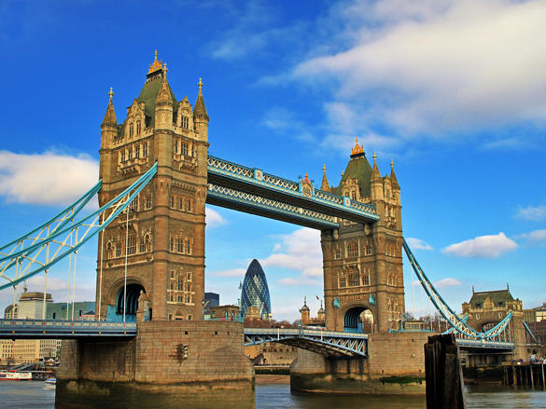

Slide 15
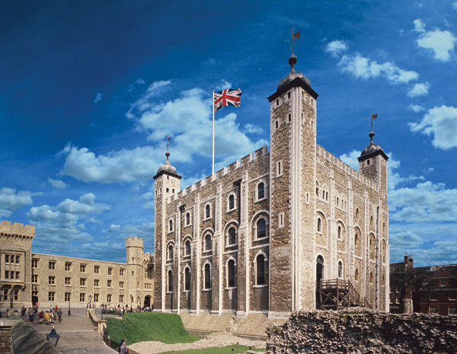

Slide 16
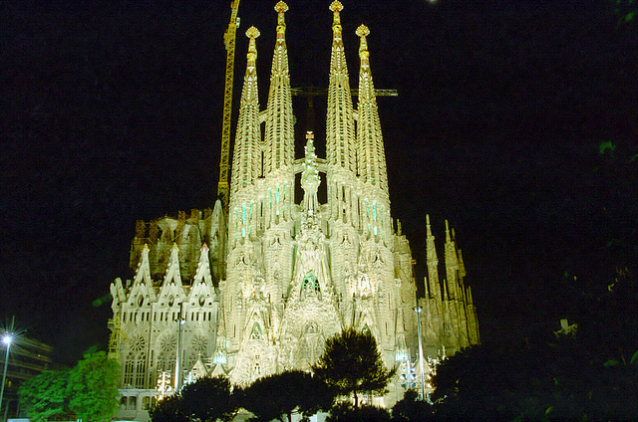
La Sagrada Familia

Slide 17
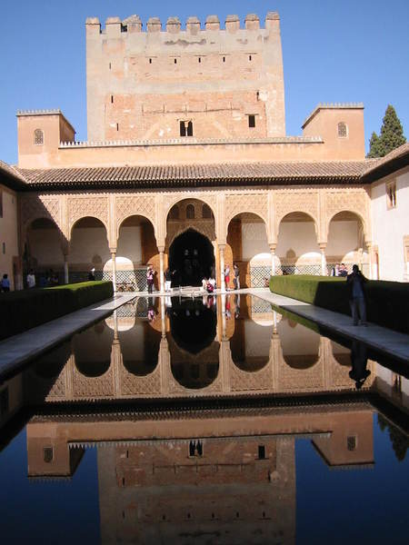
El alhambra

Slide 18
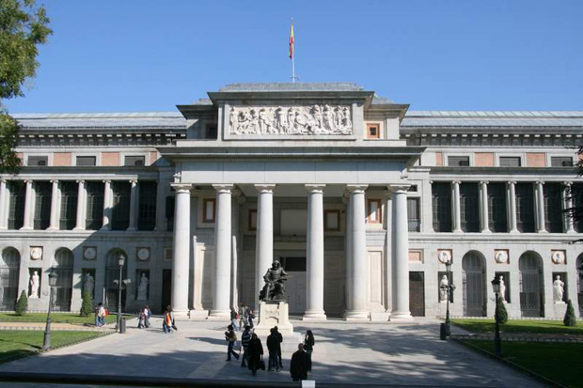
El museo del prado

Slide 19
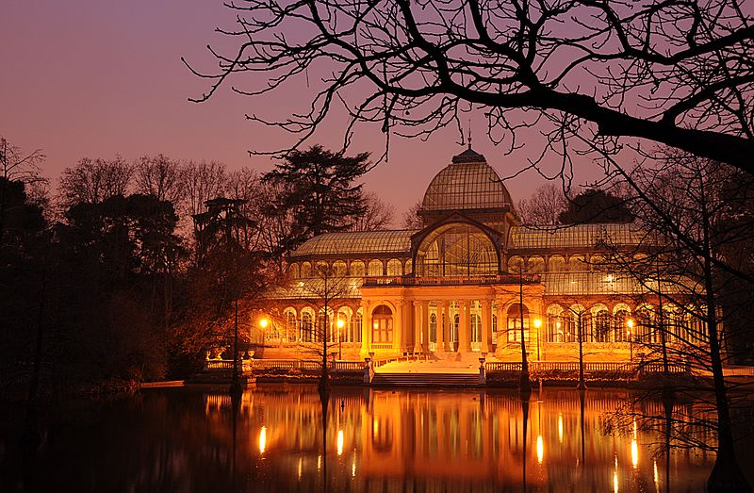
Palacio de cristal

Slide 20
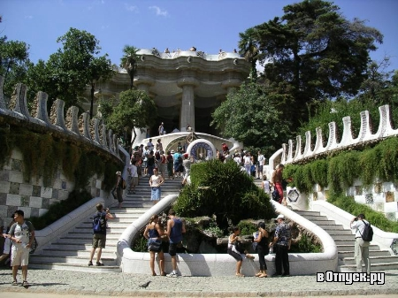
El parque guei

Slide 21
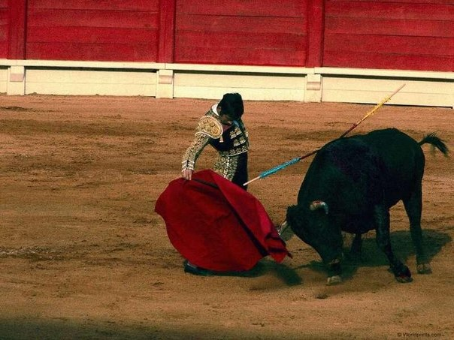
Corrida de toros

Slide 22
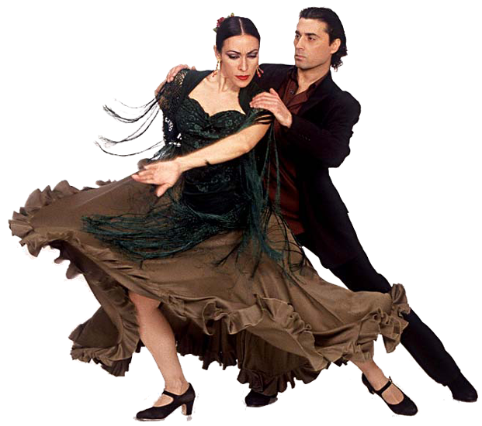
El flamenco

Slide 23
VIAJE
JOURNEY

Slide 24
Country quiz
1. What river does London stand on?
A) The Thames B) The Severn C) The Clyde
2. What’s the name of a man the monument to whom stands on Trafalgar Square?
A) Chaplin B) Nelson C) Cromwell

Slide 25
Country quiz
3. What is Big Ben?
A) A clock tower B) A clock face C) A bell
4. The traditional English Drink is
A) Coffee B) Cocoa C) Tea
5. What are the famous guards of the Tower of London Called?
A) Bobbies B) pearlies C) beefeaters

