Slide 1
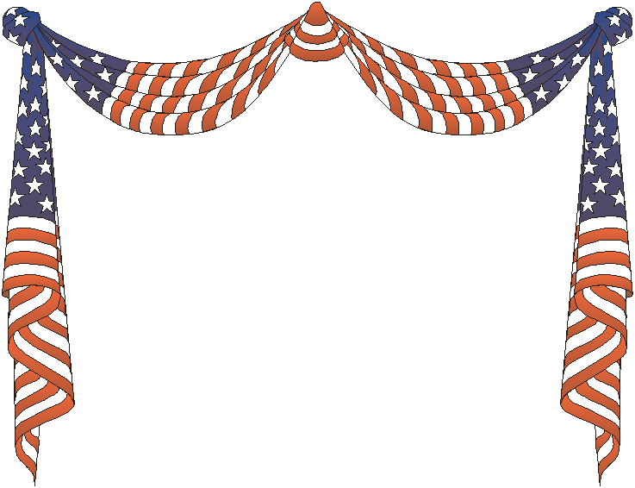
Welcome to Washington, D.C.

Slide 2
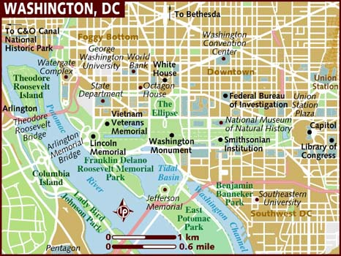

Slide 3
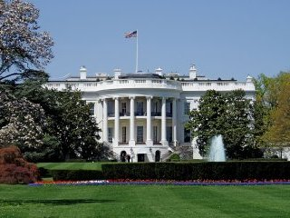
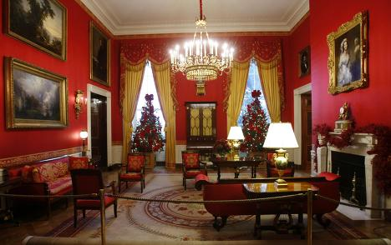
The White
House

Slide 4
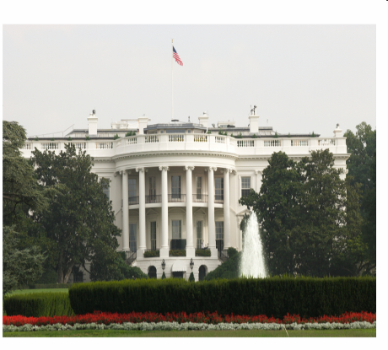
The White House
The White house is the official residence of the President.
President John Adams and his wife were the first to live there. It was in November 1800. The White House is the oldest building in Washington, D.C. It has the most famous address in the United States – 1600 Pennsylvania Avenue. There are 3 floors and 132 rooms in the White House. The rooms for public functions are on the first floor. The President and the First Family use the second and the third floor.

Slide 5
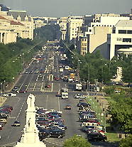
Pennsylvania Avenue
Avenue is one of the central streets in Washington. It is joined the Capitol and the White House.

Slide 6
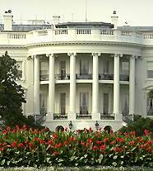
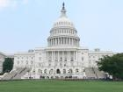
Washington is the residence of the President
and the Congress of the USA.
The Capitol
White House

Slide 7
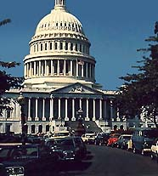
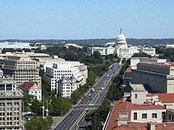
The capitol
The tallest building in Washington , D.C. , and the most famous building in the United States, because this is where laws are made. The Capitol is surrounded by a beautiful garden with many trees and flowers.

Slide 8
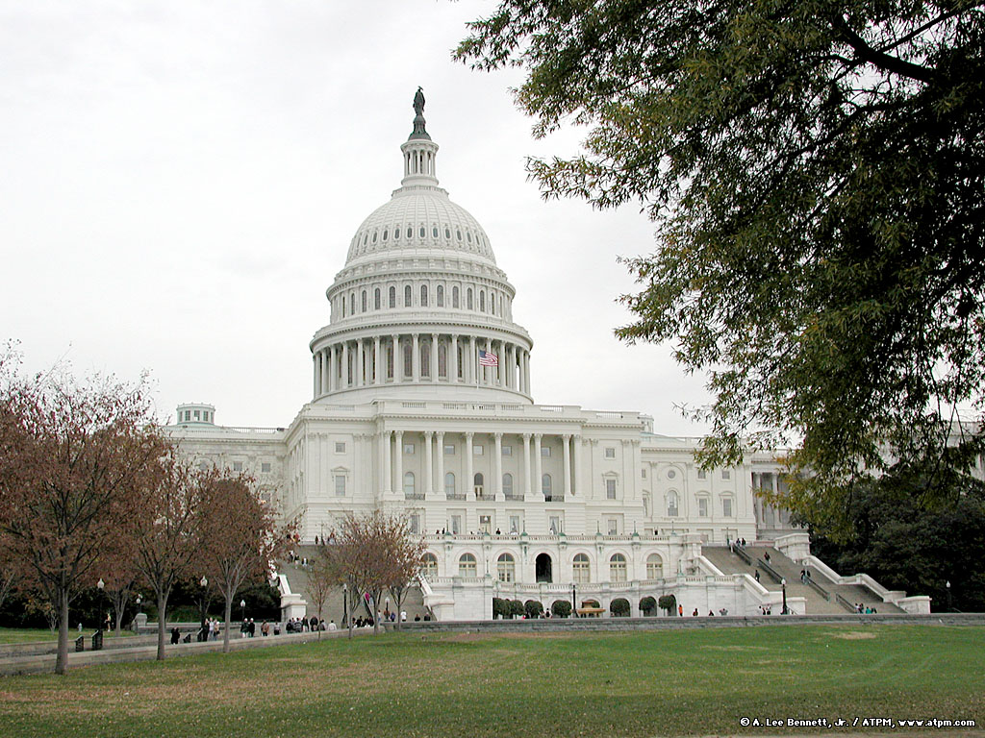
The Capitol

Slide 9
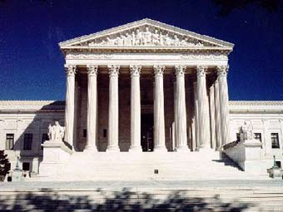
Supreme Court
This majestic building is the Supreme Court. This is where the laws are interpreted by the highest judges in the United States.

Slide 10
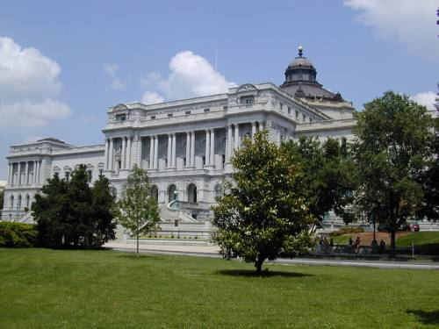
Library of Congress
Not far from the Capitol is the Library of Congress, the largest library in the States. It contains more than 13 million books, more than 19 million manuscripts, including the personal papers of the US presidents.

Slide 11
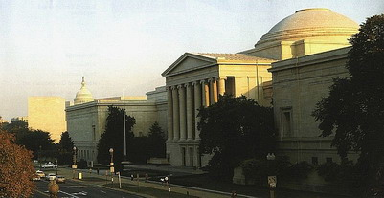
The national Gallery of Arts
The National Gallery of Arts is the finest museum. This museum is a part of Smithsonian Institution. It was found in 1941

Slide 12
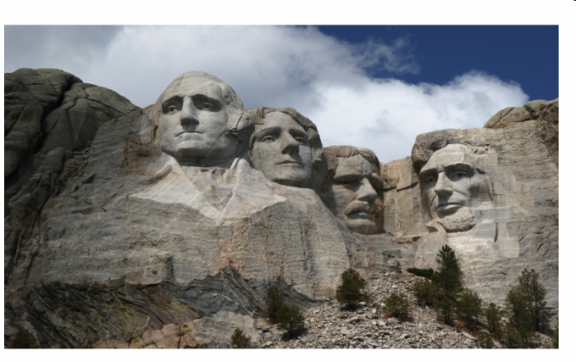
The sixty-feet high busts of Washington, Jefferson, Theodore Roosevelt, and Lincoln on the granite cliffs of Mount Rushmore, in South Dacota, are the work of sculptor Gutzon Borglum (1867-1941). After his death his son Lincoln, and a team of helpers finished this work.
The monument attracts thousand of visitors each year.

Slide 13
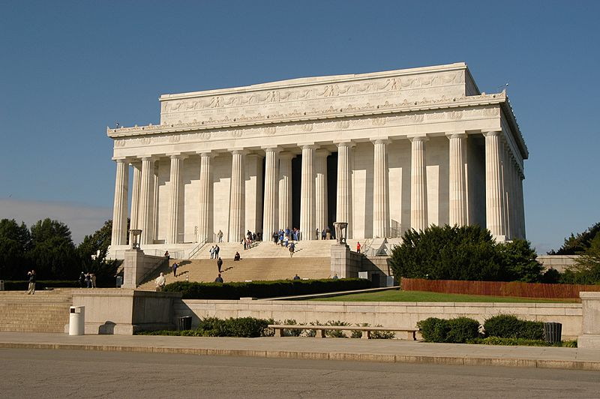
The Lincoln Memorial

Slide 14
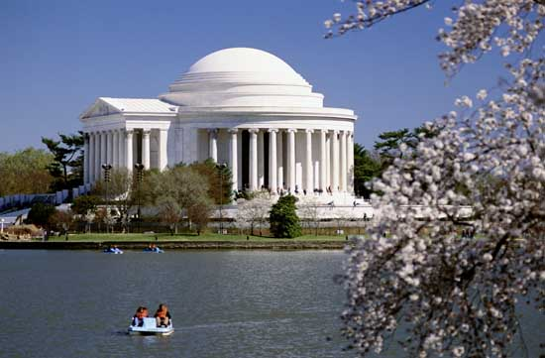
The Jefferson Memorial

Slide 15
Washington, D.C.
It stands on the Washington River Potomac. George Washington chose it to be the nation’s capital on December 1, 1800. The district D.C. is named after Columbus who discovered America in 1492.
Washington, D.C. is one of the most beautiful and unusual cities in the USA. No building in the city may be is more than 40 meters tall.
Washington, D.C. is the seat of federal government and there is the White House, the official residence of the President. President John Adams and his wife were the first to live there. It was in the November 1800. The White House is the oldest building in capital Washington, D.C. It has the most famous address in the United States -1600 Pennsylvania Avenue.
There are 3 floors and 132 rooms in the White of House. The rooms for public functions are on the first floor. The President and the First Family use the second and the third floor.
The United States Capitol is the tallest building in the Washington, D.C. and the most famous building in the USA because this is where the laws are made.
Washington, D.C. doesn’t belong to any state USA. It is a city and a district – the District of Columbia ( D.C.). The state of Washington is in the north – west of the USA. Washington, D.C. is on the East Coast.

Slide 16
Washington
D.C.
is
the
capital
of
the
USA.

Slide 17
Тренировочные задания.
1. вспомните 3 формы неправильных глаголов.
do
take
write
begin
speak
swim
eat
read
run
come
Did done
Took taken
Wrote written
Began begun
Spoke spoken
Swam swum
Ate eaten
Read read
Ran run
Came come

Slide 18
2. Измените предложения используя Present Perfect
по образцу.
Open the window, Kate.
I have already ( just) opened it.
Ann is buying a new hat. ( Kate.)
Kate has already ( just) bought it
Water the flowers!
Cut the bread please.
These boys are playing football. ( those boys).
I am drinking tea. (Granny).
Do your home task, Alice.
My sister is looking through the newspaper. ( my father).
They are having dinner. ( we).
Father, give Fred the magazine, please.

Slide 19
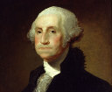
George Washington
George Washington was the first person to be elected the President of the United States. He was born in Virginia, just south of Washington, D.C.
In 1791 George Washington chose the place for a capital city. He thought it was a good place because the Potomac River was deep enough for ships to come to the city.

Slide 20
THANK YOU, good bye

