Slide 1
«Звёздный час»
“ The Star Hour”
3 класс, УМК «HappyEnglish.ru»,
К.Кауфман, М.Кауфман
Подготовила Банбан Я.М.
учитель английского языка
МБОУ СОШ г.Пионерского

Slide 2
1
2
3
We need 4 or 5 groups of 3 pupils.
Read the questions and choose the answer.
Show your answers with the number cards.
Get the star for the right answer.
The group with the most number of stars is
the winner!

Slide 3
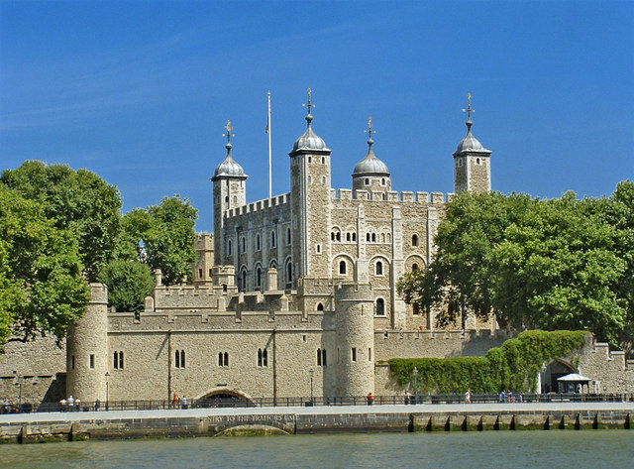
1.What’s this?
1.Tower Bridge
2. London Eye
3.Tower of London

Slide 4
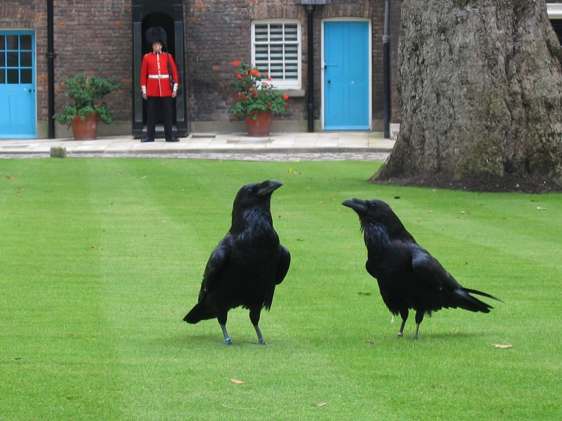
2. Who lives in the Tower of London?
1. Mice
2. Ravens
3. Cats

Slide 5
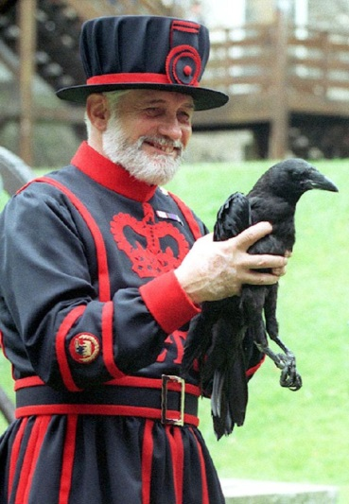
3. They feed and take care of
the ravens.
b. .f . at . rs
beefeaters
1. e e e e
2. e a e a
3. i e a e

Slide 6
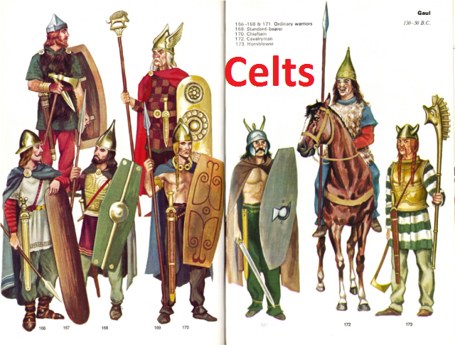
4. Who lived on the British Islands?
1. Romans
2. Saxons
3. Celts

Slide 7
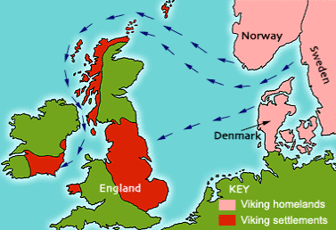
5. Where did the Vikings come from?
1. Франция
2. Скандинавия
3. Италия

Slide 8
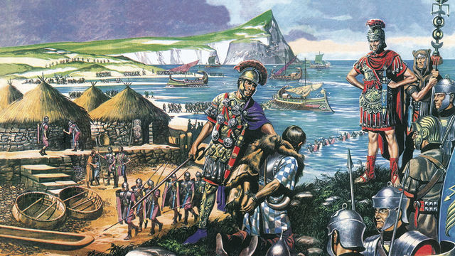
6. Кто из завоевателей Британских
островов начал строить Лондон?
1. Celts
2.Romans
3.Normans

Slide 9
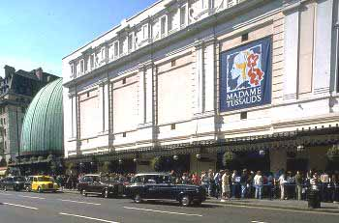
7. Кто основал музей, в котором
выставлены сотни восковых фигур
самых известных людей?
1. Queen Elizabeth II
2.Presedent of America
3. Madame Tussaud’s

Slide 10
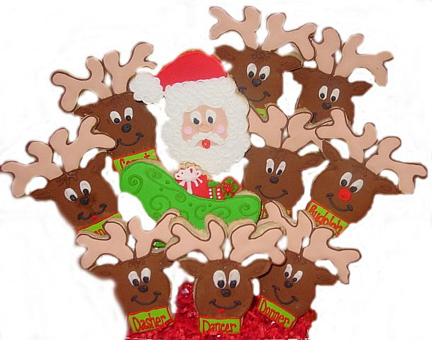
8. How many reindeer are there in
Santa’s sleigh?
1. Nine
2. Seven
3. Ten

Slide 11
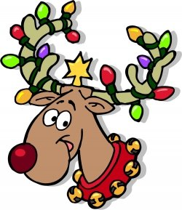
9. What has Rudolph got?
1. The brown tail
2. The blue eyes
3. The red nose

Slide 12
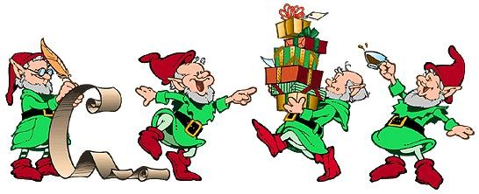
10. Who helps Santa with the
presents?
1. Boys and girls
2. Gnomes and elves
3. Rabbits and foxes

Slide 13

11.What’s this?
C . r . s . m . s t . e .
1. h i t o r i
2. h i t a r e
3. k e t a h e
Christmas tree

Slide 14
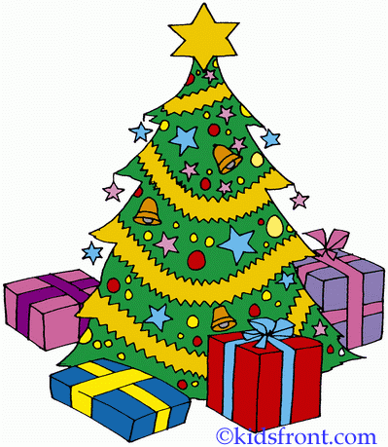
12. What is there on
the Christmas tree?
1. Reindeer and gnomes
2. Toys and presents
3. Stars and toys

Slide 15
13. Read the words with
the sound [ ʤ ]
1. age, give, gym
2. girl, gentle, cottage
3. age, page, agent

Slide 16
14. Read the words with
the sound [ a: ]
1. task, mat, table
2. fast, class, distance
3. happy, chant, ask

Slide 17
15. Read the words with
the sound [ əu ]
1. town, cover, blow
2. slow, snow, house
3. narrow, jow, window

Slide 18
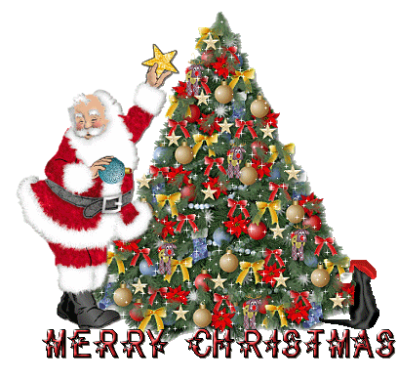

Slide 19
В презентации использованы изображения сети Интернет

