Slide 1
Museums in Kazakhstan

Slide 2
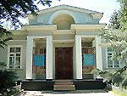
Zhambyl Zhabayev Literary Museum

Slide 3
Zhambyl Zhabayev Literary Museum was established in 1947. The Museum demonstrate visitors the literary heritage of the famous Kazakh akyn.

Slide 4
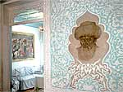
It was established in 1947.

Slide 5
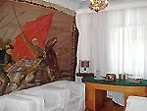

Slide 6
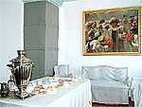
The house where
the akyn lived

Slide 7
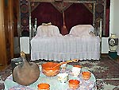
In this house akyn lived in 1936-1945

Slide 8
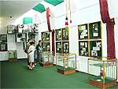
Every year thousands of people visit the museum to see the literary heritage of famous akyn.

Slide 9
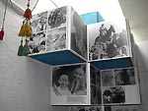

Slide 10
The State Book Museum

Slide 11
The State Book Museum
It was founded in Almaty in 1977.It`s exhibition shows the history of Kazakh writing and book printing.

Slide 12
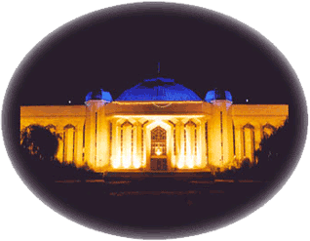
CENTRAL STATE MUSEUM OF THE REPUBLIC OF KAZAKHSTAN

Slide 13
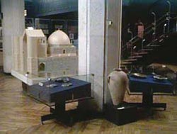

Slide 14
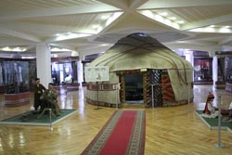
A “yurt”-the traditional Kazakh home

Slide 16
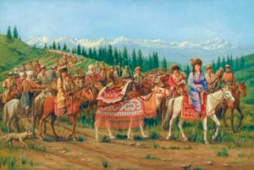
Kazakh were nomad people

Slide 17
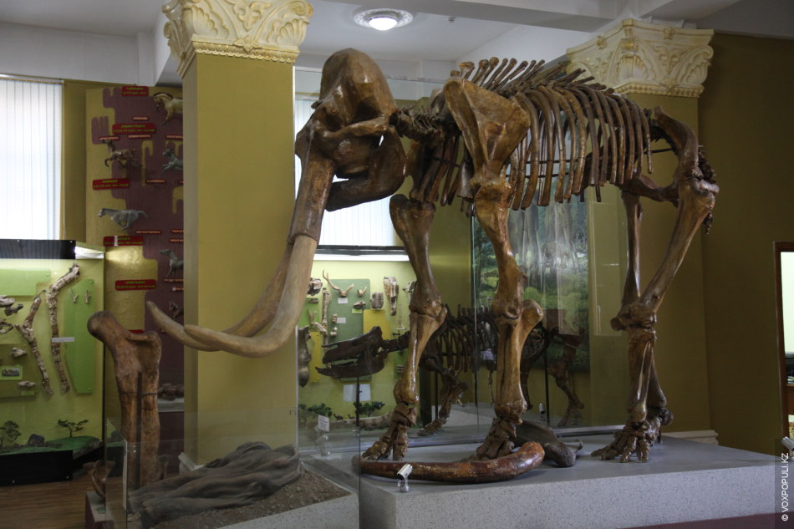

Slide 18
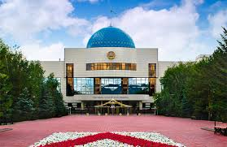
The Presidentsmuseum

