Slide 1
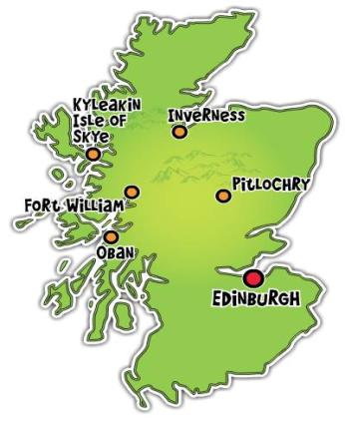
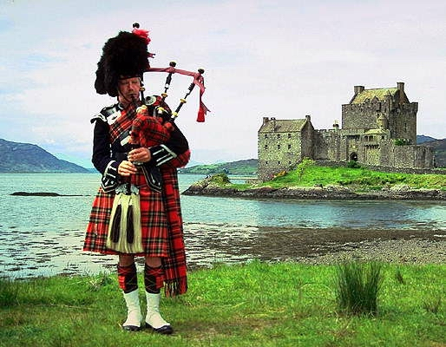
SCOTLAND THE BEAUTIFUL

Slide 2
Key question:
Why do you think Scotland is a great country?

Slide 3
What will you do?
Firstly
Secondly
Thirdly
ask and answer questions
After that
try to speak about Scotland
make a guided tour
Finally
revise the words
read and learn more about Scotland

Slide 4
Athens of the North
striking
Athens
busy
Edinburgh
a bagpipe
Glasgow
symbol
Highlands
smart
modest
The Castle
Lowlands
military tattoo
festival
computer
the thistle
the enemy
devotion
Sir Walter Scott
Princes Street
prosperous
Holyrood Palace
mountains
The Clyde Valley
The Clyde
picturesque
achievement
The Cannongate
The Royal Mile
telephone
monument
The Scott Monument

Slide 5
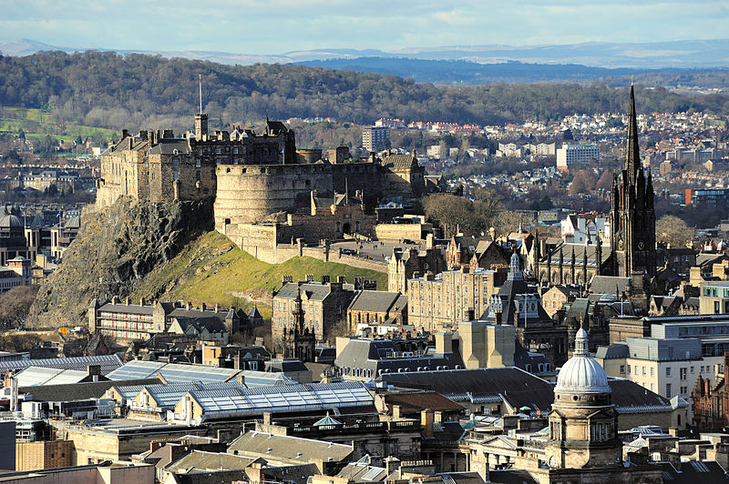
The Castle
is situated on the huge rock that stands high above Edinburgh.

Slide 7
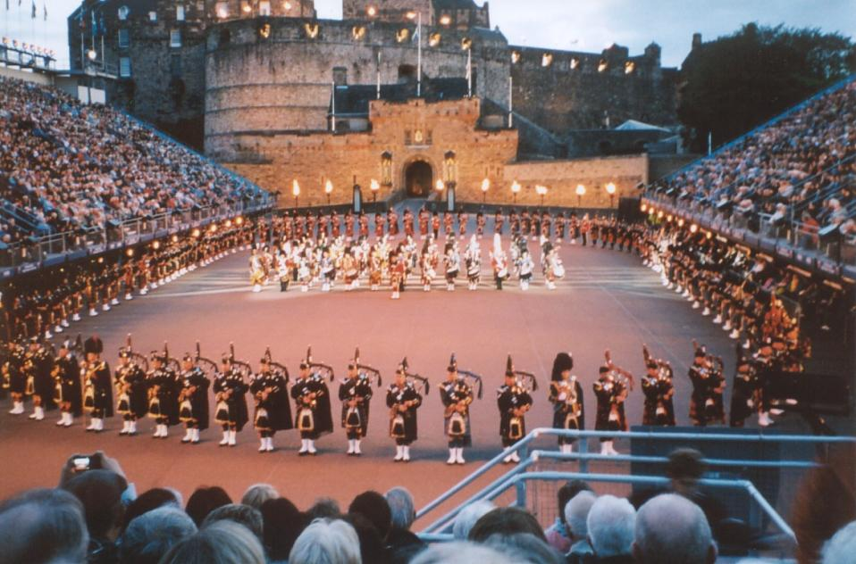
For 90 minutes on five or six nights a week, 600 people perform in the square in front of the Castle.

Slide 8
The performers play military music and march to it.

Slide 9
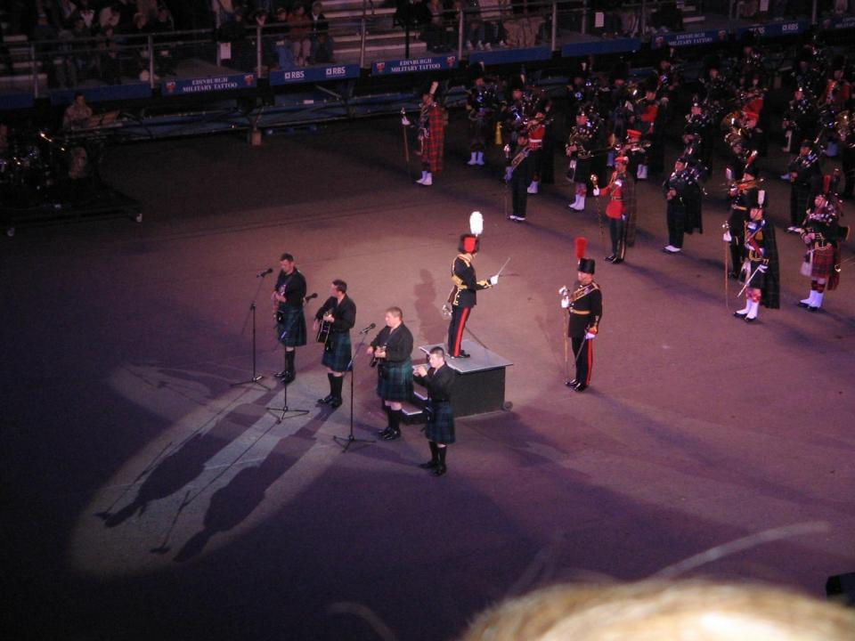

Slide 10
Edinburgh festival
The Edinburgh Festival is a collective term for many arts and cultural festivals that take place in Edinburgh, each summer, mostly in August. It is the largest annual cultural festival in the world.

Slide 11
The festival started in 1947. Every year the best performances are shown in Edinburgh.

Slide 12
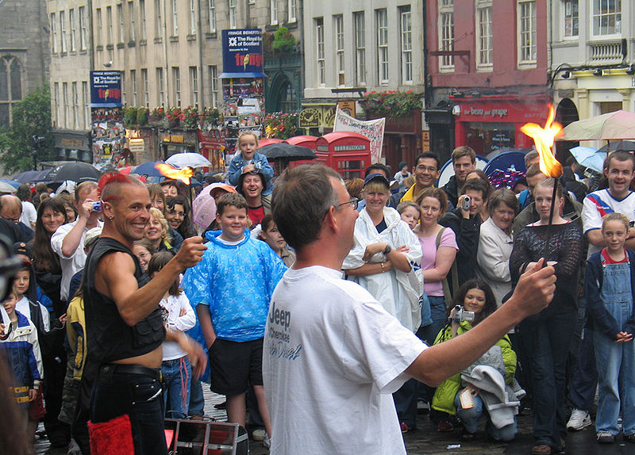
Edinburgh Festival Fringe
The original, and still the largest, component festivals are the Edinburgh International Festival and the Edinburgh Festival Fringe

Slide 13
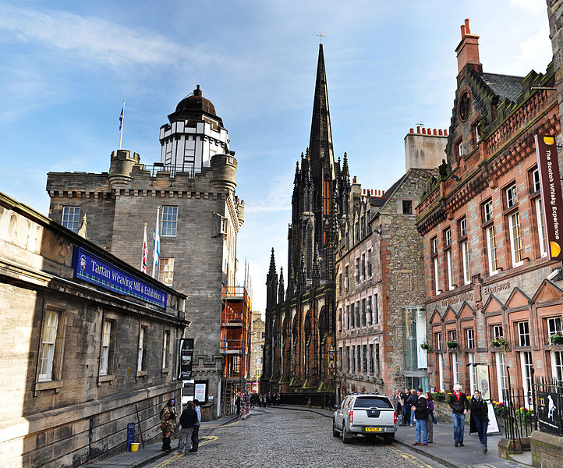
The Royal Mile
is a line of streets, which runs from the Castle to the Holyrood Palace

Slide 14
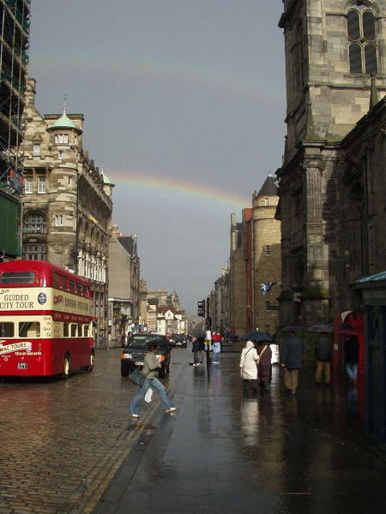
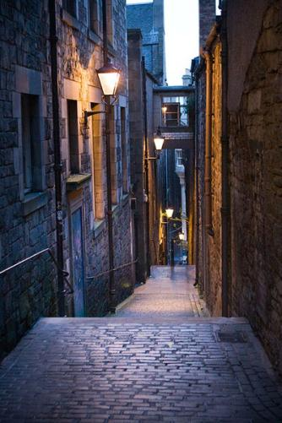
Much of the Royal Mile is laid with granite setts, as seen in this view looking east down the High Street past the old Tron Kirk. In this picture, above the Royal Mile can be seen a double rainbow.

Slide 15
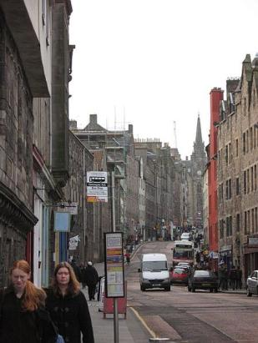
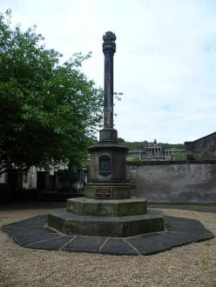
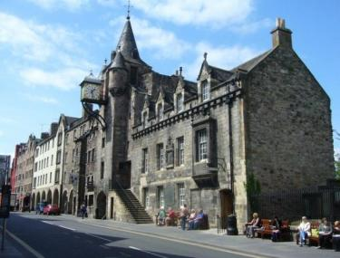
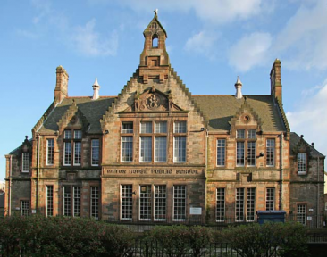
The Cannongate
The most picturesque part of the Royal Mile is the Cannongate. It is a small but important district at the heart of Edinburgh.

Slide 16
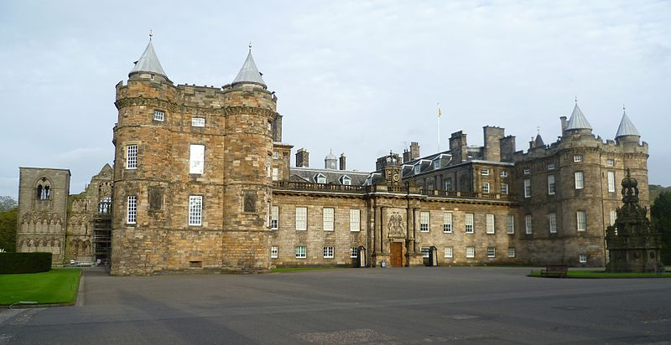
is the official residence of the Monarch of the United Kingdom in Scotland. It is located at the bottom of the Royal Mile in Edinburgh.
Holyrood Palace

Slide 17
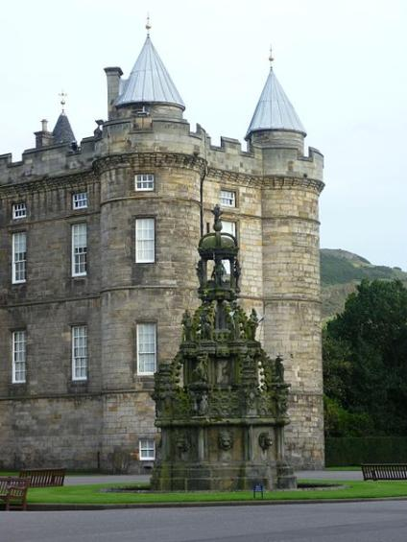
Holyrood Gate
Forecourt fountain

Slide 18
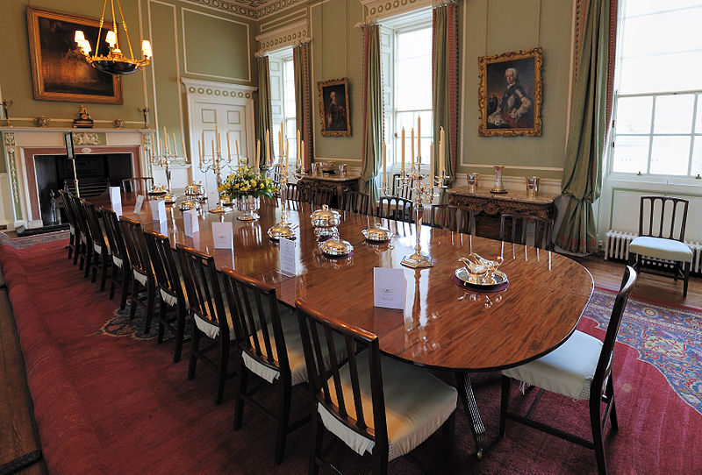
Royal Dining Room

Slide 19
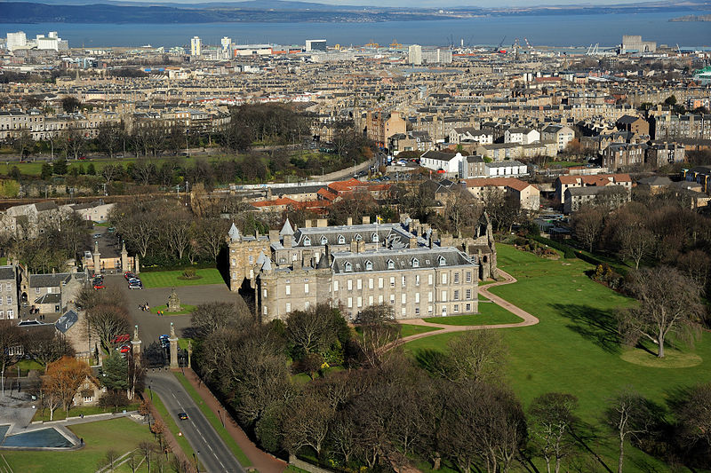
Holyrood Palace and Abbey

Slide 20
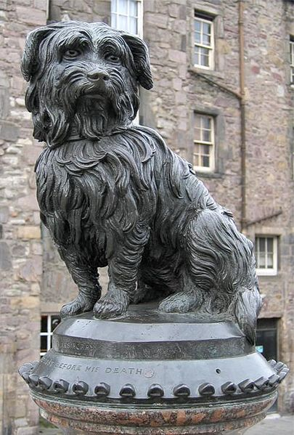
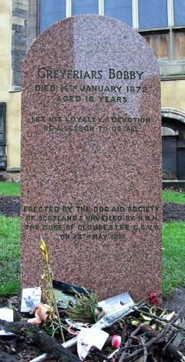
A symbol of devotion Greyfriars Bobby
One of the most modest and yet one of the best known monuments in Edinburgh is a monument to a dog called Bobby. The dog spent 14 years guarding the grave of his owner until he died himself on 14 January 1872.
Bobby's headstone in Greyfriars Kirkyard

Slide 21
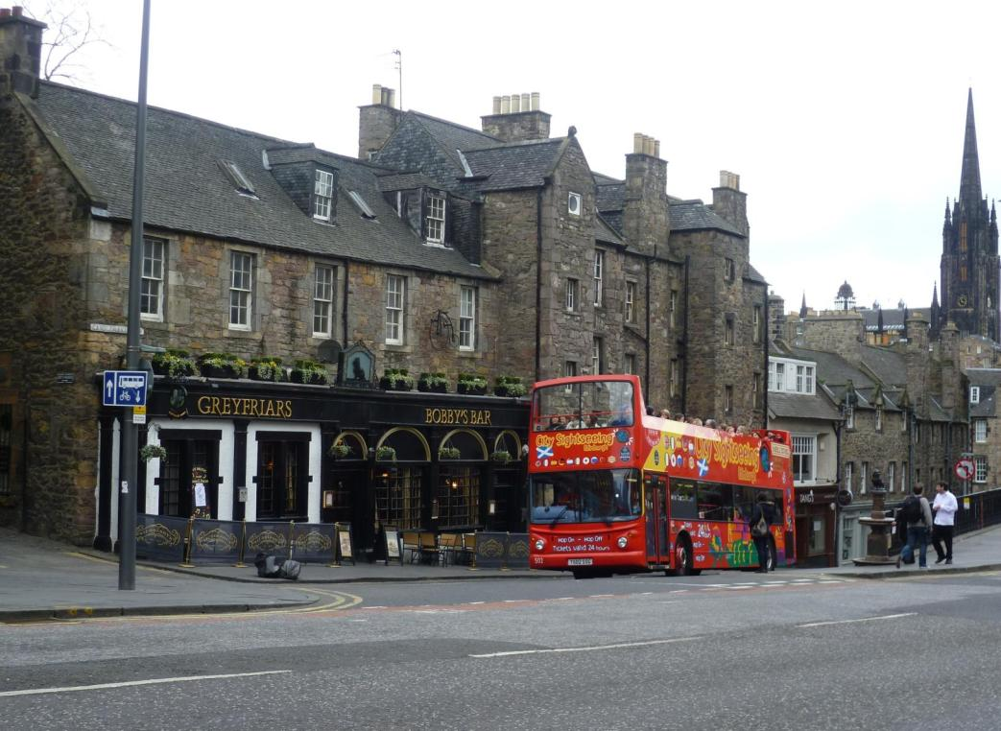
Greyfriars Bobby's Bar. Two men are passing the statue, lower right.

Slide 22
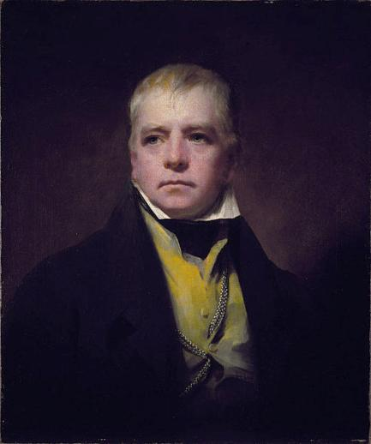
Walter Scott (1771 –1832)
Sir Walter Scott was a Scottish historical novelist, playwright, and poet, popular throughout much of the world during his time.
His novels and poetry are still read, and many of his works remain classics of both English-language literature and of Scottish literature. Famous titles include Ivanhoe, Rob Roy, The Lady of the Lake, Waverley, The Heart of Midlothian and The Bride of Lammermoor.

Slide 23
Key question:
Why do you think Scotland is a great country?

Slide 24
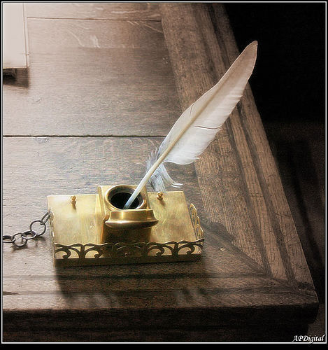
Thanks
a lot for your attention and work!

