Slide 1
Hello, friends!
English Language Lesson
“Parts of the Body”
3rd Form
Teacher: Tatiana Mikhailovna Naumenko

Slide 2
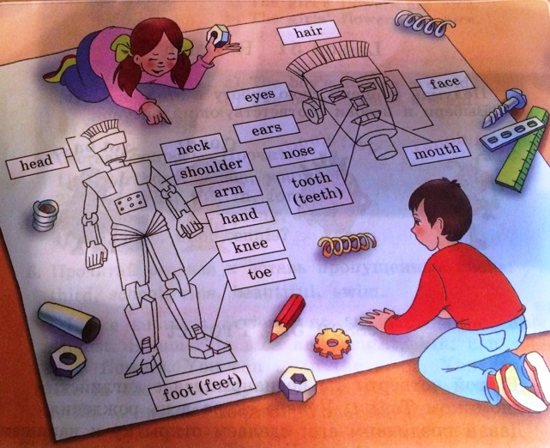
Parts of the Body

Slide 3
Parts of the body
Face
Nose
Ears
Eyes
Tooth
Toe
Neck
Mouth
Teeth
Head
Shoulder
Knee
Hand
Arm
Hair

Slide 4
Make up a word combination!
Adjectives (прил.)
Big
Long
Short
Nice
White
Black
Kind
Clean
Red
Beautiful
Angry
Nouns (сущ.)
Nose
Ears
Eyes
Feet
Head
Hair
Mouth
Leg
Hand
Arm
Teeth
Face

Slide 5
Make up a sentence about yourself!
Example:
I have got a head, two eyes, one nose, one mouth, … .

Slide 6
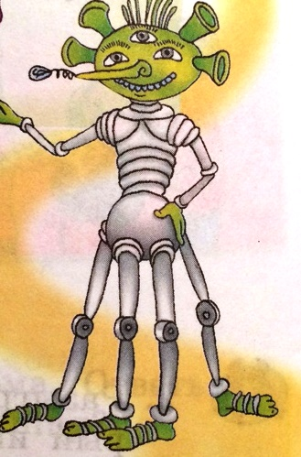
Tell us about your friend from another planet!

Slide 7
Compare!
I have got… = I have…
You/We/They have got… = You/We/They have…
He/She/It has got… =
He/She/It has…

Slide 8
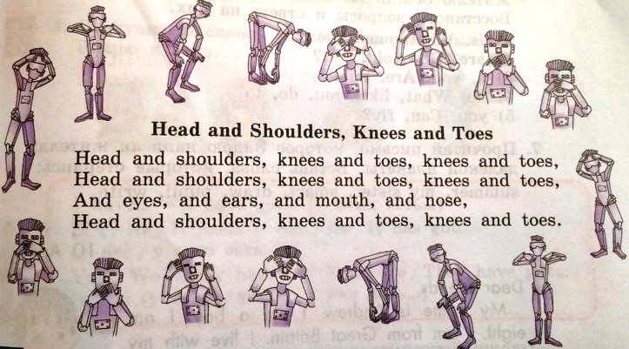
Head and shoulders, knees and toes
Let’s have a rest a little bit and do some sport exercises!

Slide 9
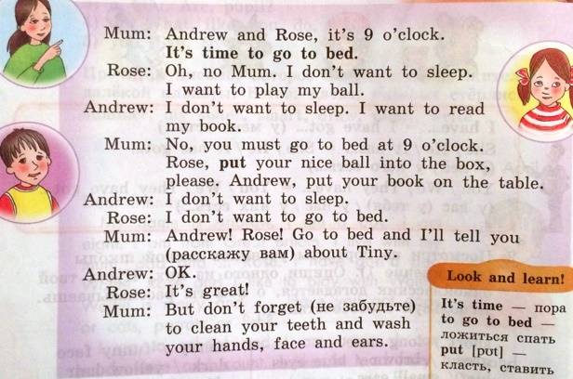
Let’s read the dialogue!

Slide 10
HOMEWORK:
Повторять изученные слова по теме «Части тела», повторять правило со стр. 47.

Slide 11
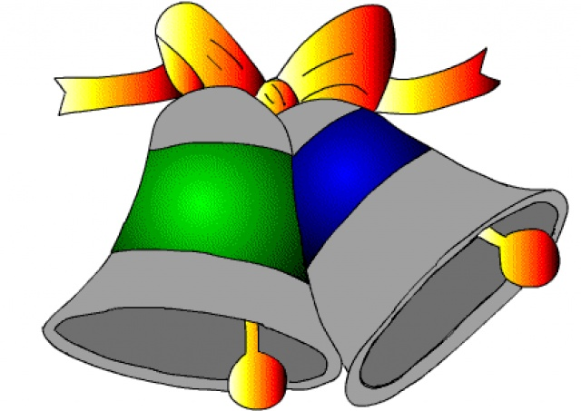
Thanks for the lesson!

