Slide 1
ТУРНИР
ЗНАТОКОВ АНГЛИЙСКОГО ЯЗЫКА

Slide 2
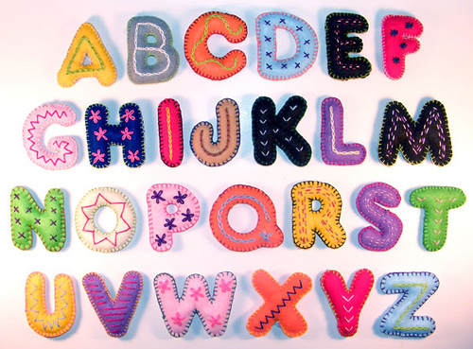
THE ALPHABITE

Slide 3
RIDDLES
1.I have four legs, but I can’t walk.
2. I’m tall and green, I’m in the garden.
3. It doesn’t have legs, but it goes.

Slide 4
RIDDLES
4. It doesn’t have legs, but it jumps.
5.Two brothers, but they don’t see each other.
6. It is white and cold and sweet. All children like it.

Slide 5
RIDDLES
7. It is not a man, it is not a woman, but it teaches us.
8. It gives us milk and butter two. It’s very kind and likes to moor.
9. The father and the mother. And all their little kids wear dresses made of silver coins or little silver lids.

Slide 6
Кто лучше знает правила чтения?

Slide 7
ENGLISH PROVERBS

Slide 8
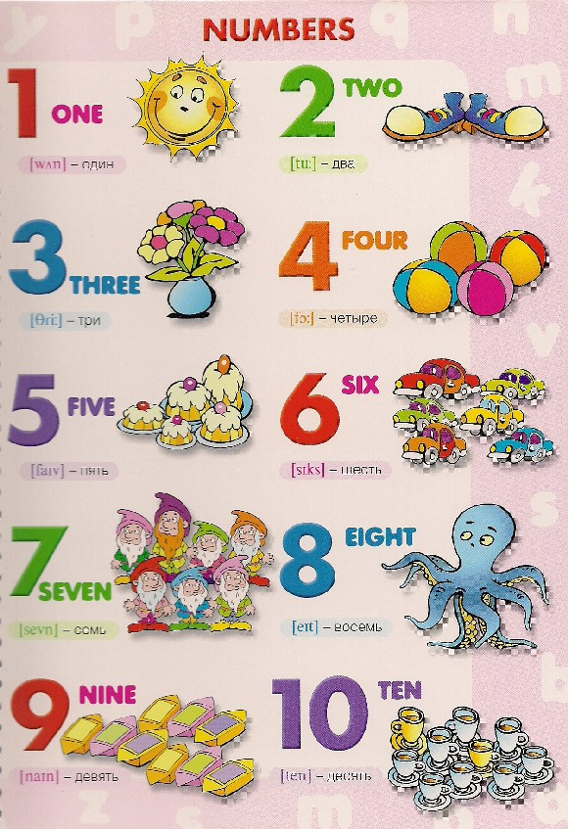
COUNT

Slide 9
If you're happy and you know it,
clap your hands. If you're happy and you know it,
clap your hands. If you're happy and you know it, And you really want to show it, If you're happy and you know it,
clap your hands.

Slide 10
If you're happy and you know it, stomp your feet.
If you're happy and you know it, stomp your feet.
If you're happy and you know it, And you really want to show it, If you're happy and you know it, stomp your feet.

Slide 11
If you're happy and you know it,
nod your head. If you're happy and you know it,
nod your head. If you're happy and you know it, And you really want to show it, If you're happy and you know it,
nod your head. .

Slide 12
If you're happy and you know it, turn around. If you're happy and you know it, turn around. If you're happy and you know it, And you really want to show it, If you're happy and you know it, turn around.

Slide 13
If you're happy and you know it,
say we are, we are. If you're happy and you know it,
say we are, we are. If you're happy and you know it, And you really want to show it, If you're happy and you know it,
say we are, we are

Slide 14
CHAIN WORD
РЕШИТЕ ЧАЙНВОРД ,
НАЙДИТЕ АНТОНИМЫ ДАННЫМ СЛОВАМ
АНТОНИМЫ – это слова одной и той же части речи, имеющие соотносительные друг с другом противоположные значения,
например:
молодой — старый, дружба — вражда,
хорошо — плохо, уезжать — приезжать.

Slide 15
GRAMMAR QUIZ
В данных предложениях слова стоят не на своих местах,
Напишите грамматически правильно предложения.
Например: His is sister name Kate.
His sister name is Kate.

Slide 16
GOOD LUCK!!!

