Slide 1
Найди в каждом ряде слов лишнее и из первых букв лишних слов составь новое слово:
peas, carrots, oranges, cap, potatoes, pears
t-shirt, shirt, hat, jeans, trousers, lollipops
orange, sweets, jam, cake, lollipops
frog, spider, t-shirt, monkey, elephant
run, hat, draw, jump, fly, swim
spider, orange, jumper, eyes, monkey, nose
socks, pear, potato, puppy, peas

Slide 2
Clothes
Одежда

Slide 3
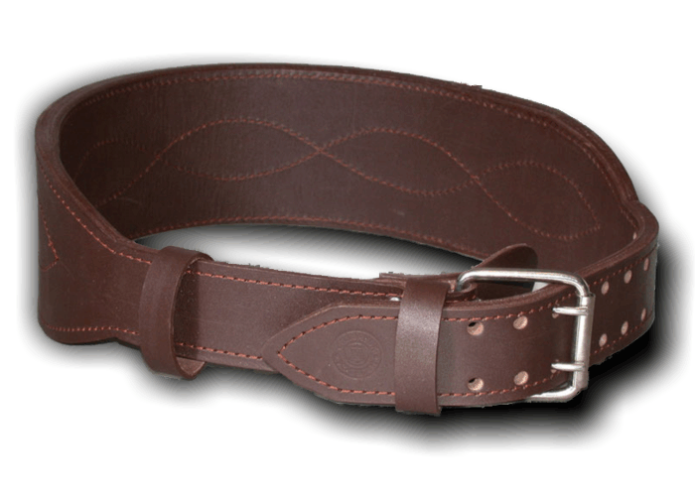
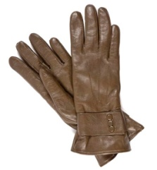
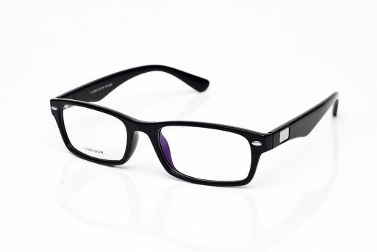
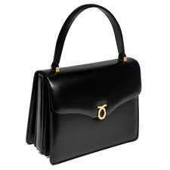
Learn some more words:
swimsuit
belt
gloves
glasses
handbag, bag
pants, trousers
Pajamas
sweater
sandals
scarf
shirt
suit
top
trainers

