Slide 1
Some the most interesting places in the Great Britain
Teachers: Декатова Л.М.
Самсонова Н.Н.

Slide 2
Gothic Cathedral in York.

Slide 3
The building of this great Cathedral lasted from XIII- XV centuries. We can find here all the features of the Gothic architecture.

Slide 4
Stonehenge

Slide 5
This mysterious place is in England and it was built about 4.000 years ago. We don’t know why it was built and what for. Scientists can’t help us now days.

Slide 6
The famous viaduct in Scotland.

Slide 7
Scotland
It was built in 1901. The express was going along it. And only rich people could be in that train and were amazing the beauty of the lands.

Slide 8
Cambridge University

Slide 9
Cambridge University
It is one of the famous and the oldest universities in the world. It was founded at the beginning of the XIII century.

Slide 10
It was built in XI cetrury by William the Conquarror

Slide 11
The fortress

Slide 12
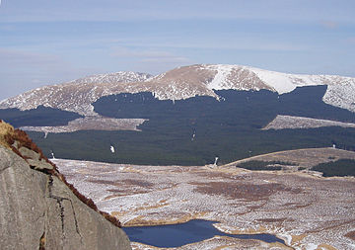
Looking north east over the Silver Flowe from Craignaw in the Dungeon hills with Corserine (just right of centre), and Carlin's Cairn (left of centre) on the Rhinns of Kells ridge - winter. The loch in the foreground is Long Loch of the Dungeon.

Slide 13
Read some more information in Wikipedia.
Go to the Great Britain and have a great pleasure watching the beautiful places.

