Slide 1
What can you do
?

Slide 2
How are you today?
Fine, thanks
Not bad, thanks
Super, thanks
So-so, thanks
Fantastic, thanks

Slide 3
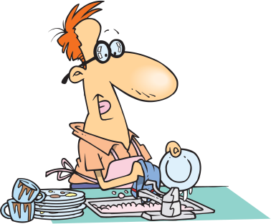
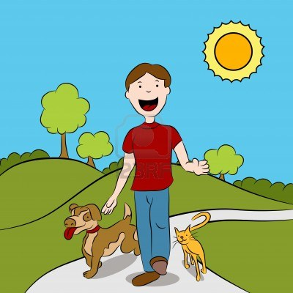
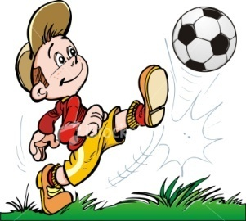
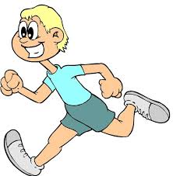
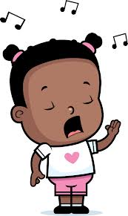
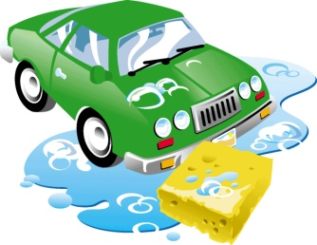
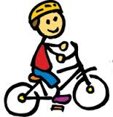
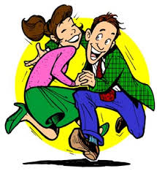
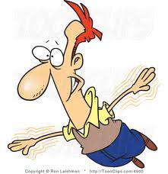

Slide 4
I can __ , but I can’t__

Slide 5
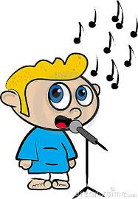

Slide 6
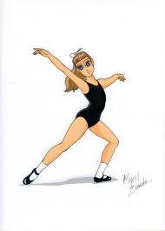

Slide 7
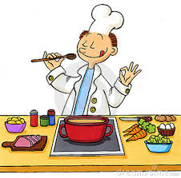

Slide 10
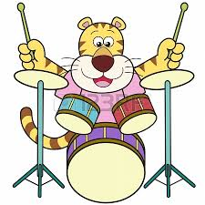

Slide 11
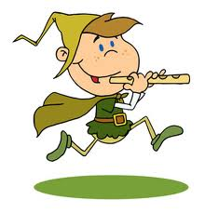

Slide 12
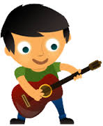

Slide 13
sing

Slide 14
dance

Slide 15
cook

Slide 16
ride a bike

Slide 17
play the piano

Slide 18
play the drums

Slide 19
play the flute

Slide 20
play the guitar

Slide 21
sing

Slide 22
dance

Slide 23
cook

Slide 24
ride a bike

Slide 25
play the piano

Slide 26
play the drums

Slide 27
play the flute

Slide 28
play the guitar

Slide 29
sing
dance
cook
ride a bike
play the piano
play the drums
play the flute
play the guitar

Slide 30
sing - петь
dance - танцевать
cook -готовить
ride a bike-кататься на велосипеде
play the piano-играть на пианино
play the drums-играть на барабанах
play the flute-играть на флейте
play the guitar –играть на гитаре

