Slide 1
Olympic Games mascots

Slide 2
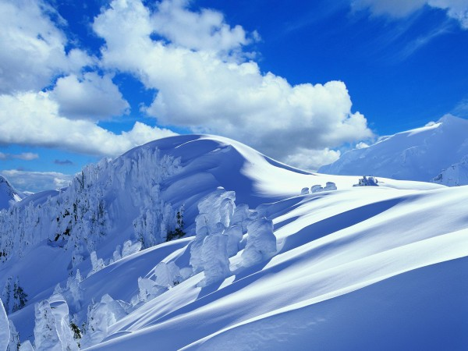
Russian bear

Slide 3
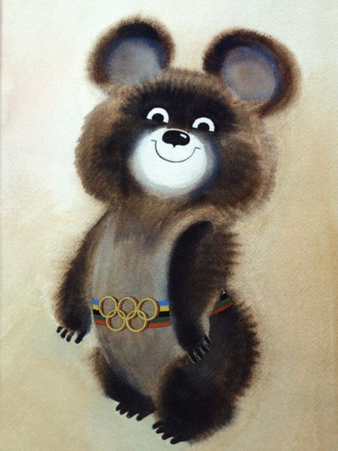
Russian bear cub
Smiling bear cub the Bear — a mascot of the Olympic Games of 1980 which was taking place in Moscow. The children's illustrator Victor Chizhikov thought up this nice character. Bear, Mikhail Potapych — traditional nicknames of a bear in Russia. Organizers of the Olympic Games-80 chose as a symbol this animal for force inherent in it, persistence and courage.

Slide 4
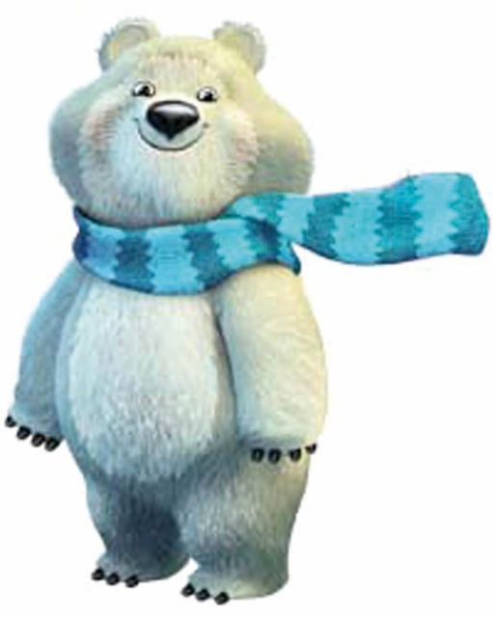
Bears of Russia
1980
2014

Slide 5
leopard

Slide 6
leopard
The dexterous and courageous leopard isn't deprived of attention. In 2014 of this mascot chose the majority of people in our country. The mining rescuer-climber Leopard lives in krone of a huge tree which grows on the highest rock in the snow-covered mountains of the Caucasus. He is always ready to come to the rescue and more than once saved the village located nearby from avalanches.
The leopard - the beautiful snowboarder, it taught this sport of all the friends and neighbors. At the Leopard cheerful nature, he can't live in loneliness and very much likes to dance.

Slide 7
hare

Slide 8
Hare
Hare - the most active inhabitant of a winter forest. Her friends always are surprised - and as it everything is in time! ? After all Hare not only manages to study in Forest Academy on "perfectly", to help mother with family small restaurant "Forest dam", but also to participate in various sports competitions. Darling assures the friends that she has no secret: simply she very much loves sports. And still she likes to sing and dance.

Slide 9
Olmpiysky friends

Slide 10
Спасибо за внимание!!!
Презентацию делала : Аткач Диана

