Slide 1
Презентация к уроку английского языка
в 4 классе по теме:
«Город и село»
Киселевск
2013

Slide 2
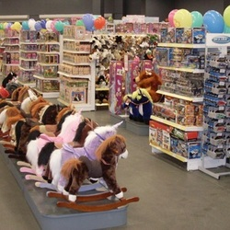
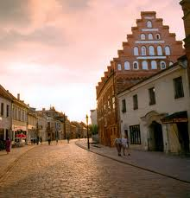
Who wants?
a shop
a street

Slide 3
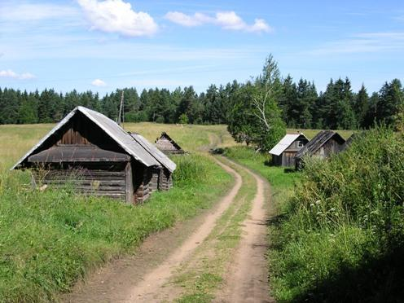
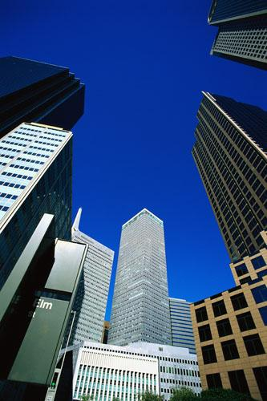
Would you like to live in the city? Do you want live in the country? Do you like the place you live in?

Slide 4
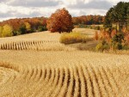
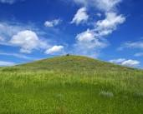
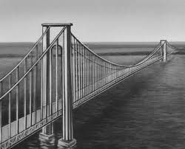
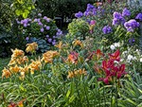
the country and the city
a field
a hill
a bridge
a garden
apple tree

Slide 5
I know | I don’t know | I want to know

Slide 6
Thomas wants to recite the poem. Listen to it, please.Do you like the poem? What is it about? You may open your textbooks on page 35 and read the sentences after the speaker. Now lets recite the poem all together. Read it alone. Well done.

Slide 7
THANK YOU FOR THE LESSON!
GOOD BYE!

