Slide 1
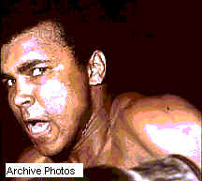
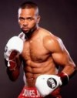
Who won the amateur "Golden Gloves" championship in 1959 and 1960.
Ali Muhammad,
Mike Tyson,
Roy Jones.

Slide 2
Where was an army officer Robert Lee born?
a)In Mexico,
b)In the state of Virginia,
c)In Los Angeles.

Slide 3
In which year did a very good rider Buffalo Bill start appearing in shows about himself?
a)In 1873,
d)In 1871,
c)In 1872.

Slide 4
What was Armstrong, Louis?
a)a popular jazz singer,
b)a popular pop singer,
c)a popular rock singer.

Slide 5
Michael Jordan is known as ….Jordan because of the height he can leap.
a) «Wind»,
b) «Air»,
c) «Water».

Slide 6
Which album in1986 was the No. 1 in 28 countries? Madonna
a)True Blue,
b) Vogue,
c) a Prayer.

Slide 7
Where was Marilyn Monroe born?
a) in Los Angeles,
b) in Norma Jean Mortenson,
c) in Aberdeen.

Slide 8
Elvis Aron Presley died in………..
a)in 1978,
b)in 1976,
c)in 1977.

Slide 9
Tina Turner is a famous American……….
a) dancer,
b) singer,
c) businesswoman.

Slide 10
How many children had Mary Kay Ash?
a)2,
b)3,
c)4.

Slide 11
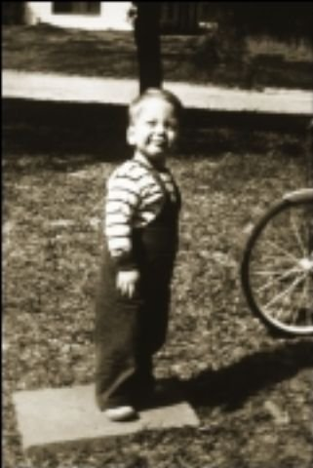
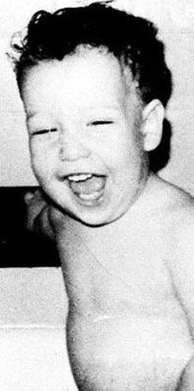
Who is who?
Johnny Depp
Patrick Swayze
Adam Sandle

Slide 12
Thank you!

