Slide 1
Famous American Persons of the Past and the Present.

Slide 2
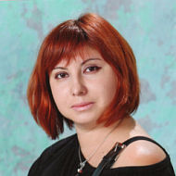
Can you answer of my questions?
What Famous American Persons do you know?

Slide 3
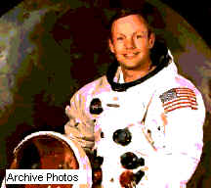
What was Neil Amstrong interested in as he was a young man?
a)in flying,
b)in driving,
c)in cooking.

Slide 4
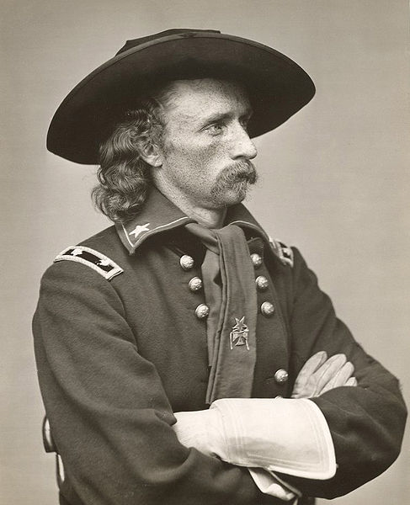
What did George Armastron Custer decide to be?
a) He decided to be a doctor,
b) He decided to be a pilot,
c) He decided to be an army officer.

Slide 5
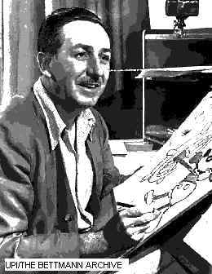
Where did Walter Disney grow up?
a) He grew up on a Missouri farm,
b) He grew up in England,
c) He grew up in Florida.

Slide 6
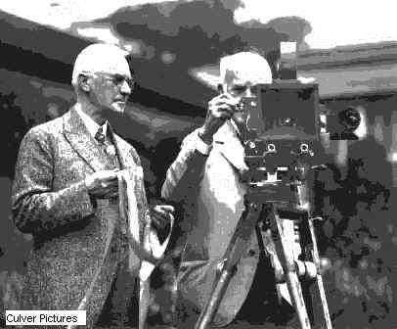
How old was Thomas Edison when he was expelled from his school?
a)5,
b)6,
c)7.

Slide 7
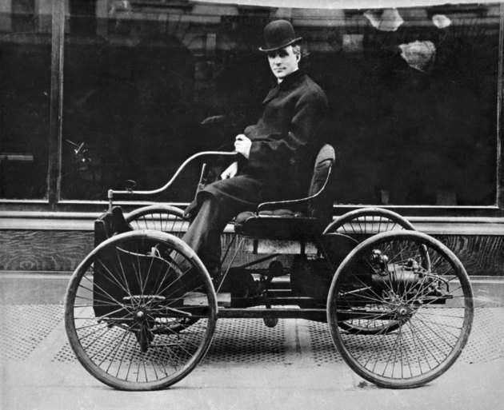
Where was Henry Ford born?
a)He was born on his family's farm,
b)He was born in the family's house,
c)He was born in North Carolina.

Slide 8
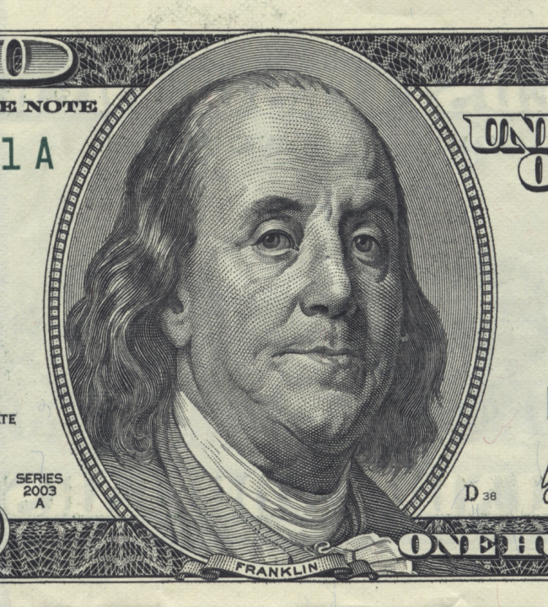
In which country did Benjamin Franklin set up his own printing business?
a) in France,
b) in England,
c) in America.

Slide 9
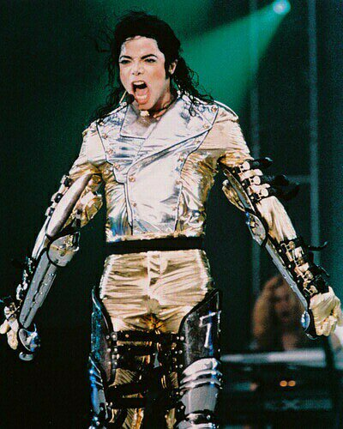
What was the name of the band Michael Jackson and his brothers formed in 1968?
a) a group called The Jackson Five,
b) a group called The Jackson Six,
c) a group called The Jackson Four.

Slide 10
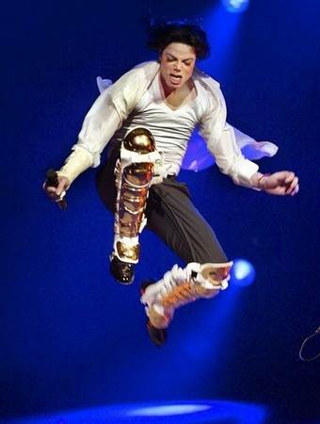
Who helped Michael Jackson to start his career?
a) Lisa-Marie, Madonna,
b) Stevie Wonder and Diana Ross , Quincey Jones, Fred Astaire,
c) Jordan, Michael.

