Slide 1
Welcome to our lesson !

Slide 2
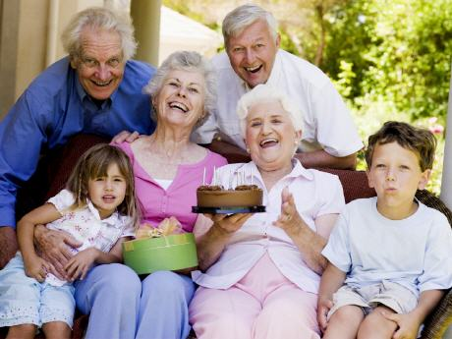
We laugh and cry,
We work and play,
We help each other
Every day.
The world's a lovely
Place to be
Because we are
а family.

Slide 3
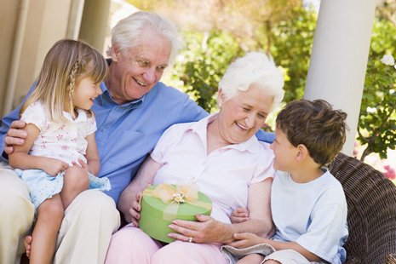
The love of family is life’s greatest happiness.
Любовь семьи - величайшее счастье в жизни.

Slide 4
We laugh and cry,
We work and play,
We help each other
Every day.
The world's a lovely
Place to be
Because we are
а family.

Slide 5
Family
Cluster

Slide 6
mother
father
grand-mother
Family
sister
grand -father
cousin
brother
aunt

Slide 7
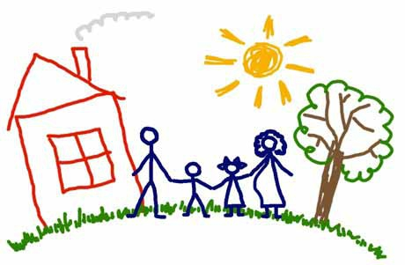
Family

Slide 8
Fill in the table
№ | NAME | AGE | CAN/CAN’T DO | SPECIAL FEATURES
1
2
3
4
5
6

Slide 9
Fill in the table
№ | NAME | AGE | CAN/CAN’T DO | SPECIAL FEATURES
1 | Jane | 35 | play the gitar | clever
2 | David | 42 | speak French | cool
3 | Tom | 8 | play compu-ter games | naughty, caring
4 | Helen | 70 | make cookies | kind, friendly
5 | Ben | 72 | ------------ | funny
6 | Emma | --------------- | can’t walk | sweet,noisy

Slide 10
clever
cool
kind
mother
father
grand-mother
Family
sister
grand -father
sweet
friendly
cousin
brother
aunt
noisy
caring
funny

Slide 11
Cinquain
1.Family
2.Happy, friendly
3.Work,rest, help
4.Family is our life.
5.Love

