Slide 1
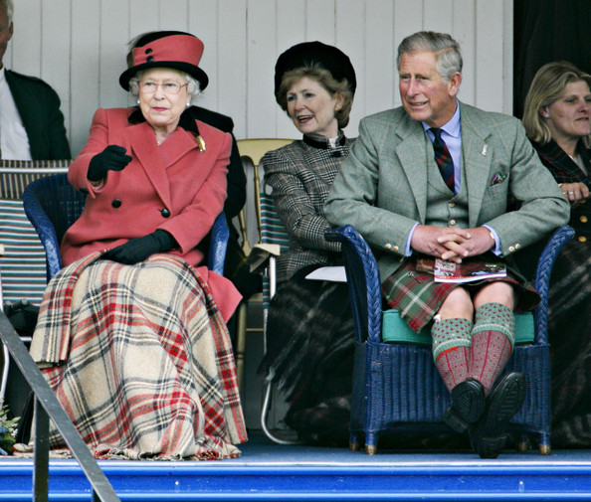
Highland Games
Highland games are events held throughout the year in Scotland and other countries as a way of celebrating Scottish and Celtic culture and heritage, especially that of the Scottish Highlands. Certain aspects of the games are so well known as to have become emblematic of Scotland, such as the bagpipes, the kilt, and the heavy events, especially the caber toss. While centered on competitions in piping and drumming, dancing, and Scottish heavy athletics, the games also include entertainment and exhibits related to other aspects of Scottish and Gaelic culture.
The royal family watching Braemar Highland Games

Slide 2
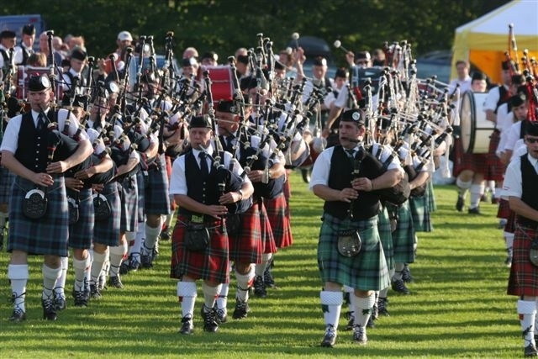
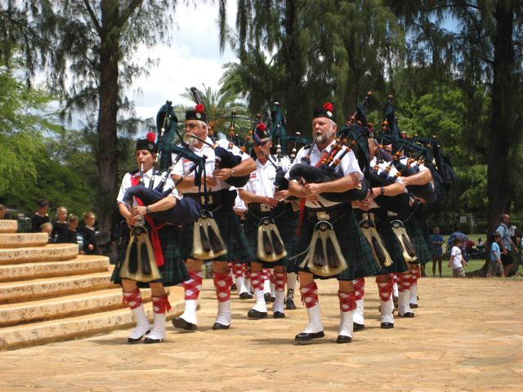

Slide 3
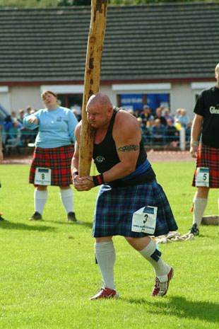
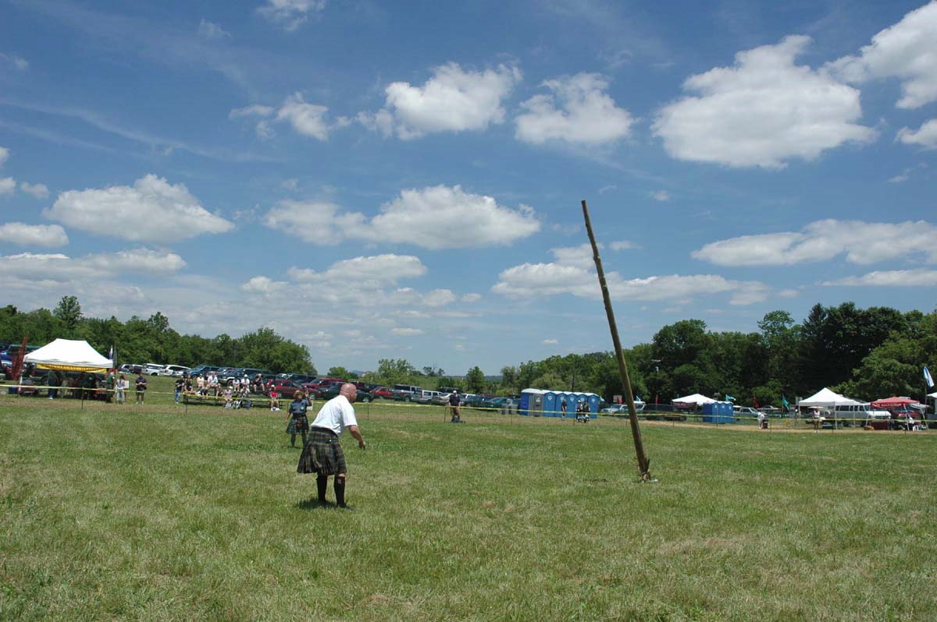
HIGHLAND GAMES EVENTS
CABER TOSS
This event is a highland games tradition. Contestants will toss a 100-120 pound pole that is 18-19 feet long. The goal is to get the caber to flip end over end, with the narrow end pointing towards the contestant, with the caber stopping in-line with the contestant. Distance is not a factor in this event.

Slide 4
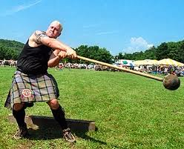
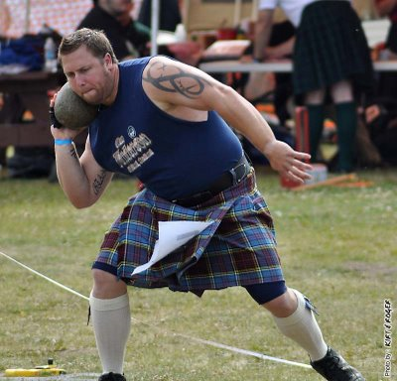
HAMMER THROW This is a test of skill and strength. A 4 ft 22 inch long hammer weighing 16 - 22 pounds is thrown for distance. Three throws are allowed, but only the longest counts. Like in the weight throw for distance, if any part of the body passes the tow bar, the throw is nullified and a foul is called.
STONE TOSS Putting the Stone (or Clachneart in Gaelic) is a test of strength and coordination. This event is similar to the modern day shot put.
Contestants toss a ball weighing 16 pounds for distance. Each contestant gets 3 tries, the longest toss being recorded.

Slide 5
Tug-O-War Competition
This a team contest consisting of either five or eight members to each team and one coach. The coach will encourage the team to pull as and when required dependant on the opposing teams actions. The coach must be very alert to keep his team fully aware of the moves intended or to just hold awaiting the correct time to make a move.

Slide 6
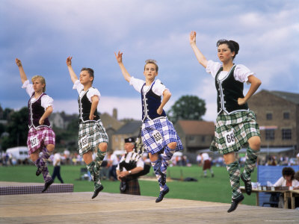
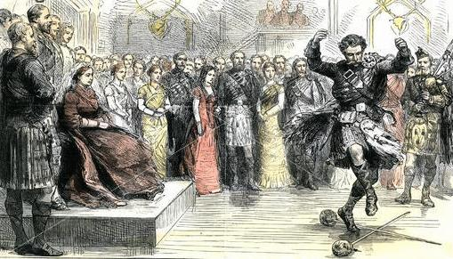
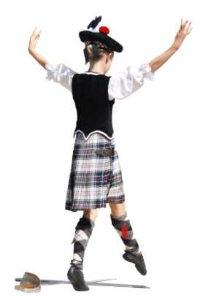
The most famous of the dances are the Sword Dance and the Highland Fling.
Queen Victoria watching a Highland sword dance, Scotland, 1880.
Sword-dance

