Slide 1
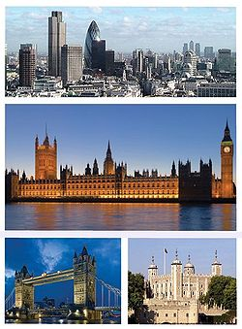
Places of interest in London

Slide 2
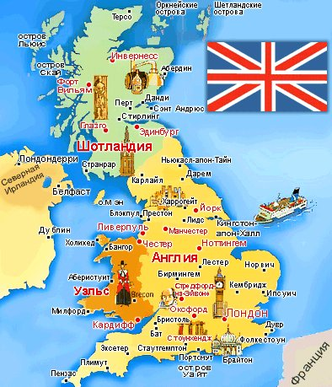
London is the capital of Britain.

Slide 3
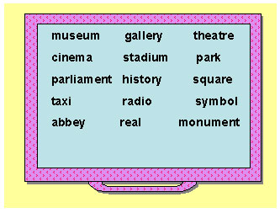

Slide 4
Музей галерея театр кино Стадион парк правительство история площадь такси радио символ аббатство настоящий памятник

Slide 5
’Window on britain’

Slide 7
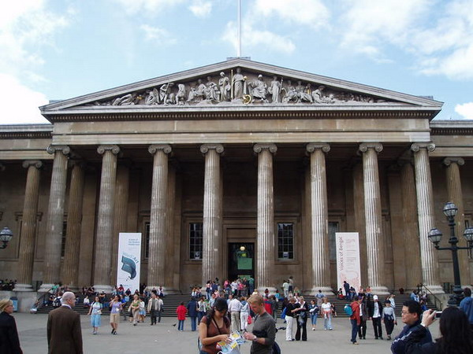
The British Museum

Slide 8
Big Ben

Slide 9
The river Thames

Slide 10
Westminster Abbey

Slide 11
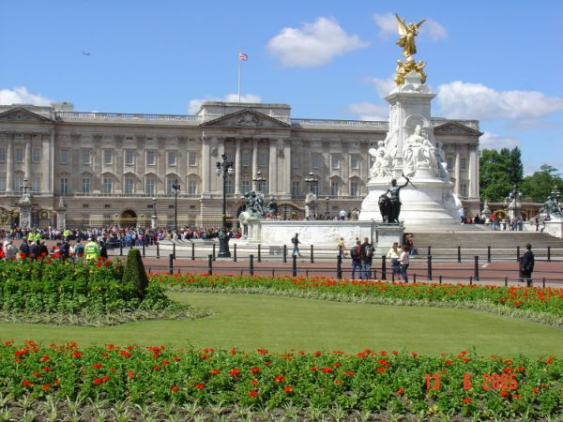
Buckingham Palace

Slide 12
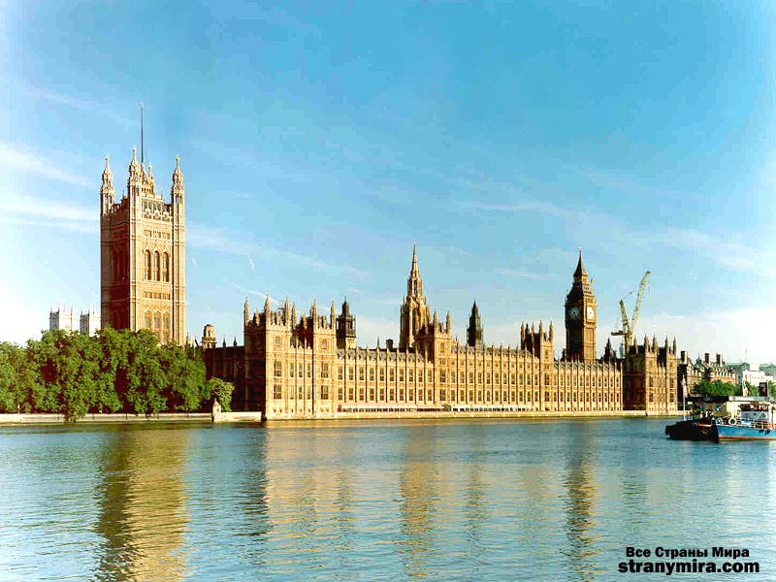
The Houses of Parliament

Slide 13
Trafalgar Square

Slide 14
The Tower of London

Slide 15
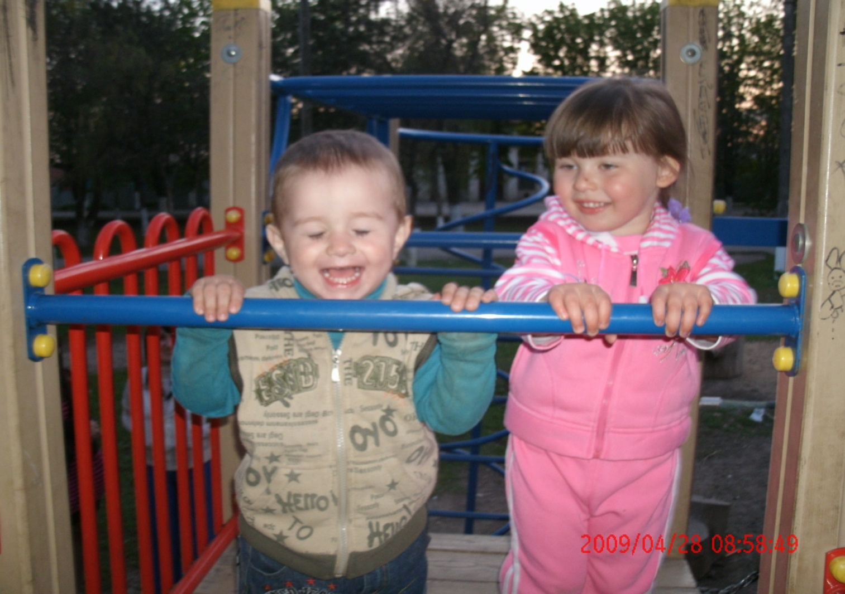
Let's rest

Slide 17
Do you agree or disagree? 1.London is the capital of Spain. 2. Big Ben is a famous street. 3. Buckingham Palace is the home for the Queen. 4. The Thames is the main river in London. 5. London Eye is the monument in London. 6. Queen Elizabeth 2 lives in Westminster Abbey. 7. Trafalgar Square is a popular place for tourists. 8. Piccadilly circus is a square.

Slide 18
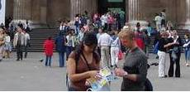
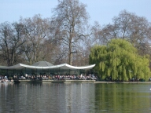
make up dialogues. A student “A” has come to London to visit a friend and ask about the city and places of interest. A student “ B” advises what to see in London.

Slide 19
Let’s relax

Slide 20
Homework: to make a cluster: what associations do you have when you think of London.

