Slide 1
Monsanto Corporation

Slide 2
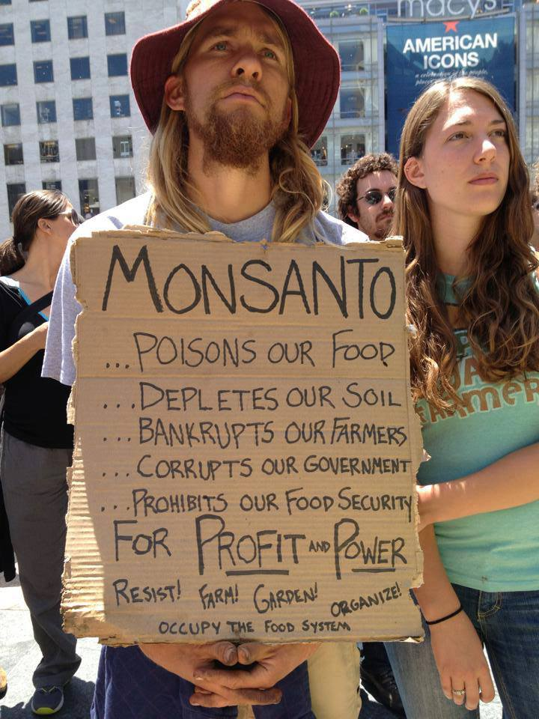
History
Monsanto Company is a publicly traded American multinational chemical and agricultural biotechnology corporation headquartered in Creve Coeur, Missouri (the USA)
It is a leading producer of genetically engineered seed and of the herbicide glyphosate which it markets under the Roundup brand (most famous product)

Slide 3
History and data:
Founder: John Francis Queeny- a 30‑year veteran of the pharmaceutical industry who funded the start-up with his own money and capital from a soft drink distributor and gave the company his wife's maiden name.
Industry: Agriculture, biotechnology, genetic modification
Founded: St. Louis, Missouri (U.S.) in 1901
Headquarters Creve Coeur, Missouri,
U.S. Key people Hugh Grant (Chairman, President and CEO)
Products: Herbicides, pesticides, crop seeds
Revenue in 2011: US$ 11.822 billion
Operating income in 2011: US$ 2.502 billion

Slide 4
Benchmarks:
Monsanto was the first company that modified a plant cell, along with three academic teams, which was announced in 1983, and was among the first to conduct field trials of genetically modified crops, which it did in 1987.
The Monsanto founder (Mr. Queeny was first who opened cofein and vanilla) that sooner began the essential company`s exporting products
In 1940s Monsanto became the leading producer of polisterol (plastic) and synthetic fibres.
Through a series of transactions, the Monsanto that existed from 1901 to 2000 and the current Monsanto are legally two distinct corporations.
Most of the genetically modified products were created after 1997.

Slide 5
Benchmarks
In 1982 Robb Fraley, Robert Horsch, Ernest Jaworski, Stephen Rogers realized the first genetic transformation and gained the first National US medal in technology sphere.
Many of Monsanto's agricultural seed (mostly soy and sunflower) are genetically modified for resistance to herbicides. Monsanto sells glyphosate under the brand, "Roundup" – Monsanto calls these seeds "Roundup Ready“.
In 1990s the company began to produce the first genetically modified sugar.
In 1994 the company created the trnsgenetic hormon for the strongness of bulls. That later were recognized as dangerous for the human health and were prohibited in New Zealand, Canada, Australia, the EU.

Slide 6
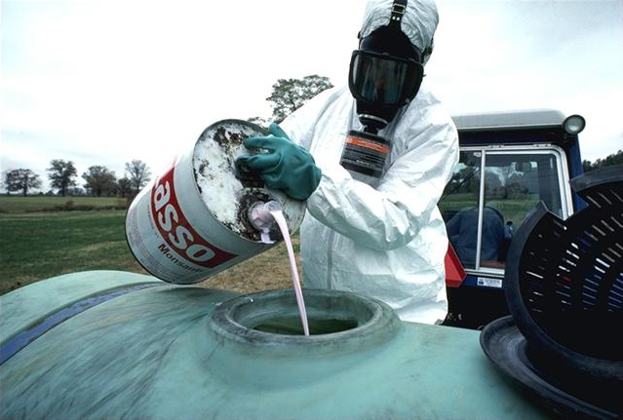
Pesticides used for the harvest increase

Slide 7
Scandals
Monsanto is constantly critisez by the human-rights organizations.
In the late 1990s and early 2000s, public attention was drawn to suicides by indebted farmers in India following crop failures
In 1999, Monsanto was condemned by the UK Advertising Standards Authority for making "confusing, misleading, unproven and wrong" claims about its products over the course of a £1 million advertising campaign.
It is known for using the child labor in India and testing its products in the Indian fields. (Child labor is widespread in India's agricultural sector, which employs ~60% of India's child labor. Child labor is especially used in seed production)

Slide 8
Scandals
In 1960 s Monsanto used the dangerous “Orange agent” during the Vietnam war that is used in order to defoliate the leaves before the harvest. As a result more than a million vietnamese became invalids before reaching 18 years.
In 2005 Monsanto was sued for the bribing to the Indonesian officials.
In the mid 2000 export and import of Monsanto products were prohibited in Hungary.

Slide 9
Judicial proceedings
In the early 1990s Monsanto faced several lawsuits over harm caused by PCBs from workers at companies such as Westinghouse that bought PCBs from Monsanto and used them to build electrical equipment
In 2000, Great Lakes Chemical Corporation sued Monsanto for the $71 million shortfall in expected sales. After that Monsanto had failed to alter its manufacturing process to eliminate dioxin as a byproduct and that it had failed to warn the public about dioxin's harmfulness.
A worldwide protest against Monsanto and GMOs took place on May 25, 2013. The number of protesters who took part is uncertain; figures of "hundreds of thousands" or "two million" were variously cited. According to organizers, protesters in 436 cities and 52 countries took part.

Slide 10
Government support
It is well-known that Monsanto company is supported and lobbied actively in the White House.
A number of people have held positions at Monsanto and in US government agencies such as the Food and Drug Administration for example and the US Suprime Court.
The following connections allows the Monsanto Corporation not tho mark “genetically modified” status on its products.
Monsanto has also been the corporate sponsor of many attractions at Disneylandand Walt Disney World

Slide 11
Future of the Monsanto Corporation
With the Monsanto continuing lobbying the United States Congress and the U.S. Department of Agriculture about regulations that would affect the production and distribution of genetically engineered produce there is a high chance that no changes will be provided in the future.
Activist groups will continue to use the court system to challenge regulatory approvals of corn, soybean and other biotechnology‐derived crops in future.

Slide 12
Monsanto in Russia
Russia remain the most perspective market for the Monsanto.
Even thought there are two headquarters of the Company in Russia (inKrasnodar region and Orenburg city) most of its products were prohibited by the Russian Agriculture Ministry.
The only products that are allowed for import are Round-up and Harness.

