Slide 2
The Winter Olimpic games 2014

Slide 3
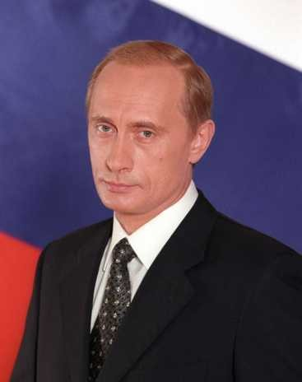
WELCOME TO SOCHI-2014: XXII OLYMPIC WINTER GAMES

Slide 4
City organizer | Sochi
Participating countries | 85
Number of athletes | 2750
It is played medals | 98 sets in 7 sports
Opening ceremony | February 7, 2014
Closing ceremony | February 23, 2014

Slide 5
“Sochi – the host city for the 2014 Winter Olympics”. 1st group – Sochi. History.
In the resort small town Sochi there are many well-known places and buildings. For example, Winter theater. The winter theater is constructed in 1937.

Slide 6
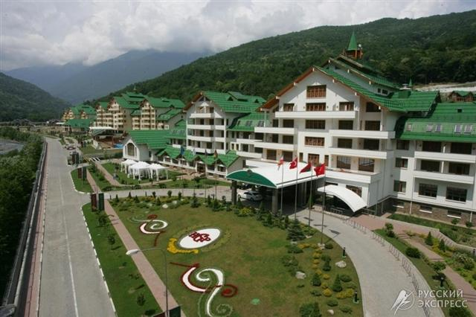
2nd group – Sochi. Environment. Krasnaya Polyana
Krasnaya Polyana — the popular center of mountain skiing and a snowboard. At the beginning of 2007 near The structure of the first stage includes 6 ropeways and 18 routes.

Slide 7
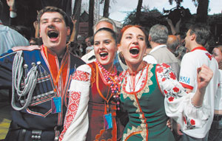
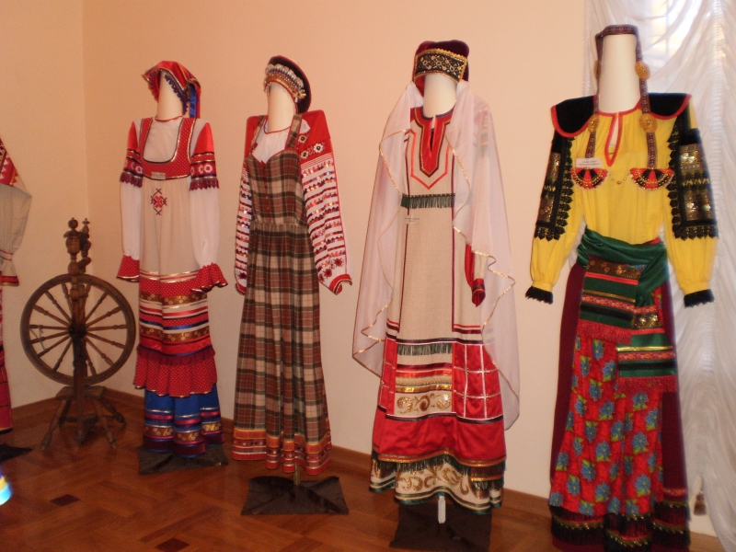
3d group – Sochi. Culture and Entertainment.
Sochi – one of the few cities of Russia where people of several various nationalities on a footing of equality get on. Here in a uniform family in peace there live representatives more than 108 nationalities.

Slide 8
10 THINGS TO KNOW ABOUT SOCHI
Sochi is the largest resort region of the Russian Federation.
It has 4 administrative districts.
Sochi is often referred to as the “Russian Riviera”.
It has the most northern subtropical climate.
Mount Elbrus in the Russian Caucasus is considered the highest mountain in Europe.

Slide 9
6. The average summer temperature is +26 C and -3 C in the winter. 7. The air quality is considered the best in the world. 8. Sochi is a city with more than 400,000 inhabitants representing over 100 nationalities. 9. Sochi has over200,000 hectares of forests, 4,000 of which are within Sochi Center. 10. The Sochi tennis school became the launching pad for the careers of many Russian stars, including Maria Sharapova and Yevgeny Kafelnikov

Slide 10
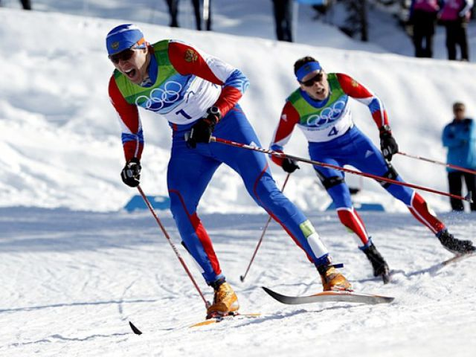
Competitions
Fifteen winter sports disciplines, united in seven Olympic sports included in the program of the Olympic Winter Games in 2014.

Slide 11
Games will take place in two locations:
Coastal cluster, or Olympic park
Mountain cluster, or Krasnaya Polyana
Near Krasnaya Polyana will pass competitions of "a mountain cluster"
sled sports; skeleton; bobsled; double-event; skiing; biathlon; jumps on skis from a springboard. And other competitions will take place in the Olympic park.

Slide 12
The Olympic oath : "On behalf of all athletes I promise that we will participate in these Olympic Games, respecting and observing rules by which they are led, in truly sports spirit, to glory of sports and for the sake of honor of the teams."

Slide 13
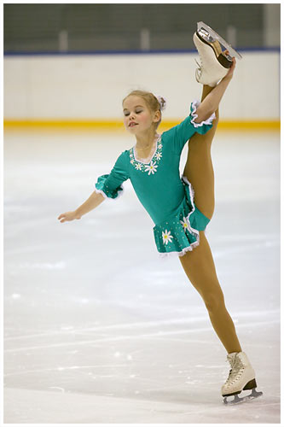
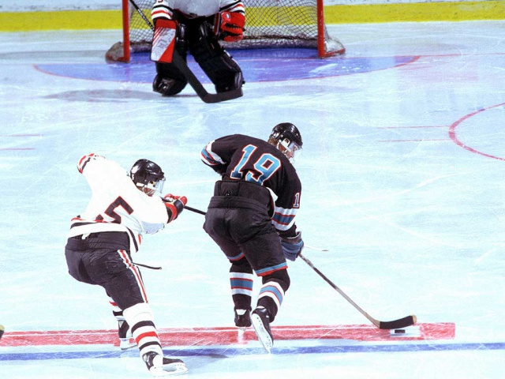
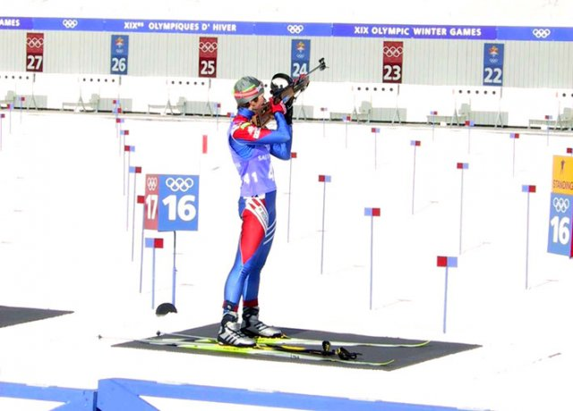
Biathlon
Bobsled
Mountain skiing
Curling
Skating sports
Skiing
Sled sports
Skeleton
Snowboard
Figure skating
Freestyle
Hockey
Short track

Slide 14
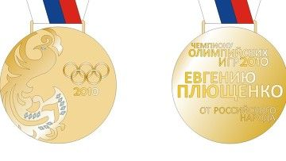
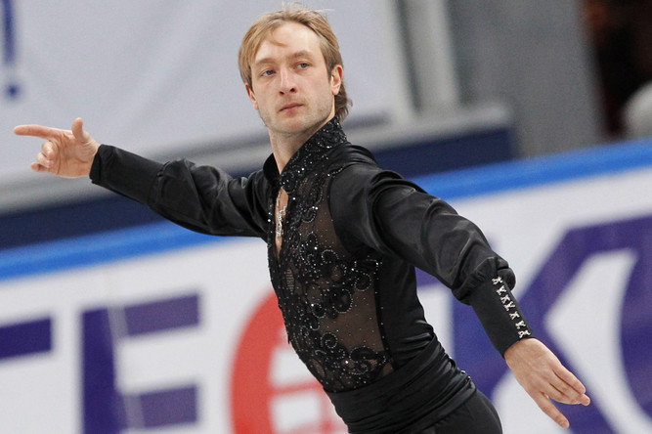
Evgeny Plushenko - the Olympic champion of 2006 and the silver prize-winner 2002 and 2010, the triple world champion, the sevenfold champion of Europe and the tenfold champion of Russia in man's single to driving. The deserved master of sports of Russia.

Slide 15
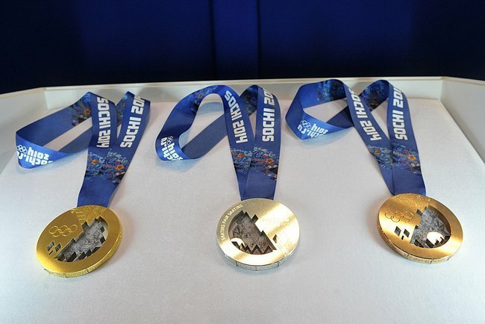
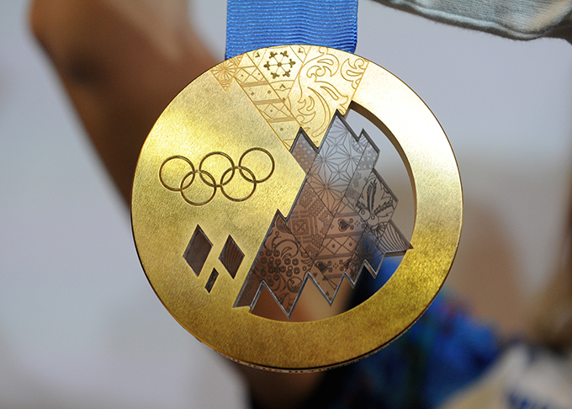
Medals
Results will be made ​​around 1300 sets of awards. Each medal on the front side will have the image of Olympic rings on the back of the English language will be cast kind of competitive Olympic program, and shows the official logo of "Sochi-2014".

Slide 16
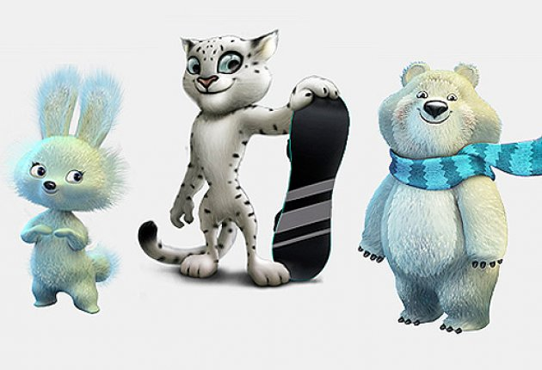
Talismans
In the Winter Olympics three characters, Polar Bear, Leopard and White Bunny.

Slide 17
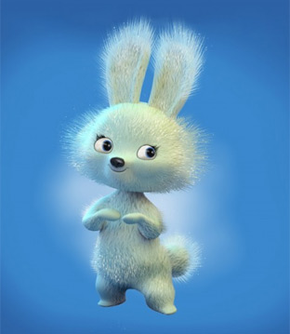
Arrow-white bunny. Active Bunny manages everything: sports, she most loves ice skating

Slide 18
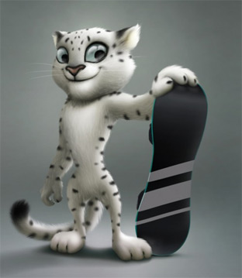
White leopard Barsik - strong, hardy animal that lives in the mountains of the Caucasus. White leopard - a connoisseur of mountain slopes and a great climber.

Slide 19
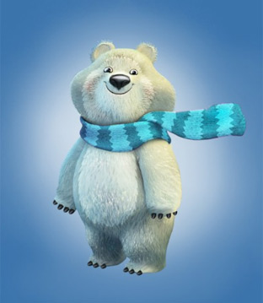
White teddy bear named Pole-docile and kind nature, he is a symbol of the best friend of children, giving them their care and respect.

Slide 20
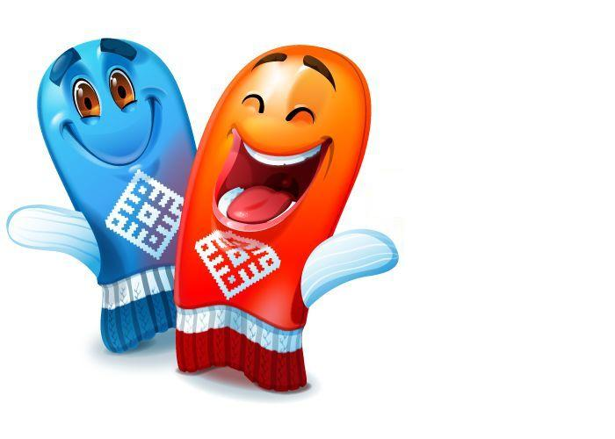
We wish good luck to our athletes! Also we will support them certainly.

