Slide 1
My room
Sofa, armchair, mirror, window, coffee table ,paintings, carpet, wall, bookcase, furniture, curtain, chair

Slide 2
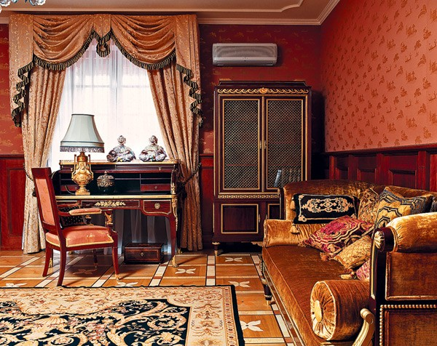
Description of the living room

Slide 3
My living room
Which floor is your flat on?
What’s your living room like?
Is there a TV in your living room?
Where’s the lamp?
Is it cozy?

