Slide 1
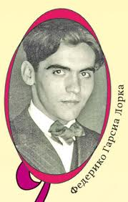
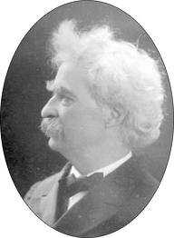
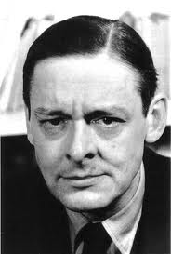
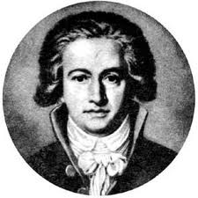
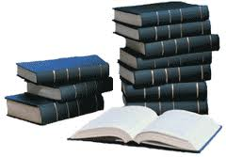
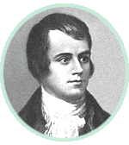
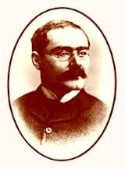
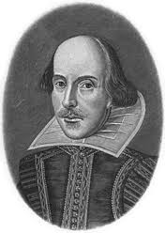
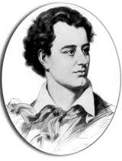
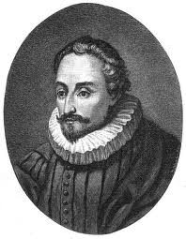
Гении иностранной литературы

Slide 2
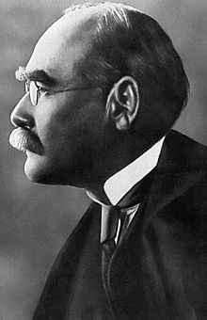
Rudyard Kipling
Joseph Rudyard Kipling (30 December 1865 – 18 January 1936) was an English short-story writer, poet, and novelist chiefly remembered for his tales and poems of British soldiers in India, and his tales for children. He was born in Bombay, in the Bombay Presidency of British India, and was taken by his family to England when he was five years old. Kipling is best known for his works of fiction, including The Jungle Book (a collection of stories which includes “Just So Stories (1902), Kim (1901) (a tale of adventure), many short stories, including "The Man Who Would Be King" (1888); and his poems, including "Mandalay" (1890), "Gunga Din" (1890), "The White Man's Burden" (1899) and "If—" (1910). Kipling was one of the most popular writers in England, in both prose and verse, in the late 19th and early 20th centuries.

Slide 3
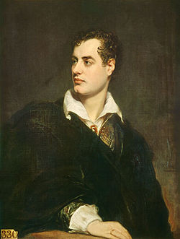
Lord Byron
George Gordon Byron, 6th Baron Byron, later George Gordon Noel, 6th Baron Byron, FRS (22 January 1788 – 19 April 1824), commonly known simply as Lord Byron, was an English poet and a leading figure in the Romantic movement. Among Byron's best-known works are the lengthy narrative poems Don Juan and Childe Harold's Pilgrimage and the short lyric "She Walks in Beauty." He is regarded as one of the greatest British poets and remains widely read and influential.
He travelled to fight against the Ottoman Empire in the Greek War of Independence, for which Greeks revere him as a national hero. He died at 36 years of age from a fever contracted while in Greece.

Slide 4
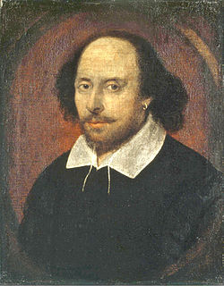
William Shakespeare
William Shakespeare (26 April 1564 (baptized) – 23 April 1616was an English poet and playwright, widely regarded as the greatest writer in the English language and the world's pre-eminent dramatist. He is often called England's national poet and the "Bard of Avon". His extant works, including some collaborations, consist of about 38 plays,154 sonnets, two long narrative poems, two epitaphs on a man named John Combe, one epitaph on Elias James, and several other poems. His plays have been translated into every major living language and are performed more often than those of any other playwright.
Shakespeare was born and brought up in Stratford-upon-Avon. At the age of 18, he married Anne Hathaway, with whom he had three children: Susanna, and twins Hamnet and Judith.

Slide 5
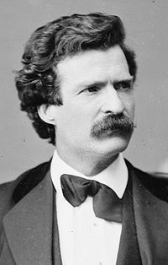
Mark Twain
Samuel Langhorne Clemens (November 30, 1835 – April 21, 1910), better known by his pen name Mark Twain, was an American author and humorist. He is most noted for his novel The Adventures of Tom Sawyer (1876) and its sequel, Adventures of Huckleberry Finn (1885), the latter often called "the Great American Novel."
Twain grew up in Hannibal, Missouri, which would later provide the setting for Huckleberry Finn and Tom Sawyer. While a reporter, he wrote a humorous story, "The Celebrated Jumping Frog of Calaveras County," which became very popular and brought nationwide attention. His travelogues were also well received. Twain had found his calling.
He achieved great success as a writer and public speaker. His wit and satire earned praise from critics and peers.

Slide 6
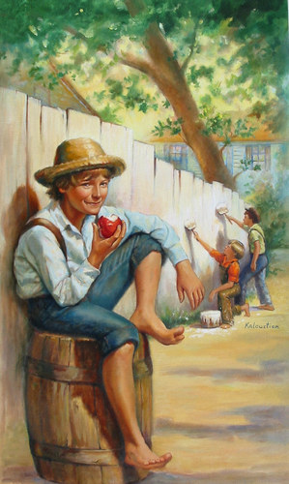
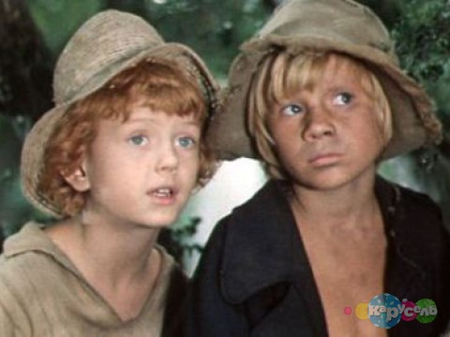
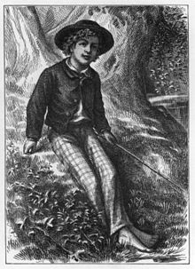
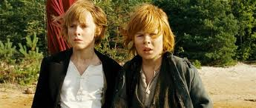
The Adventures of Tom Sawyer by Mark Twain is an 1876 novel about a young boy growing up along the Mississippi River. The story is set in the Town of "St. Petersburg", inspired by Hannibal, Missouri, where Twain lived.

Slide 7
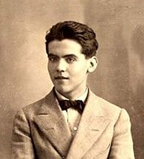
Federico García Lorca
Federico García Lorca (Fuente Vaqueros,Granada, 5 de junio de 1898 – entre Víznar y Alfacar, Granada, 19 de agosto de 1936) fue un poeta, dramaturgo y prosista español, también conocido por su destreza en muchas otras artes. Adscrito a la llamada Generación del 27, es el poeta de mayor influencia y popularidad de la literatura española del siglo XX. La obra poética de Lorca constituye una de las cimas de la poesía de la Generación del 27 y de toda la literatura española. La poesía lorquiana es el reflejo de un sentimiento trágico de la vida, y está vinculada a distintos autores, tradiciones y corrientes literarias. En esta poesía conviven la tradición popular y la culta. Aunque es difícil establecer épocas en la poética de Lorca, algunos críticos diferencian dos etapas: una de juventud y otra de plenitud.

Slide 8
William Shakespeare
William Shakespeare (26 April 1564 (baptized) – 23 April 1616was an English poet and playwright, widely regarded as the greatest writer in the English language and the world's pre-eminent dramatist. He is often called England's national poet and the "Bard of Avon". His extant works, including some collaborations, consist of about 38 plays,154 sonnets, two long narrative poems, two epitaphs on a man named John Combe, one epitaph on Elias James, and several other poems. His plays have been translated into every major living language and are performed more often than those of any other playwright.
Shakespeare was born and brought up in Stratford-upon-Avon. At the age of 18, he married Anne Hathaway, with whom he had three children: Susanna, and twins Hamnet and Judith.

Slide 9
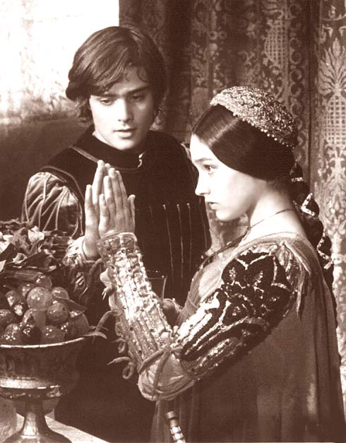
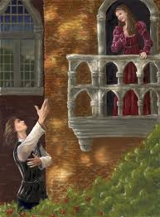
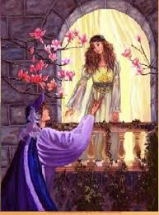
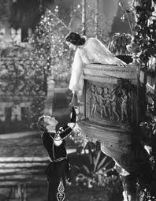
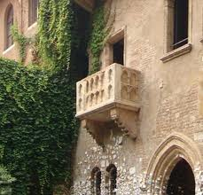
Romeo and Juliet
is a tragedy written early in the career of William Shakespeare about two young star-crossed lovers whose deaths ultimately reconcile their feuding families. It was among Shakespeare's most popular plays during his lifetime and, along with Hamlet, is one of his most frequently performed plays. Today, the title characters are regarded as archetypal young lovers.

Slide 10
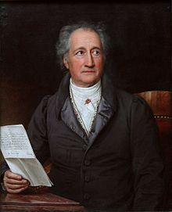
Johann Wolfgang von Goethe
Johann Wolfgang von Goethe ( 28. August 1749 in Frankfurt am Main; † 22. März 1832 in Weimar), geadelt 1782, war ein deutscher Dichter. Er forschte und publizierte außerdem auf verschiedenen naturwissenschaftlichen Gebieten. Ab 1776 bekleidete er am Hof von Weimar unterschiedliche politische und administrative Ämter.
Goethes literarische Produktion umfasst Gedichte, Dramen, erzählende Werke (in Vers und Prosa), autobiografische, ästhetische, kunst- und literaturtheoretische sowie naturwissenschaftliche Schriften. Auch sein umfangreicher Briefwechsel ist von großer literarischer Bedeutung. Goethe war ein Vorreiter und der wichtigste Vertreter des Sturm und Drang. Sein Roman Die Leiden des jungen Werthers machte ihn 1774 in ganz Europa berühmt.

Slide 11
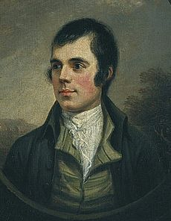
Robert Burns
Robert Burns (25 January 1759 – 21 July 1796) was a Scottish poet and lyricist. He is widely regarded as the national poet of Scotland and is celebrated worldwide. He is the best known of the poets who have written in the Scots language, although much of his writing is also in English and a light Scots dialect, accessible to an audience beyond Scotland. As well as making original compositions, Burns also collected folk songs from across Scotland, often revising or adapting them. His poem (and song) "Auld Lang Syne" is often sung at Hogmanay (the last day of the year), and "Scots Wha Hae" served for a long time as an unofficial national anthem of the country. Other poems and songs of Burns that remain well known across the world today include "A Red, Red Rose"; "A Man's A Man for A' That"; "To a Louse"; "To a Mouse"; "The Battle of Sherramuir"; "Tam o' Shanter"; and "Ae Fond Kiss".

Slide 12
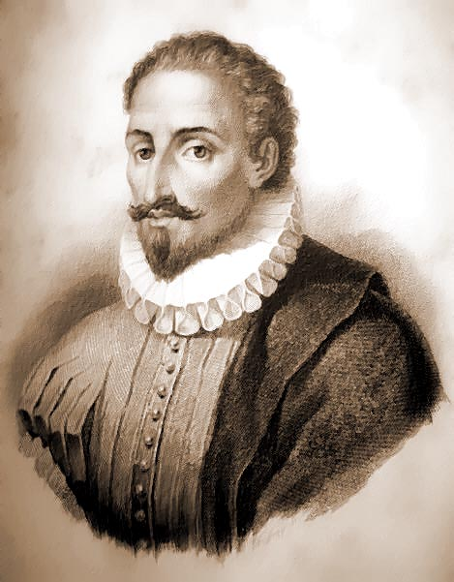
Miguel de Cervantes Saavedra
Miguel de Cervantes Saavedra (Alcalá de Henares,29 de septiembre de 1547 – Madrid, 22 de abril de 1616) fue un soldado, novelista, poeta y dramaturgo español.
Es considerado una de las máximas figuras de la literatura española y universalmente conocido por haber escrito Don Quijote de la Mancha, que muchos críticos han descrito como la primera novela moderna y una de las mejores obras de la literatura universal, además de ser el libro más editado y traducido de la historia, sólo superado por la Biblia. Se le ha dado el sobrenombre de «Príncipe de los Ingenios».

Slide 13
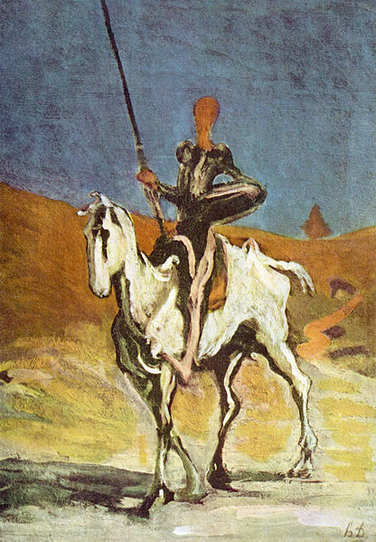
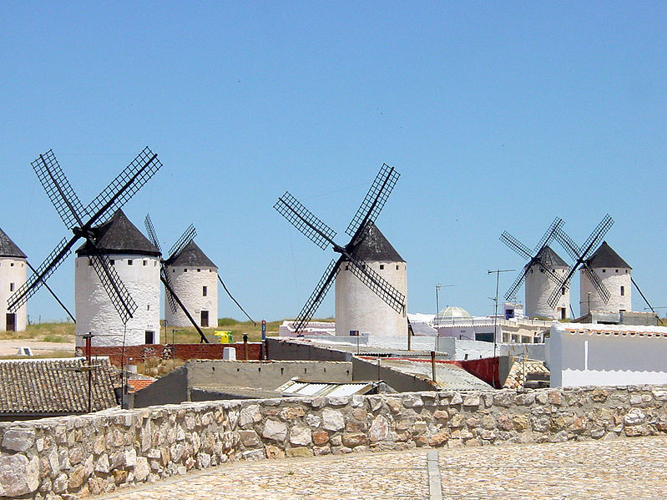
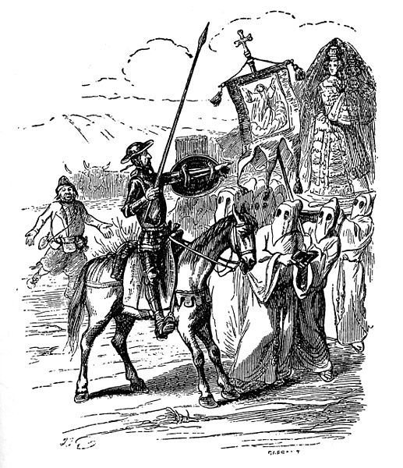
Don Quijote de la Mancha
es una novela escrita por el español Miguel de Cervantes Saavedra. Publicada su primera parte con el título de El ingenioso hidalgo don Quijote de la Mancha a comienzos de 1605, es una de las obras más destacadas de la literatura española y la literatura universal, y una de las más traducidas. En 1615 aparecería la segunda parte del Quijote de Cervantes con el título de El ingenioso caballero don Quijote de la Mancha. Don Quijote fue la primera obra genuinamente desmitificadora de la tradición caballeresca y cortés, por el tratamiento burlesco que da a la misma. Representa la primera obra literaria que se puede clasificar como novela moderna y también la primera novela polifónica, y como tal, ejerció un influjo abrumador en toda la narrativa europea posterior.

Slide 14
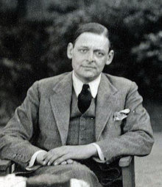
Thomas Stearns Eliot
Thomas Stearns Eliot (September 26, 1888 – January 4, 1965) was a publisher, playwright, literary and social critic and "arguably the most important English-language poet of the 20th century". Although he was born an American, he moved to the United Kingdom in 1914 (at age 25) and was naturalized as a British subject in 1927 at age 39.
The poem that made his name, The Love Song of J. Alfred Prufrock—started in 1910 and published in Chicago in 1915—is seen as a masterpiece of the Modernist movement, and was followed by some of the best-known poems in the English language, including, The Waste Land (1922), The Hollow Men (1925), Ash Wednesday (1930), The Naming of Cats(1945 ).

Slide 15
The End
Fin

