Slide 1
Nina Petrovna Titova is a
She lives in Vazhiny.Nina Petrovna has been working as a dentist for 30 years .
dentist

Slide 2
Olga Albertovna Vasilyeva is a
She lives in Vazhiny too. Olga Albertovna has been working as a veterinarian for 19 years.
veterinarian

Slide 3
Vera Zinovyevna Safronova is a
.She lives in our village too. Vera Zinovyevna has been working as a pediatrician for 30 years .
pediatrician

Slide 4
Dr Andy Collings is a general practitioner from the UK.

Slide 5
The pediatrician’s advice
Play sports
Exercise
Eat a lot of vegetables and fruit
Walk
Don’t smoke and drink alcohol

Slide 6
As a result

Slide 7
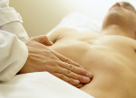
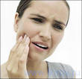
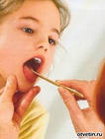
Test yourself
I have a headache
I have earache
I have toothache
I have a cold
I have a sore throat
I have a stomachache

Slide 8
Check your answers
1 | 2 | 3 | 4 | 5 | 6
a | d | c | f | e | b
Your score | 6 | 5 | 4 | 3
Your mark | 5 | 4 | 3 | 2

Slide 9
Home –task
p.94 ex. 4 (1 )

