Slide 1
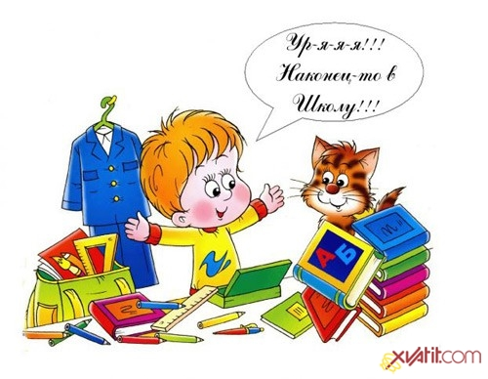
Our school life

Slide 2
Time table
 | Yellow | Red | Green
Monday A Phonetic Lesson
Tuesday A Lexical Lesson
Wednesday A Musical Lesson
Thursday A Grammar Lesson
Friday A Drama Lesson
Saturday A Creative Lesson
Score

Slide 3
School Subjects

Slide 4
Monday A Phonetic Lesson

Slide 5
A Phonetic Lesson
1.[ni__neim]
2. [ t__mteibl ]
3. [ h__lidei ]
4. [ s__bdзikt ]
5[ ju:nif__m ]

Slide 6
A Phonetic Lesson
1.[nikneim]
2. [ taimteibl ]
3. [ holidei ]
4. [ s^bdзikt ]
5. [ ju:nifo:m ]

Slide 7
Tuesday A Lexical Lesson

Slide 8
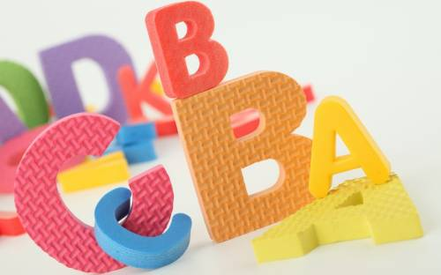
A Lexical Lesson
Make up the words
(the things you use at school):
1. ulrer
2. ainpst
3. tcmouper
4. beburr
5. oobkextt

Slide 9
A Lexical Lesson
1. ruler
2. paints
3. computer
4. rubber
5. textbook

Slide 10
Solve this crossword
Школа
2. Школьная форма
3. Класс, урок
4. Карандаш
5. Парта
6. Расписание уроков
7. Город (большой)
8. Русский язык (школьный предмет)
1
2
3
4
5
6
7
8

Slide 11
Solve this crossword
Школа
2. Школьная форма
3. Класс, урок
4. Карандаш
5. Парта
6. Расписание уроков
7. Город (большой)
8. Русский язык (школьный предмет)
1 |  |  |  |  |  | s |  | c | h | o | o | L
2 | u |  | n |  |  | i |  | f | o | r | m
3 |  |  |  |  |  |  |  | c | l | a | s | s
4 | p |  |  | e |  |  | n | c | i | l
5 |  |  |  |  |  |  |  |  | d | e | s | k
6 | t | i |  |  | m |  | e | t | a | b | l | e
7 |  |  |  |  | c |  | i | t | y
8 |  |  |  |  |  |  | R | u | s | s | i | a | n

Slide 12
Wednesday A Musical Lesson

Slide 13
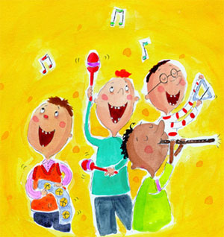
Sing a song “At our School”

Slide 14
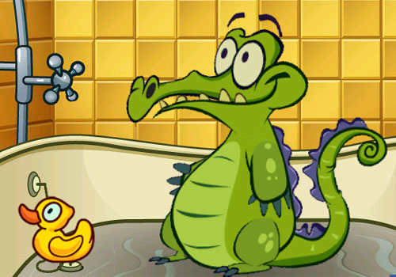
GAME Show the words without saying a word

Slide 15
Thursday A Grammar Lesson

Slide 16
A Grammar Lesson
Choose the correct answer:
1. Last September my mother and I ………..abroad.
a) went b) go c) will go
2. Sam ………football with his friends tomorrow.
a) plays b) played c) will play
3. I …….a pupil of the fifth form.
a) am b) is c) do
4. My sister often ………… books in the evening.
a) read b)reads c) will read
5. We ……………..not at school yesterday.
a) are b) was c) were

Slide 17
A Grammar Lesson
Choose the correct answer:
1. Last September my mother and I ……A…..abroad.
a) went b) go c) will go
2. Sam …C……football with his friends tomorrow.
a) plays b) played c) will play
3. I …A….a pupil of the fifth form.
a) am b) is c) do
4. My sister often ……B…… books in the evening.
a) read b)reads c) will read
5. We ……B……not at school yesterday.
a) are b) was c) were

Slide 18
Friday A Drama Lesson

Slide 19
Saturday A Creative Lesson

Slide 20
Our lesson is over

