Slide 1
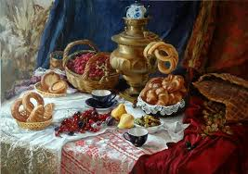
Russian tea ceremony
Traditions of our country.
School №31
Kargapoltseva A. V.

Slide 2
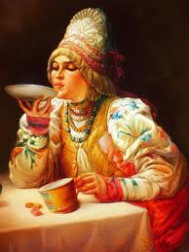
Tea was introduced to Russia in the early seventeenth century by China.

Slide 3
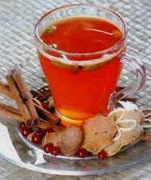
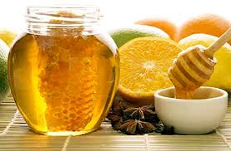
Prior to its introduction in Russia, the drink of choice was"sbiten", a brew of hot water, honey and herbs. Today, tea remains the most popular non-alcoholic drink.

Slide 4
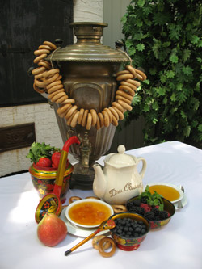
Loose tea is brewed in either a hot teapot or a "samovar", a special tea-making device that produces strong tea called "zavarka". Zavarka is served in teacups diluted with hot water to fit personal taste.

Slide 5
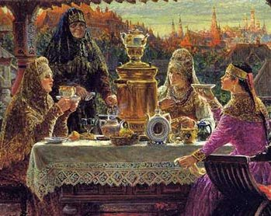
It is old Russian tradition to serve tea from the samovar after supper. After clearing the supper table, the samovar is put in the cen­ter and whole family gathers around for tea.

Slide 6
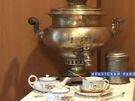
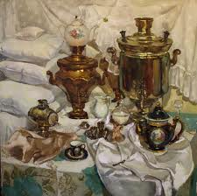
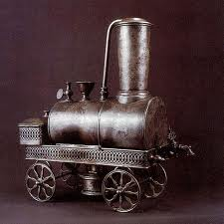
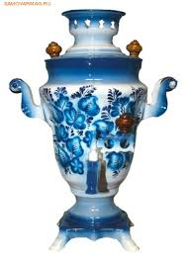
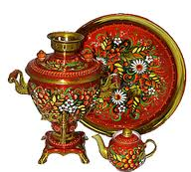
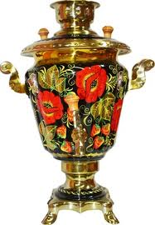
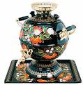
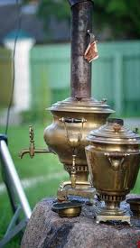
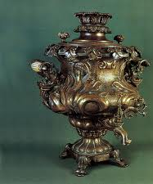
The samovar is the central symbol of the Russian Tea Ceremony. As a combination of a teapot and a brewing device, it is a truly unique creation.

Slide 7
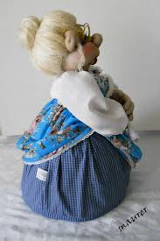
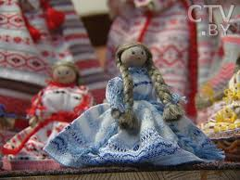
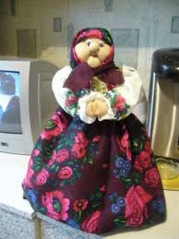
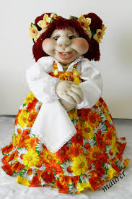
They are tea cozies for samovars called "baba na samovar" (woman on samovar) and a wonderful tea set with the vibrant blue and white patterns that distinguish Russian tea sets.

Slide 8
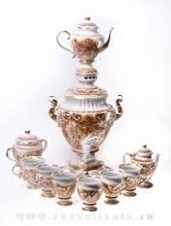
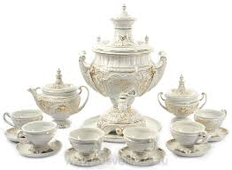
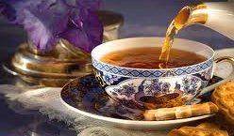
Popularity, traditions and customs of Russian tea drinking, "chaepitie", have helped to foster a uniquely styled system of teapots, teacups, cozies, and more to sup­port this tradition. By the end of the 18th century, more than a hundred small facto­ries creating Russian tea wares had sprung up.

Slide 9
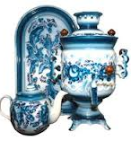
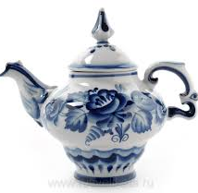
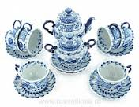
One of the most famous, "Gjel" (Ggel), takes its name from a little town located in central Russia. Gjel is renowned for its white and blue designs prevalent in today's Russian teawares. Russian teaware designs typically feature images of daily life, the most popular being animals and scenes from folk stories.

Slide 10
