Slide 1
МБОУ СОШ №2 с. Новобелокатай
Урок английского языка в 10 классе
MUSIC IN OUR LIFE
Учитель английского языка: Маштакова Анна Дмитриевна

Slide 2
MUSIC IN OUR LIFE
WHERE
WORDS
FAIL…

Slide 3
Тип урока:
урок комплексного применения учащимися
знаний, умений, навыков.
Задачи урока:
обучающая- выработка у учащихся общеучебных умений и навыков
развивающая- развитие коммуникативной компетенции, внимания, речевой реакции
воспитывающая- формирование собственного
мировоззрения, нравственное, эстетическое воспитание
Оборудование:
магнитофон, аудиокасеты, компьютер,
проектор, карточки для выполнения задания

Slide 4
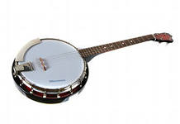
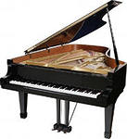
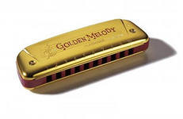
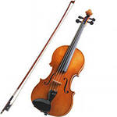
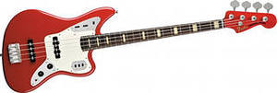
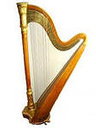
Listen and number the pictures
banjo
piano guitar drums
electric bass harmonica
violin
harp

Slide 5
Check yourself
banjo 6
piano 3 guitar 1 drums 4
electric bass 8 harmonica 7
violin 2
harp 5

Slide 6
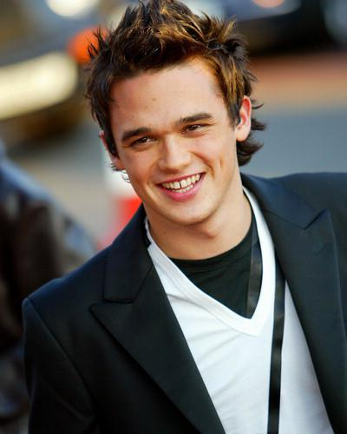
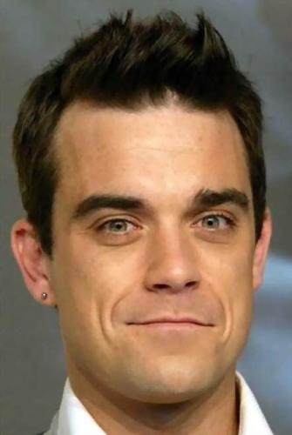
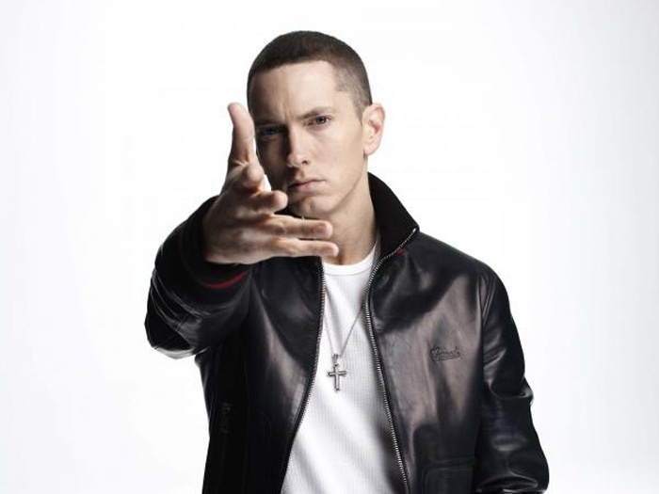
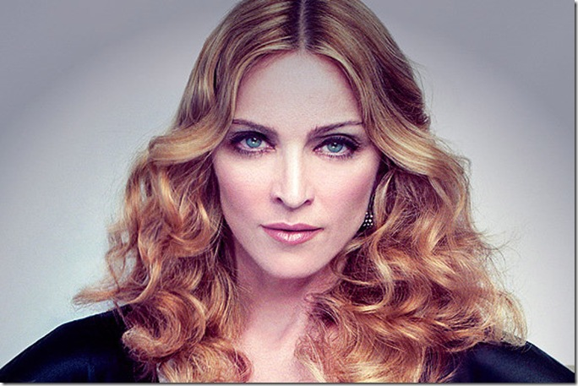
B.Spears
R.Williams
G.Gates
Madonna
Eminem

Slide 7
Listen and match
 | Name of pop star | Speaker’s opinion | Your opinion
Speaker 1
Speaker 2
Speaker 3
Speaker 4
Speaker 5

Slide 8
Check yourself
 | Name of pop singer | Speaker’s opinion | Your opinion
Speaker 1 | R.Williams | c
Speaker 2 | Eminem | e
Speaker 3 | Madonna | a
Speaker 4 | G.Gates | d
Speaker 5 | B.Spears | b

Slide 9
A WORD WEB
verbs: compose… |  | kinds of music: classical…
adjectives to characterise a piece of music: tuneful… |  | how music affects you: makes you feel happy…
Adjectives to characterise a singer: talented… |  | the words you can add:

Slide 10
use:
Melodious, light, want to listen over and over,make you feel happy(sad),compose, perform,romantic,classical,modern,violent,lovely,cool,energetic,folk,cheers you up,makes you smile,fast,joiful,pleasant,popular,sweet-sounding,lyrical,rhythmic,country,dance,serious,makes you feel bored,gets you relaxed,cute,favourite,talented,tuneful

Slide 11
A word web
verbs: to compose,to perform,to play adjectives to characterise a piece of music: melodious,slow,joyful,favourite,tuneful,cool,energetic,fast,violent,pleasant,romantic,lyrical,rhythmic,sweet-sounding Adjectives to characterise a musician/singer :favourite,talented,lovely, energetic,popular,romantic,cute | M U S I C | Kinds of music: classical, modern,background, folk, organ,light,popular,dance, country,serious how music affects you:want to listen over and over again,chear smb.up,make smb.feel happy/sad,make someone smile,get someone relaxed ,make someone feel bored,want to dance or sing to music

Slide 12
Guess the type of music Listen and number
rock pop
rap classical
jazz reggae
techno heavy meta
country

Slide 13
Check yourself
rock 1 pop 3
rap 5 classical 6
jazz 2 reggae 9
techno 4 heavy metal 7
country 8

Slide 14
Reflexion
Music
Sweet-hearted, cool
Helps,relaxes,cheers up
Makes us feel happy
Life

Slide 15
Thank you for the Lesson.
Good Bye!

Slide 16
Литература:
1. Англ.яз:Учеб.для 10 кл.общеобр.учрежд./М.Биболетова,Е.Бабушис-Обнинск:Титул,2012.-216с.:ил.
2. Англ. с удовольствием/Enjoy English/:Раб.тетрадь к учеб.для 10кл.общеобр.учрежд./М.Биболетова,Е.Бабушис-Обнинск:Титул,2012.
3.Английский язык Click-On/Virginia Evans-Neil O’Sullivan-Express Publishing,2000
4.Журнал ‘’Английский язык в школе’,№2(42)/2013 5.Интернет-ресурсы

