Slide 1
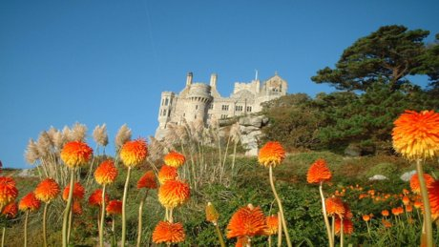
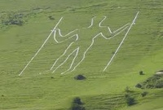
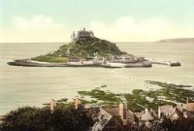
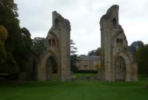
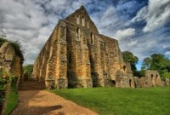
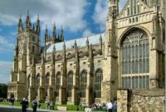
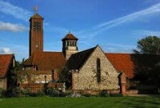
Mystical places of England
выполнил:
Шестакова Анастасия Рафаиловна
МАОУ «СОШ №110» г. Новокузнецк
учитель иностранных языков

Slide 2
St Michael's Mount Гора Святого Михаила, графство Корнуолл, Англия, Великобритания.
St. Michael's Mount is a rocky (каменистый) island in Cornwall, England.
It is a civil parish and is united with the town of Marazion by a man-made causeway of granite setts, passable between mid-tide and low water.

Slide 3
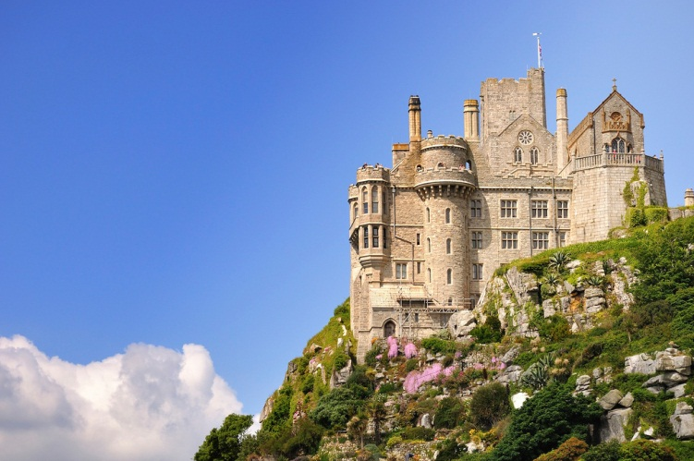
St Michael's Mount
St Michael's Mount is one of 43 unbridged tidal (связанный с приливом и отливом) islands which can be walked to from the mainland of England, Scotland and Wales.

Slide 4
Cerne Abbas Giant Великан Керн-Аббас, под Дорчестером
The Cerne Abbas Giant is a hill figure near the village of Cerne Abbas in Dorset, England. Made by a turf-cut outline filled with chalk, it depicts a large, naked man, typically described as a giant, wielding a club. The figure is listed as a scheduled monument in the United Kingdom and the site in which he sits is owned by the National Trust.

Slide 5
Tintagel Castle Тинтагель, Корнуэлл
Tintagel Castle stands on windswept cliffs in North Cornwall on one of England’s most dramatic coastlines. The Castle is believed to be the birthplace of King Arthur who, as legend has it, was protected from the evil magician Merlin by his magical sword, Excaliber (легендарный меч короля Артура, которому часто приписываются мистические и волшебные свойства).
Tintagel Castle is an awe-inspiring place to visit and soak up the atmosphere generated by the dramatic views and wonderful legends. Today, the remains of Tintagel castle stand on rugged cliffs high above the sea.

Slide 6
Glastonbury Tor Гластонбери Тор (Холм святого Михаила)
It is a prominent hill overlooking the Isle of Avalon, Glastonbury and Somerset. Tor is a local word of Celtic origin meaning 'rock outcropping' or 'hill'. The Tor has a striking location in the middle of a plain called the Summerland Meadows, part of the Somerset Levels.
Glastonbury Tor is known as being one of the most spiritual sites in the country. Its pagan beliefs are still very much celebrated. It’s a beautiful place to walk, unwind and relax.

Slide 7
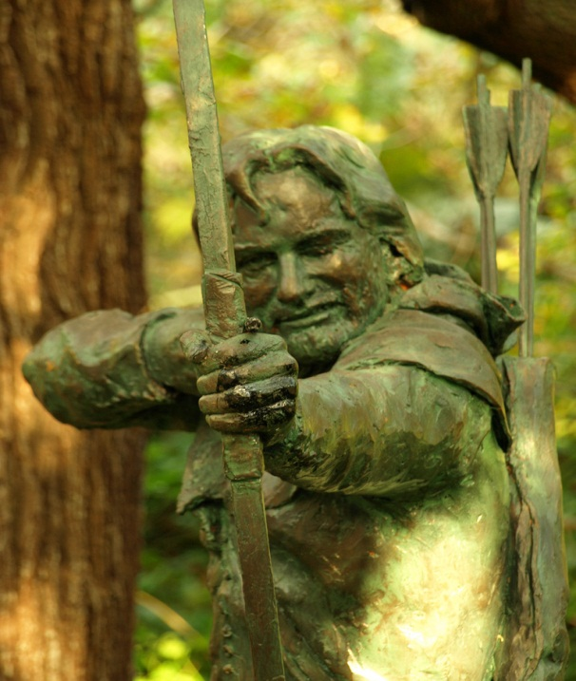
Sherwood Forest Шервудский лес
Sherwood Forest is a royal forest in Nottinghamshire, England, that is famous through its historical association with the legend of Robin Hood.

Slide 8
Loch Ness Monster Лох-несское чудовище
The modern legend of Nessie begins in 1934 with Dr. Robert Kenneth Wilson, a London physician, who allegedly photographed a plesiosaur-like beast with a long neck emerging out of the murky waters. That photo created quite a fuss and is still at the center of controversy

Slide 9
Stonehenge, Salisbury Стоунхендж, Солсбери
Stonehenge is a prehistoric monument located in the English county of Wiltshire. One of the most famous sites in the world, Stonehenge is composed of a circular setting of large standing stones set within earthworks (земляное укрепление).
It is at the centre of the most dense complex of Neolithic and Bronze Age monuments in England, including several hundred burial mounds.

