Slide 1
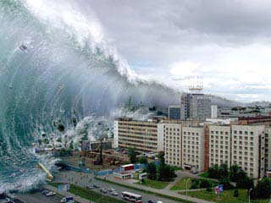
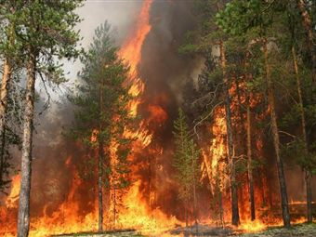
Natural disasters

Slide 2
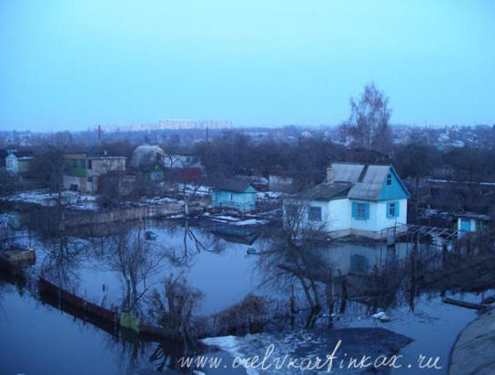
Natural disasters
Flood
Hurricane
Blizzard
Earthquake
Tornado
Lava
Volcano
Eruption
Landslide
To wash away
To repair
To destroy
To blow over
To freeze
To injure
To damage
To hurt
To predict
Deliberately
Careless
tsunami

Slide 3
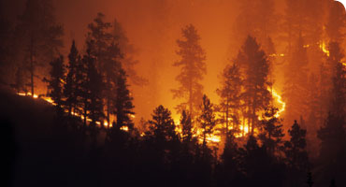
Answer the questions:
What is the article about?
How much of Greece is covered by forests?
What were the main reasons of vegetation destroying?
Can people build on forested land?
Do people burn forested
land deliberately?

Slide 4
Passive voice
Thousands of people are killed every year.
People aren’t allowed to build on land with forests.
Was the land covered by forest in the past?
Have people been killed or injured in fires?
I hope a solution to this problem will be found.

Slide 5
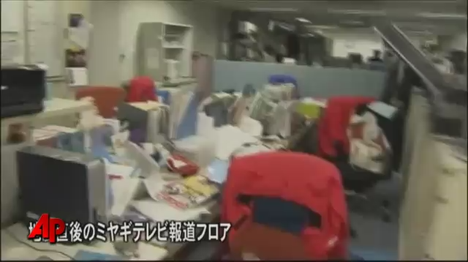

Slide 6
You are journalists. You want to find out about a tsunami in Japan. Ask some questions
What kind of disasters/you have/ in Japan?
You/ often / have / tsunami?
When/ the last disaster/ in Japan?
What / you can/ tell us / about it?
What/ damaged?
Were / many people / killed?
How many / people / injured?
Was / the tsunami / predicted/ by scientists?
How many / houses / destroyed?
Who / rescued/ people?

Slide 7
Homework
Write a composition about a natural disaster in your country. Ex. 6b, p. 69

